Slide 1
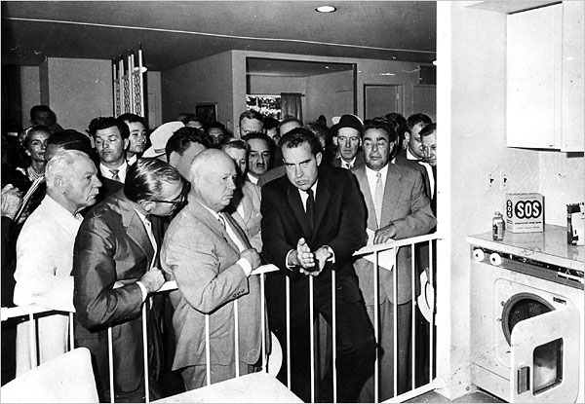
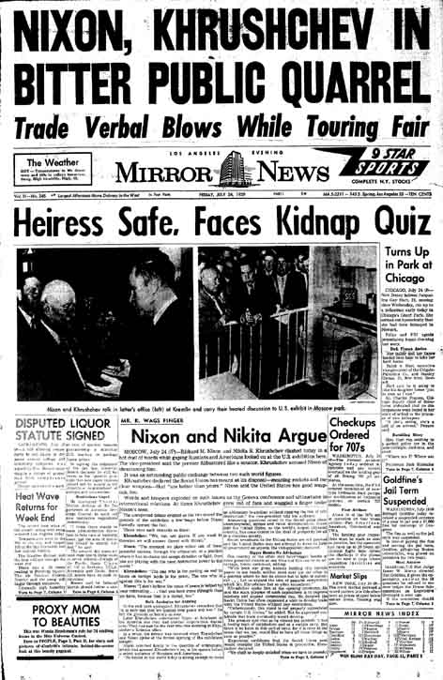
To what extent was there a ‘thaw’ in the Cold War after 1953?
L/O – To evaluate how developments during the 1950s led to both a reduction and rise in tensions

Slide 2
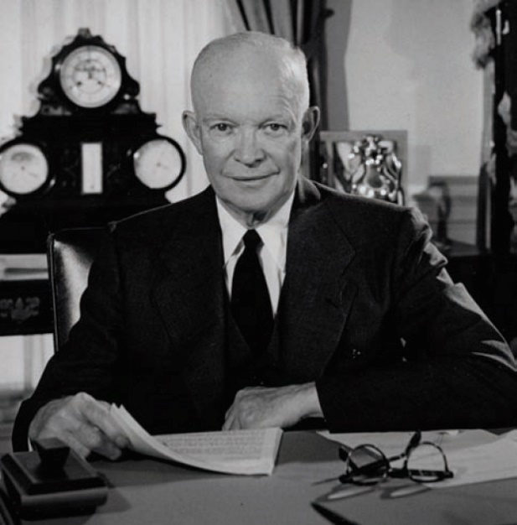
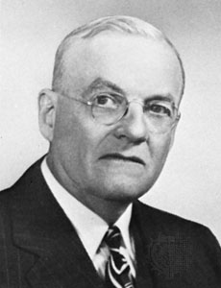
Eisenhower and ‘New Look’
Republican Dwight D. Eisenhower was elected in 1952. He and his Secretary of State, John Foster Dulles, had campaigned on a strongly anti-Communist message.
The Eisenhower administration develop a new policy of containment called ‘New Look’ which was formalised in NSC 162/2 in October 1953.
It shifted the focus from conventional military forces to ‘air-atomic’ capability. Eisenhower wanted to avoid, ‘an unbearable security burden leading to economic disaster.’

Slide 3
NSC 162/2
In the face of the Soviet threat, the security of the US requires:
A strong military posture, with emphasis on…inflicting massive retaliatory damage by offensive striking power
Maintenance of a sound, strong and growing economy
Maintenance of morale and… willingness of US people to support the measure necessary for national security…
Develop and maintain an intelligence system capable of… undertaking military, political, economic and subversive courses of action affecting US security
The US should keep open the possibility of settlements with the USSR which would resolve specific conflicts or reduce the magnitude of the Soviet threat…[and] to maintain the continued support of its allies, the US must convince them of its desire to reach such settlements

Slide 4
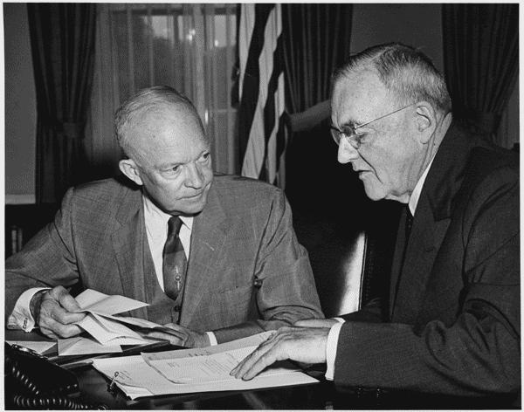
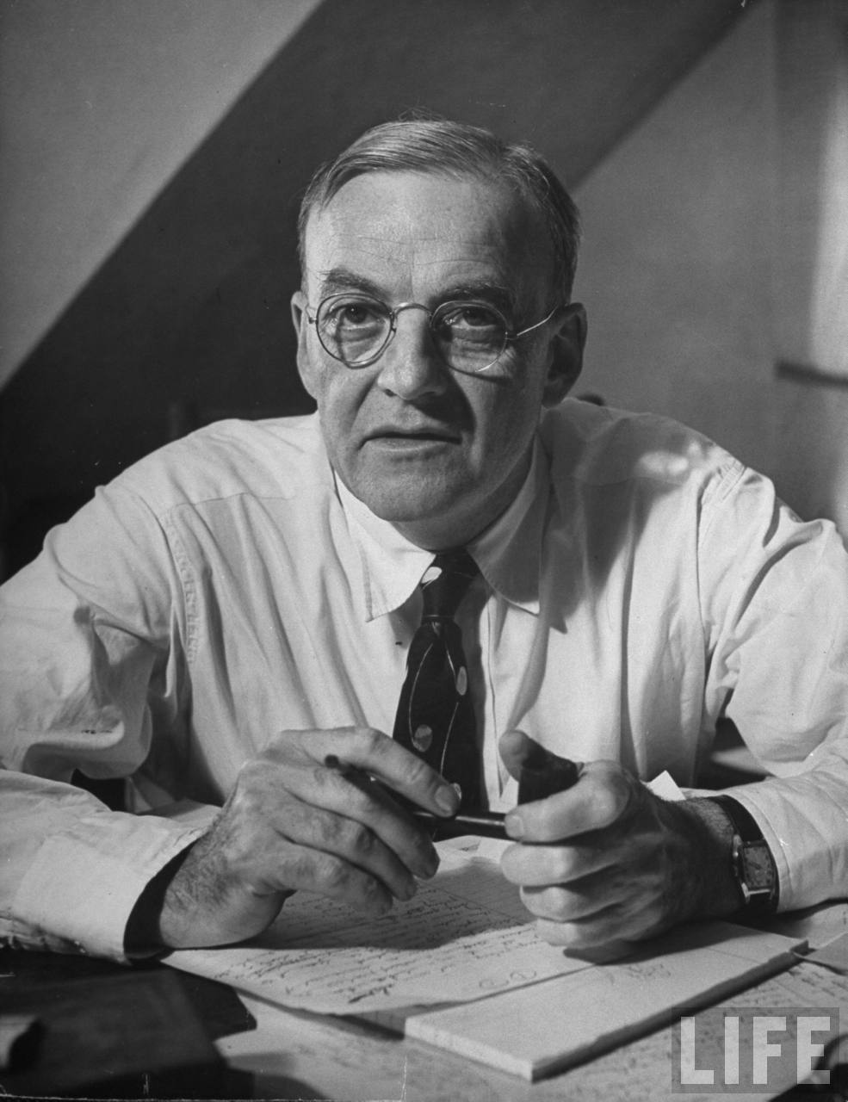
Eisenhower and ‘New Look’
The plan called for ‘massive retaliation’ in order to deter an enemy, using nuclear weapons if necessary.
During the Korean War, the US military budget had quadrupled. Eisenhower was keen to reduce costs. ‘New Look’ was a way of maintaining a credible deterrence threat whilst reducing military costs.
Secretary of State Dulles called this policy ‘brinkmanship’ – ‘the ability to get to the verge without getting into the war is the necessary art.’ Yet this was a high-risk strategy – it was a defensive strategy based on very offensive threats!

Slide 5
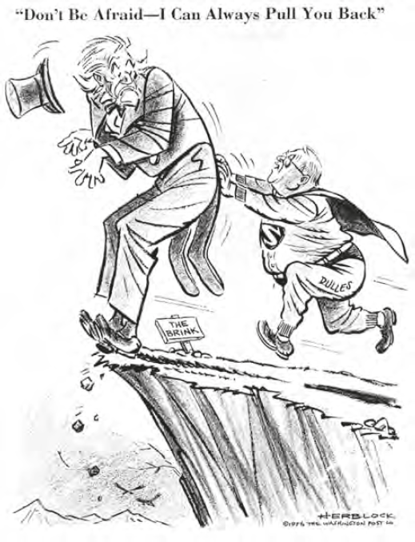
Cartoon by Herblock published in the Washington Post in 1956

Slide 7
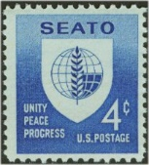
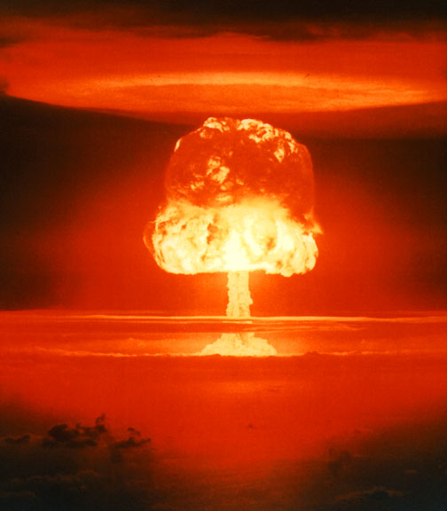
Eisenhower and ‘New Look’
New Military Alliances – ANZUS 1951, SEATO in Asia 1954, attempts for a ‘European Defence Community’ (EDC) in Europe, 1957 ‘Eisenhower Doctrine’ in the Middle East, Taiwan-US Defence Treaty 1955.
Strengthening Military Forces – West Germany admitted to NATO in 1955, Hydrogen Bomb 1952, ‘Brinkmanship’ policy from 1953, Atlas ICBM 1959, Polaris SLBM 1960.
More Covert Operations – increased use of CIA to affect regime change in Iran 1953, Guatemala 1954 and Cuba 1961 & spy on USSR with U2.
Assist forces fighting Communism – support for Diem in South Vietnam, Sukarno in Indonesia, Mobutu in Congo.

Slide 8
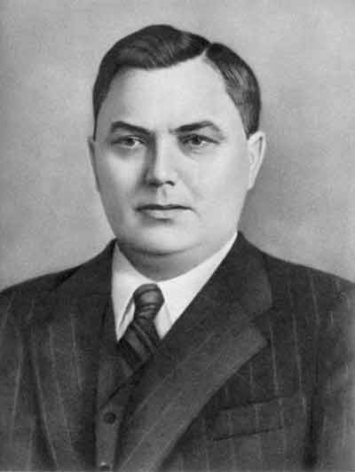
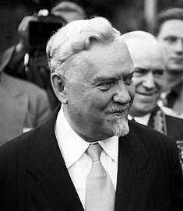
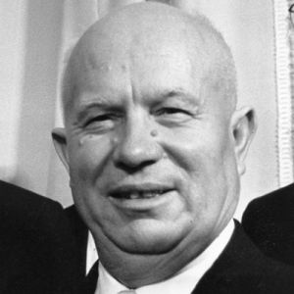
Changes in Soviet Foreign Policy
After the death of Stalin in March 1953, the USSR became led by a triumvirate of Georgy Malenkov, Nikita Khrushchev and Nikolai Bulganin.
Malenkov initiated the policy of a ‘New Course’. When Khrushchev finally won the power struggle in 1956, he renamed the policy ‘peaceful co-existence’.
This policy called for the acceptance of the USA rather than the Leninist idea of the inevitability of war. He believed that capitalism would die out on its own eventually.

Slide 9
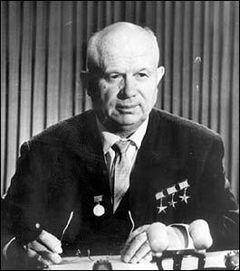
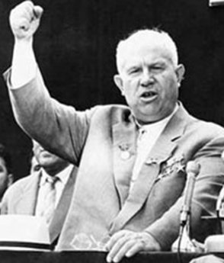
Changes in Soviet Foreign Policy
In February 1956, this ‘new course’ in Soviet policy took a dramatic turn when Khrushchev gave his ‘Secret Speech’ to the 20th Party Congress.
It was a four hour demolition of Stalin’s reputation: ‘he often chose the path of repression and physical annihilation, not only against actual enemies, but also against individuals who had not committed any crimes…’
The speech lead to a policy of ‘de-Stalinisation’ within the Soviet bloc with a relaxation in totalitarian control. Many in the West viewed this as a chance for peace or ‘détente’ with the USSR.

Slide 10
“…Stalin acted not through persuasion, explanation, and patient cooperation with people, but by imposing his concepts and demanding absolute submission to his opinion. Whoever opposed this concept or tried to prove his viewpoint, and the correctness of his position-was doomed to removal from the leading collective and to subsequent moral and physical annihilation
You see to what Stalin's mania for greatness led. He bad completely lost consciousness of reality; he demonstrated his suspicion and haughtiness not only in relation to individuals in the USSR, but in relation to whole parties and nations. . . .
Comrades, the cult of the individual acquired such monstrous size chiefly because Stalin himself, using all conceivable methods, supported the glorification of his own person
Comrades, in order not to repeat errors of the past, the central committee has declared itself resolutely against the cult of the individual. We consider that Stalin was excessively extolled. However, in the past Stalin doubtless performed great services to the party, to the working class, and to the international workers' movement. . . .”

Slide 11
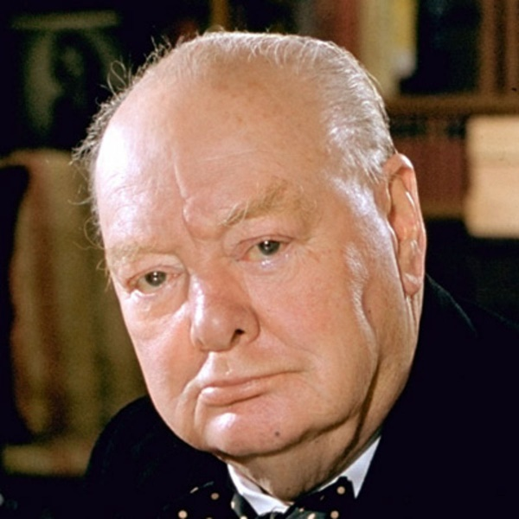
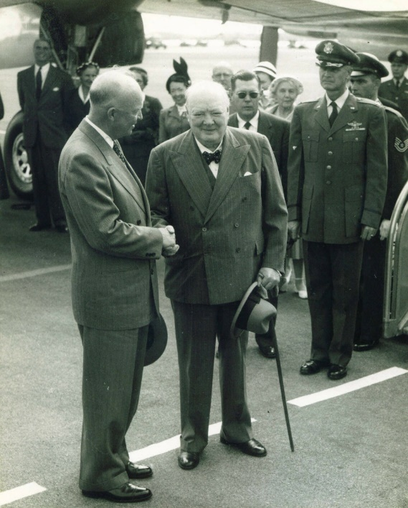
Other reasons for the ‘thaw’
The UK led by Prime Minister Winston Churchill was also pressing the US for the need for more dialogue with the USSR.
At the Bermuda Conference in December 1954, Churchill called on Eisenhower to extend the ‘hand of friendship’ to the USSR.
Both superpowers were also concerned with economics. The US was spending over 12% GDP on its military. The USSR almost 1/3! With the end of the Korean War in 1953, both sides wanted to reduce military spending.

Slide 12
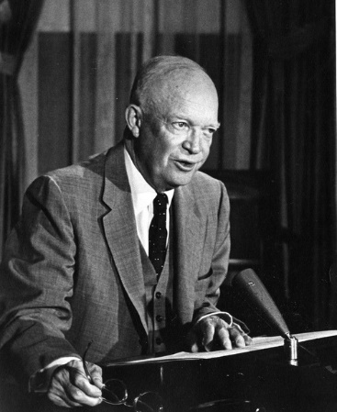
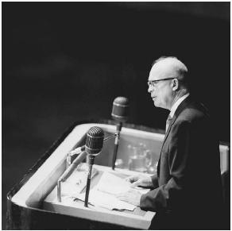
Diplomatic Achievements
In this new atmosphere of co-operation, both superpowers attempted to reduce tensions. In April 1953, Eisenhower gave his ‘Chance for Peace’ speech criticising the arms race.
The USSR now led by a collective leadership of Malenkov, Bulganin and Khrushchev, began to pursue a ‘New Course’ that sought to reduce Cold War tensions. Malenkov believed: ‘a nuclear war could lead to global destruction’.
Eisenhower replied with his ‘Atoms for Peace’ speech at the UN General Assembly in December 1953. He called for the repurposing of nuclear energy for civilian projects and disarmament.

Slide 13
Now a new leadership has assumed power in the Soviet Union. Its links to the past, however strong, cannot bind it completely. Its future is, in great part, its own to make...So the new Soviet leadership now has a precious opportunity to awaken, with the rest of the world, to the point of peril reached and to help turn the tide of history. Will it do this?
We do not yet know. Recent statements and gestures of Soviet leaders give some evidence that they may recognize this critical moment. We welcome every honest act of peace.
We could proceed with the next great work - the reduction of the burden of armaments now weighing upon the world. To this end we would welcome and enter into the most solemn agreements. These could properly include:
1. The limitation, by absolute numbers or by an agreed international ratio, of the sizes of the military and security forces of all nations.
2. A commitment by all nations to set an agreed limit upon that proportion of total production of certain strategic materials to be devoted to military purposes.
3. International control of atomic energy to promote its use for peaceful purposes only and to insure the prohibition of atomic weapons.
4. A limitation or prohibition of other categories of weapons of great destructiveness.
5. The enforcement of all these agreed limitations and prohibitions by adequate safeguards, including a practical system of inspection under the United Nations.

Slide 14
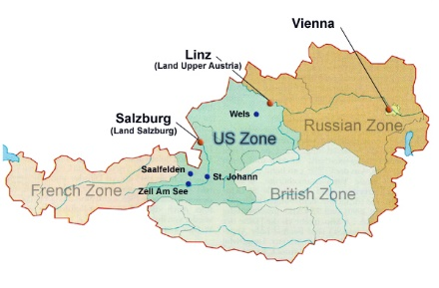
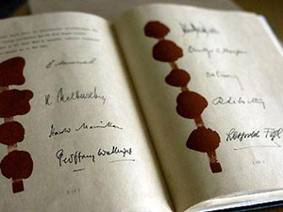
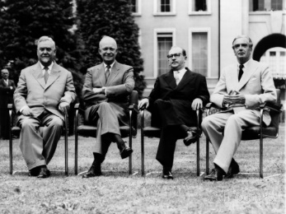
Diplomatic Achievements
In April 1955 the USSR proposed a formal peace treaty with Austria which had been occupied by the USA, USSR, Britain and France since 1945.
The Austrian State Treaty created an independent and neutral Austria.
This was followed by the Geneva Summit in July 1955. It was the first meeting of Heads of State since the war. Although it achieved very little, it did lead to better relations.

Slide 15
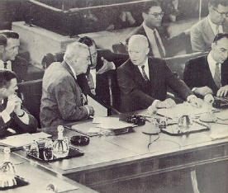
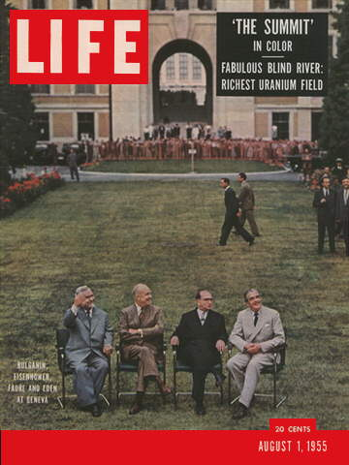
The Geneva Summit - 1955
The USSR proposed mutual disbandment of NATO and the Warsaw Pact, withdrawal of all foreign forces from Europe and free elections for a united Germany – however West European governments were hostile.
The USA proposed ‘Open Skies’. The would have allowed aerial surveillance of each others’ countries and sharing of military bases. It was hoped this would reduce security fears but Khrushchev dismissed it as an ‘espionage plot’.
Regardless, the summit did lead to future trade relations, scientific sharing and cultural exchanges.

Slide 16
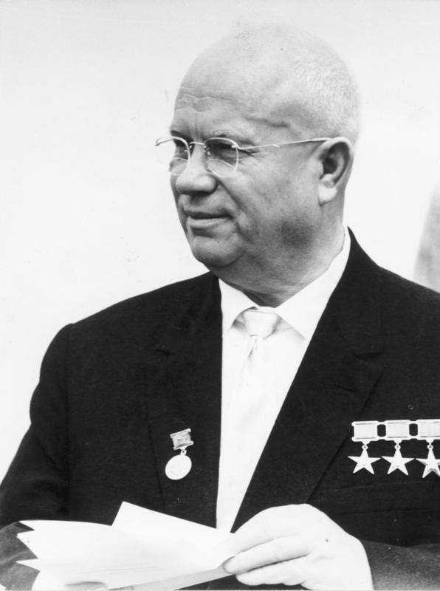
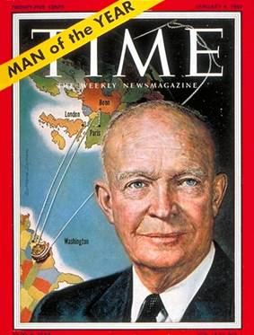
Increasing Tensions after 1955
In February 1956, Khrushchev gave his ‘de-Stalinisation’ speech. Many interpreted it as an end to totalitarian government. It encourage a mass uprising in Hungary which Khrushchev had no choice but to end with force.
The West in response criticised the USSR for its use of force. The Suez Crisis in the same year also increased tensions. The US believed that the USSR was increasing its influence in the Middle East.
In response, the US declared the ‘Eisenhower Doctrine’ of material support for nations fighting Communism in the area.

Slide 18
The action which I propose would have the following features.
It would, first of all, authorize the United States to cooperate with and assist any nation or group of nations in the general area of the Middle East in the development of economic strength dedicated to the maintenance of national independence.
It would, in the second place, authorize the Executive to undertake in the same region programs of military assistance and cooperation with any nation or group of nations which desires such aid.
It would, in the third place, authorize such assistance and cooperation to include the employment of the armed forces of the United States to secure and protect the territorial integrity and political independence of such nations, requesting such aid, against overt armed aggression from any nation controlled by International Communism.

Slide 19
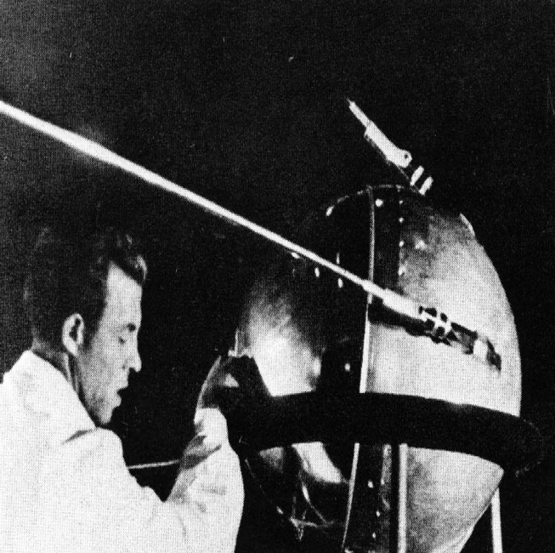
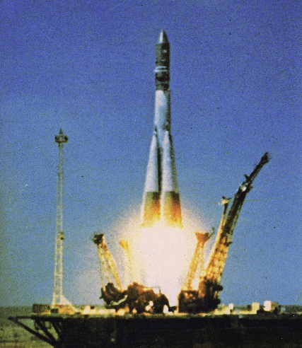
Increasing Tensions after 1955
Developments in the arms race also increased tensions and competition during this period.
In October 1957 the USSR launched the world’s first satellite into space, Sputnik 1. It was based on their ‘Semyorka R-7’ inter-continental ballistic missile (ICBM).
This sent the USA into panic over a perceived ‘missile gap’. Khrushchev boasted that the USSR could produce missiles ‘like sausages’.

Slide 20
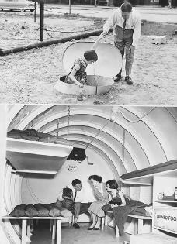
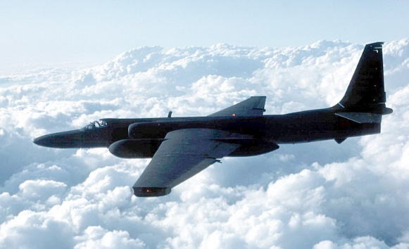
Increasing Tensions after 1955
The development of ICBM’s meant that the US was now vulnerable to ‘massive retaliation’ itself.
The US commissioned the top-secret ‘Gaither Report’ to find out about this ‘missile gap’. It recommended an increase in military spending & fallout shelters!
In reality, their U-2 Spy programme had proved that there was no ‘gap’. However the US government used this paranoia to increase science spending and establish NASA in 1958 to research missile development.

Slide 22
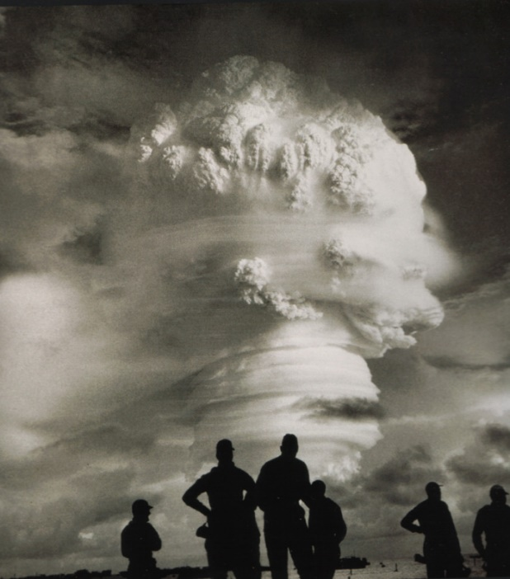
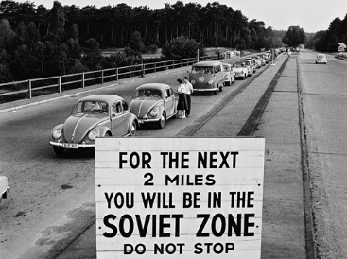
Increasing Tensions after 1958
By 1958 the US was again confident about its missile and nuclear superiority. The balance of power had resumed. It therefore took steps to ban atmospheric testing of nuclear weapons in October 1958. The USSR did the same.
However tensions over Berlin again became a problem. In November 1958 Khrushchev issued an ultimatum to the USA, UK and France. Leave within 6 months. They refused but agreed to a new summit meeting in the USA.

Slide 23
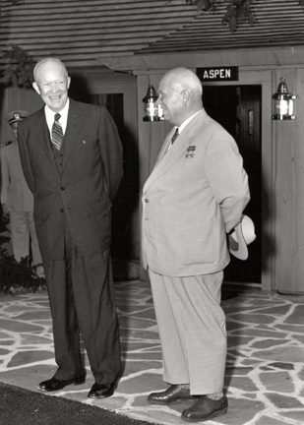
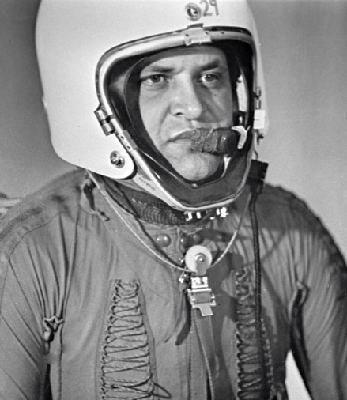
Increasing Tensions after 1958
In September 1959 Khrushchev became the first Soviet leader to visit the USA, attending the Camp David summit. However he was unable to visit Disneyland!
Despite the lack of agreement, Khrushchev agreed their would be no firm deadline over Berlin. Both sides agreed to meet again in Paris in May 1960. There was optimism.
However in May 1960, a U-2 spy plane was shot down over the USSR. Its pilot, Gary Powers, was captured and confessed to spying.

Slide 25
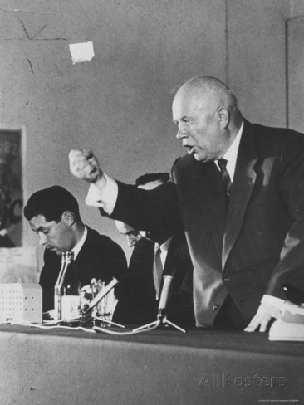
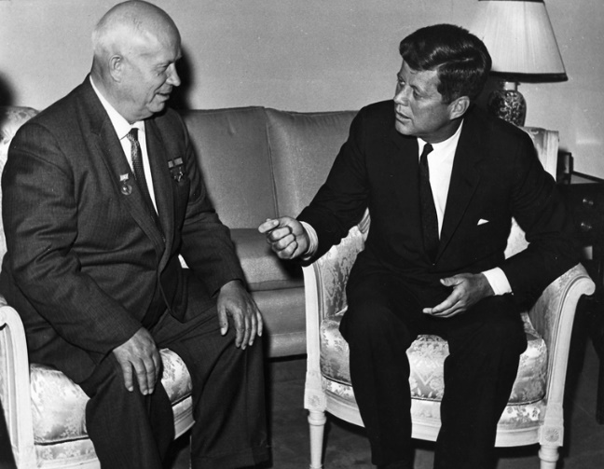
Increasing Tensions after 1958
At the Paris meeting in May 1960, Eisenhower refused to apologise for spying. Khrushchev retaliated by cancelling plans for Eisenhower’s visit to the USSR.
With the election of US President John F. Kennedy in 1960, a new summit was held in Vienna to discuss Berlin in June 1961.
Khrushchev challenged Kennedy to withdraw from West Berlin in 6 months or declare war! Kennedy refused to back-down.

Slide 26
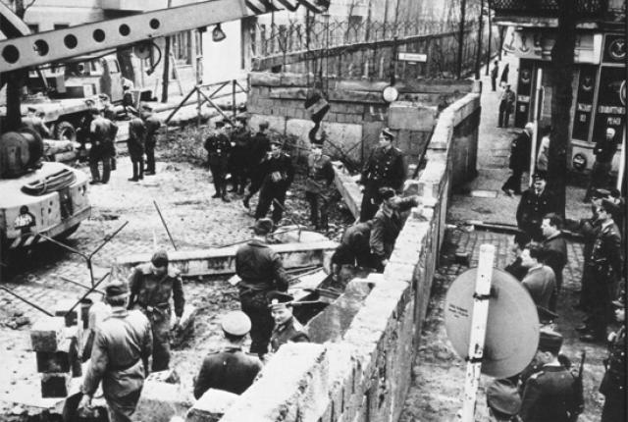
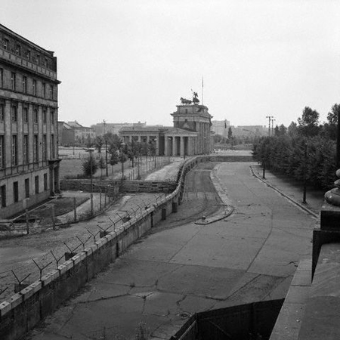
Increasing Tensions after 1958
In retaliation, Khrushchev ordered the construction of the Berlin Wall in August 1961. It was designed to stop the flow of emigrants into West Berlin.
A crisis over Berlin was averted despite the Wall being built. However tensions between the Superpower remained high as both sides continued to develop their nuclear deterrents.
This culminated in the 1962 Cuban Missile Crisis in which nuclear war seemed like a very real possibility.

Slide 28
To what extent was there a ‘thaw’ in the Cold War after 1953?
L/O – To evaluate how developments during the 1950s led to both a reduction and rise in tensions

