Slide 1
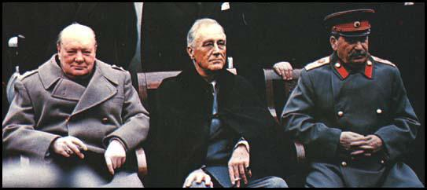
Why did the ‘Grand Alliance’ Breakdown?
L/O – To identify how disagreements arising from the Second World War led to the Cold War

Slide 2
Why did the Grand Alliance breakdown?
In 1941 Nazi Germany invaded the Soviet Union and along with Japan, declared war on the USA.
Despite their long-term differences, the USSR, UK and USA formed a military alliance – the ‘Grand Alliance’.
Suspicions remained throughout the war. They met at three conferences during the war: Tehran in 1943, and Yalta and Potsdam in 1945.
Disagreements emerged over Germany, Poland and Eastern Europe, Economic reconstruction and nuclear weapons – after the war, these problems remained unresolved.
By 1946, the Grand Alliance had broken down completely.

Slide 3
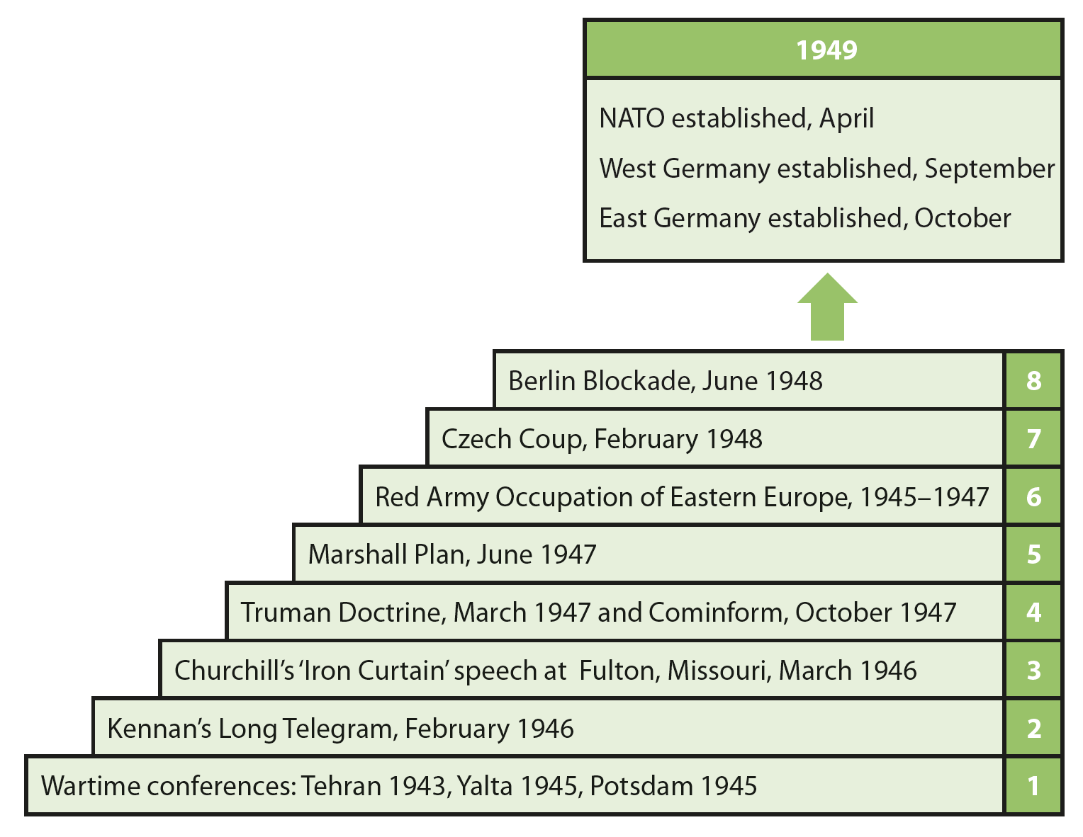
Why did the Grand Alliance breakdown?
The Grand Alliance broke down in eight stages. Today we will examine Steps 1-3:

Slide 4
The Tehran Conference – Nov 1943
The first conference held was in Tehran, Iran in November 1943 and was attended by Joseph Stalin of the USSR; Winston Churchill of the UK; Franklin Roosevelt of the USA.
The conference was a fair success. Both Roosevelt and Stalin seemed to work reasonably well together.
However as the war progressed, a gap emerged between Stalin’s post-war aims and those of the Western powers.

Slide 6
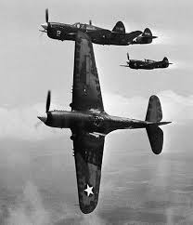
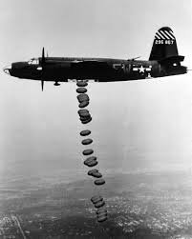
The Tehran Conference - Debates
State of the War – By 1943, the Allies were winning. The Germans in retreat on the Eastern Front, the UK and USA had invaded North Africa and Italy and the Pacific War had entered its ‘island hopping’ phase. However Stalin still demanded the creation of a Second Front in Western Europe.
Germany – Debates over what to do with Germany. Differences stemmed from wartime experiences, ‘lessons’ from the failure of the ToV and differing ideologies. They only agreed that ‘unconditional surrender’ was the objective. Date set for Second Front – June 1944.

Slide 7
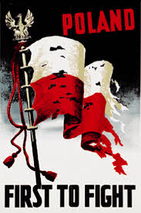
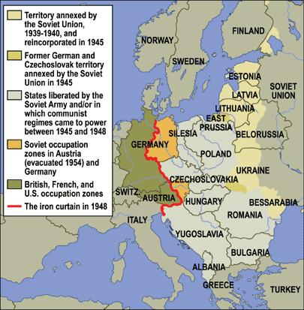
The Tehran Conference - Debates
Poland – Stalin’s concern for ‘security’ led him to demand territory from Poland and a pro-Soviet government. Agreed that the USSR could keep territory seized in 1939, Poland would be compensated with land from Germany.
Eastern Europe – Soviets demanded the right to keep territory they had seized between 1939-40 – The Baltic States, Finland & Romania. The USA and UK reluctantly agreed, despite this being against the Atlantic Charter.

Slide 8
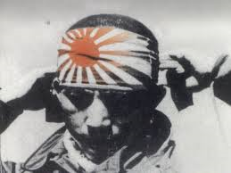
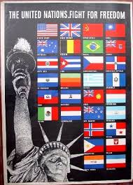
The Tehran Conference - Debates
Japan – The USA and UK tried to convince Stalin to open up a Soviet ‘second front’ in Asia – Stalin refused until the war with Germany was won.
The UN – British and Soviets agreed in principle to the US idea of a new international organisation to be established after the war. It would settle international disputes through collective security.
Conclusions – The main positive outcomes included: agreement on the United Nations, and on the need for a weak post-war Germany.

Slide 9
How did the Tehran Conference effect Superpower Relations?

Slide 10
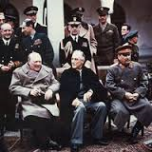
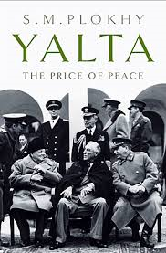
The Yalta Conference – Feb 1945
The second conference was held in February 1945 at Yalta on the Black Sea in the USSR. The same leaders attended this conference.
Stalin’s position was strengthened by the fact that the Red Army occupied most of Eastern Europe. He seemed more willing to be assertive.
By the time of the conference, it was clear that Stalin was already going back on his word – he began supporting communist groups across Eastern Europe.

Slide 11
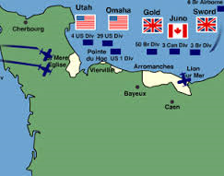
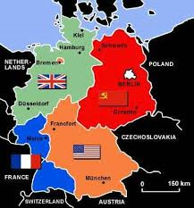
The Yalta Conference – Debates
The State of the War – Germany was on verge of being defeated. The Second Front had begun with the Normandy Landings in 1944. The Allies were ready to invade Germany itself. The Japanese were preparing for the invasion of their homeland.
Germany – Decided that Germany would be disarmed, demilitarised, de-Nazified and divided into four zones. This division would be temporary – Germany was to be run as ‘one country’. An Allied Control Commission (ACC) would govern Germany. Stalin demanded reparations – agreed $20 billion, 50% to USSR.

Slide 12
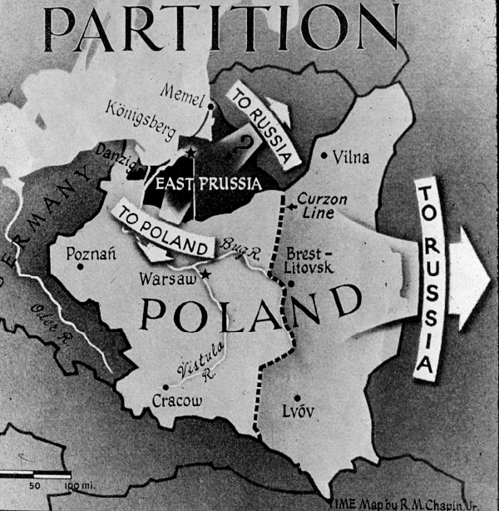
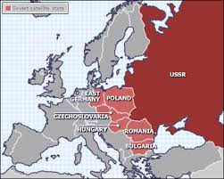
The Yalta Conference – Debates
Poland – New frontiers of Poland decided. Eastern border was drawn at the ‘Curzon Line’ – its pre-Russo-Polish War (1921) border. Poland gained territory in the West from Germany along the ‘Oder-Neisse Line’. Stalin, now satisfied, agreed to promise ‘free elections’ for Poland.
Eastern Europe – Stalin agreed that Eastern Europe would be able to have ‘free elections’. This was seen as a major victory for USA/UK.

Slide 14
The Yalta Conference – Feb 1945
Japan – Stalin now promised to enter the war against Japan but demanded territory in return from Japan as ‘reward’ – South Sakhalin and the Kurile Islands.
United Nations – Stalin agreed that the USSR would join the UN. They would be a 5-permanent member Security Council, each with the power of veto.
Conclusions – Main outcomes were the agreement on the United Nations; Soviet agreement to join the Pacific War; and the ‘Declaration for Liberated Europe’ pledging democratic governments and free elections in all European countries.

Slide 15
How did the Yalta Conference effect Superpower Relations?

Slide 16
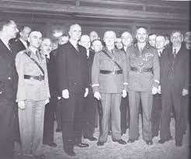
The Polish Question
The London Poles - Thousands of Poles escaped from Poland in 1939 when they were invaded by Germany and the USSR. Members of the government, armed forces and over 100,000 refugees fled to France. They moved to London after the fall of France in 1940.
The London Poles were opposed to any deals with the Soviets. They were against the proposal at Yalta to move the borders of their country. They demanded that if they were to sacrifice land, they must have cast-iron guarantees the Poland’s government would be ‘free’ after the war.

Slide 17
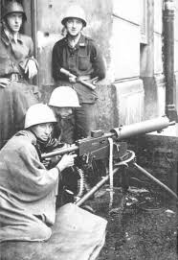
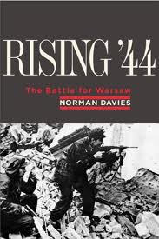
The Polish Question
The London Poles played a key role in the 1944 Warsaw Rising. When the Red Army reached Warsaw, Polish Underground Forces, commanded by the London Poles, rose up against the Germans.
Instead of assisting, Stalin ordered the Red Army to stop. The Nazis brutally put down the rebellion, killing almost 200,000 resistance fighters.
The Soviets then moved in and ‘liberated’ Warsaw and Poland, putting their own government in place – the Lublin Poles.

Slide 18
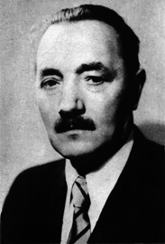
The Polish Question
The Lublin Poles – Were a generally pro-Soviet group. In July 1944, a ‘Committee of National Liberation’ was set-up in Soviet controlled Lublin in eastern Poland.
They became known as the Lublin Committee, stating they wished to work with the Soviet Union.
They agreed to the Curzon Line and other reforms. The USSR recognised this group as the only lawful authority in Poland and refused to work with the London Poles.

Slide 19
The Potsdam Conference
The final conference took place at Potsdam in Germany in July 1945. Joseph Stalin represented the USSR, Harry S Truman the USA and Clement Atlee represented the UK.
By this time, Germany had fully surrendered. President Roosevelt had died and was replaced by the hard-line Harry S. Truman. Winston Churchill lost the 1945 general election to the Labour Party Leader, Clement Atlee.
On the second day of the Conference, 17th July 1945, the USA successfully tested its first atomic bomb.

Slide 20
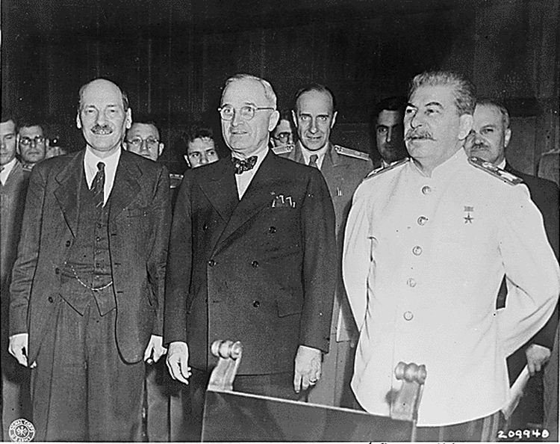

Slide 21
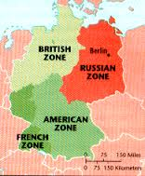
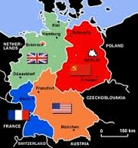
The Potsdam Conference
The State of the War – Germany had surrendered and Japan was on the verge of defeat. The USA was planning to use its new atomic bomb against Japan.
Germany – They agreed to deal with Germany in their own ways in their own zones. German economy to be run ‘as a whole’ but was limited to domestic industry and agriculture. USSR would receive 25% of their reparation bill from the Western Zones. Eastern zone would give food in exchange.

Slide 22
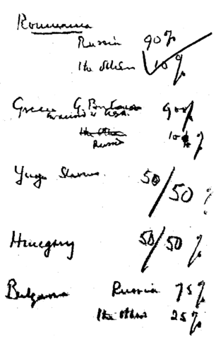
The Potsdam Conference
Poland – Truman was not happy over Poland. He demanded that the Polish government be ‘re-organised’ – more London Poles within government and ‘free elections’.
Eastern Europe – Truman was unhappy with the ‘percentages agreement’ between the UK/USSR. He didn’t want Eastern Europe to become a Soviet ‘sphere of influence’ – but he didn’t have any choice – Stalin was unwilling to budge.

Slide 23
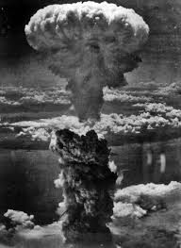
The Potsdam Conference
Japan – On 6th August 1945, the first atomic bomb was dropped. The second on Nagasaki was dropped on 9th August. However Truman did not tell Stalin the full story and even boasted of his ‘new power’ to Stalin. Truman did not encourage Stalin to join the war against Japan.
United Nations – UN became a reality and was officially created at the Treaty of San Francisco in 1945. The USA, USSR, France, Britain and Nationalist China would be the 5 permanent members.

Slide 24
How did the Potsdam Conference effect Superpower Relations?

Slide 25
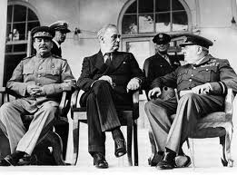
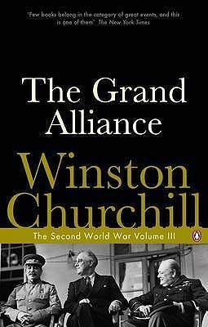
The final breakdown of the Alliance
Despite agreement over the United Nations, the division of Germany and Poland’s new borders, many disagreements remained unresolved.
Stalin had taken over Eastern Europe and it seemed unlikely he would allow free elections. The USSR was also threatened by the atomic bomb – it deepened mistrust between the Allies.
Between 1946-1947, six key developments contributed to the breakdown of the Grand Alliance:

Slide 26
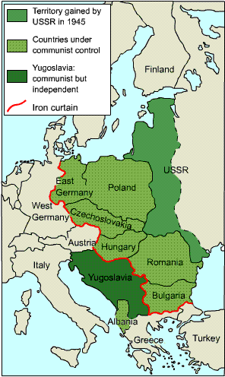
1. Soviet take-over of Eastern Europe
The USSR slowly gained increasing political control over Eastern Europe.
The Soviets used ‘Salami Tactics’ to defeat the opposition – slicing off political parties one by one. By 1946, many Moscow-trained communists leaders returned to Eastern Europe, ensuring that post-war governments would be dominated by Moscow.
In the Polish ‘free elections’ of January 1947, 246 candidates were disqualified, 149 arrested and 18 murdered. 50,000 people were deported to Siberia. Hardly ‘free’!

Slide 27
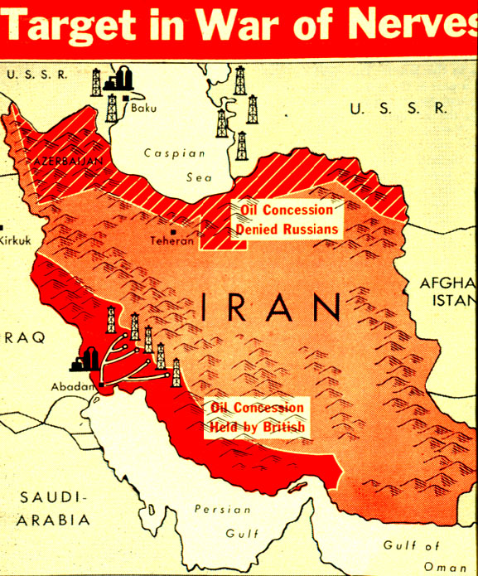
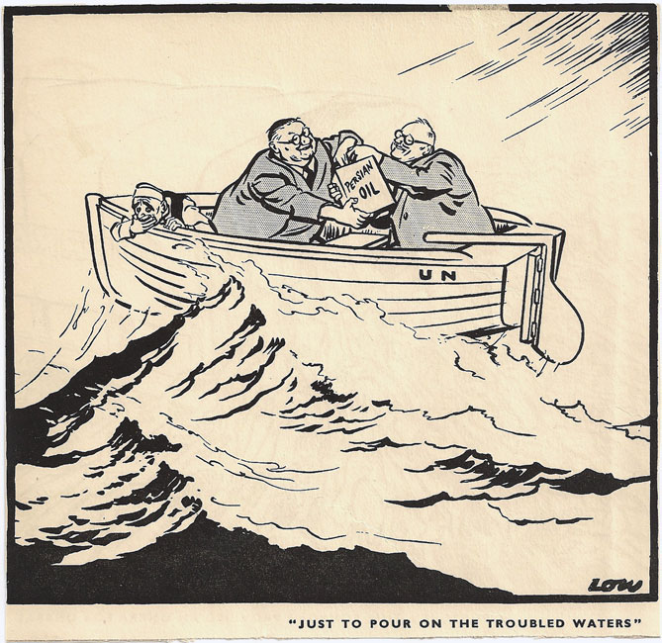
2. Soviet Pressure on Iran
The USSR also tried to increase its control of Iran. It was agreed at the Tehran Conference that the British and Soviets would withdraw after the war.
UK troops left but Stalin left 30,000 troops in the north, claiming they were needed to restore order. Iran complained to the UK and USA.
On 1st January 1946, Stalin again refused to withdraw. In March, Iran referred the case to the United Nations. Under this pressure, Moscow pulled out.

Slide 29
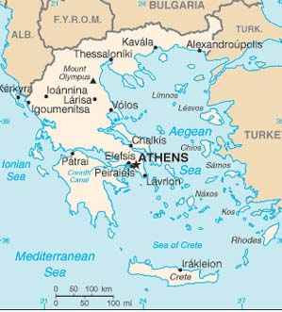
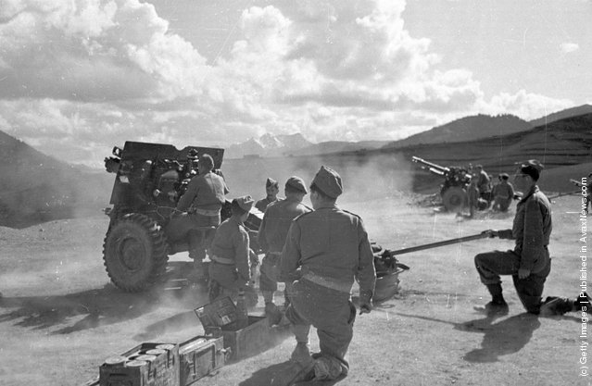
3. Instability in Greece and Turkey
After the Second World War there were anti-imperialist, nationalist and pro-communist rebellions in Greece and Turkey.
The British struggled to contain these threats. They believed that the USSR was supporting the rebellions.
Churchill's was particularly annoyed at Stalin’s disregard for their ‘Percentages Agreement’ – Greece and Turkey were supposed to be under the West’s ‘sphere of influence’.

Slide 30
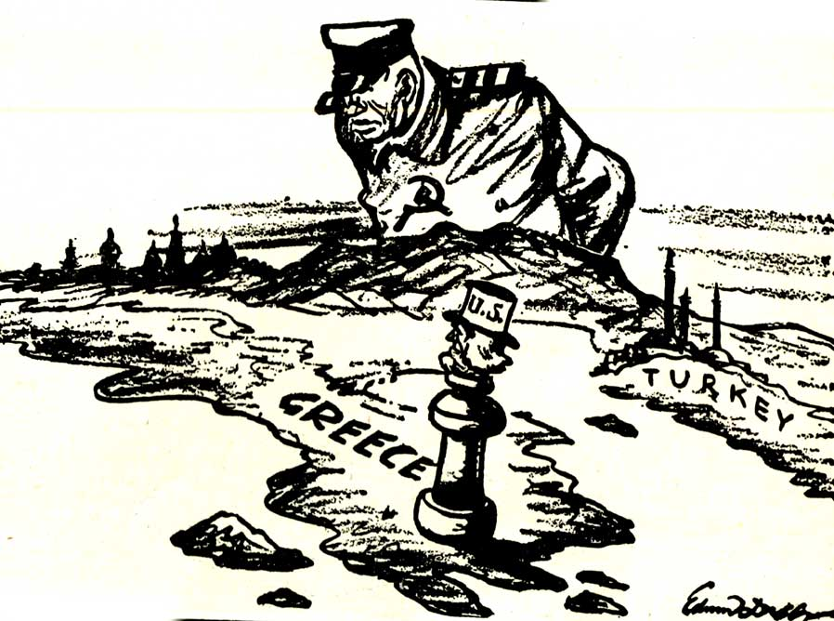

Slide 31
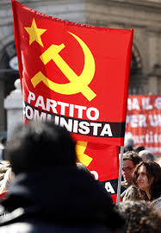
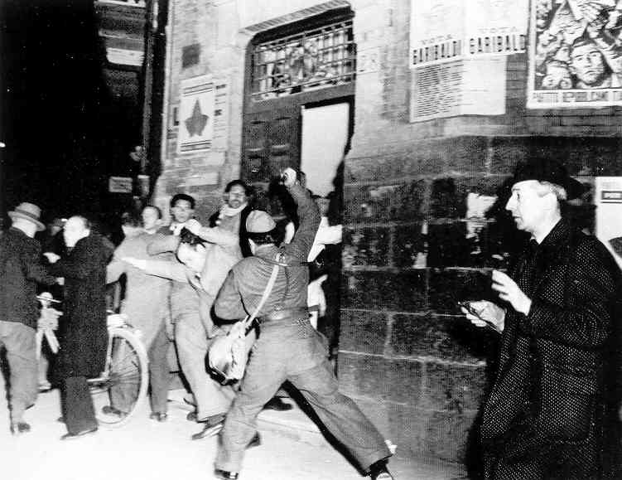
4. Communism in Italy and France
In post-war Europe, Communist parties in Italy and France grew stronger, threatening to take-over these Western Democracies.
This was due to the economic hardships these countries faced. The US and UK were suspicious – they believed Moscow was encouraging them.
This gave the impression that the Communists were trying to take-over Western Europe as well.

Slide 32
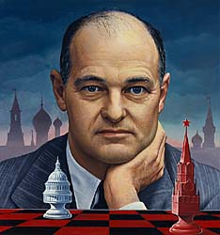
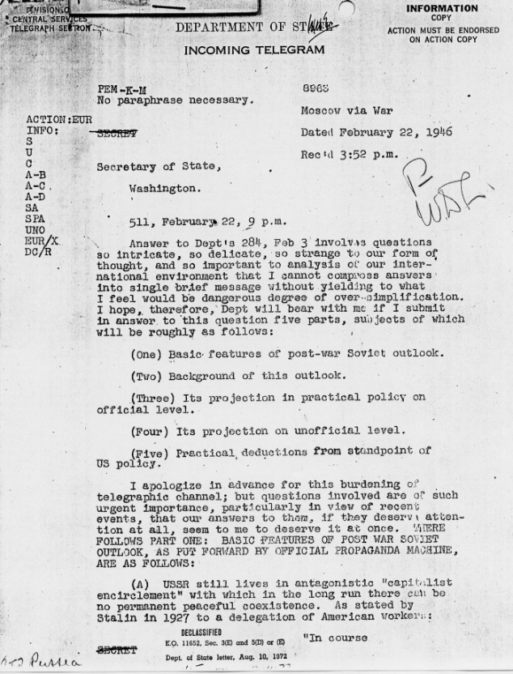
5. Kennan’s Long Telegram
In February 1946, a key US diplomat in Moscow, George F. Kennan, sent a telegram to the US State Department, describing Soviet foreign policy.
His views would have a lasting influence on the State Department throughout the Cold War, helping to shape the policy of ‘containment’.
He argued that the USSR was ‘fanatically and implacably’ hostile to the West; and only listens to the ‘logic of force’.

Slide 33
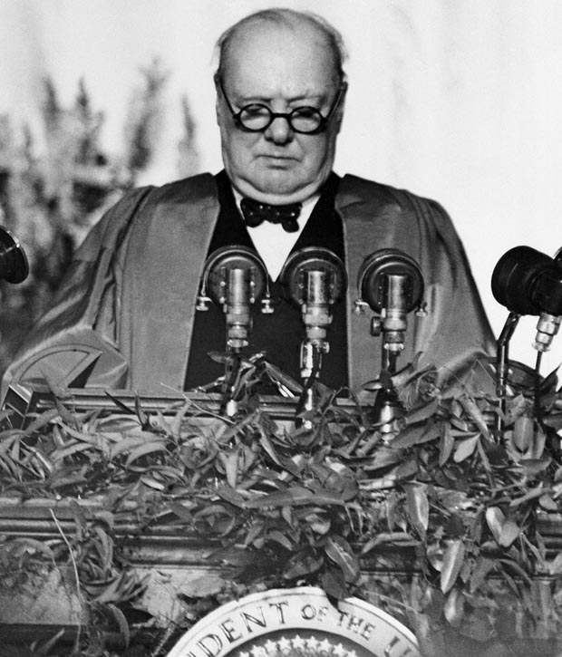
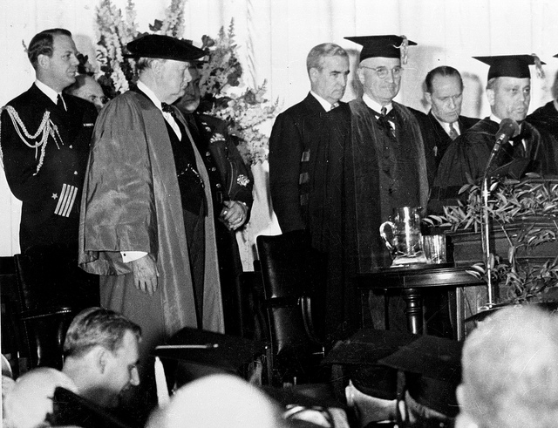
6. Churchill’s Iron Curtain Speech
On 5th March 1946, former British Prime Minister Winston Churchill gave a speech at Westminster College in Fulton, Missouri with President Harry S. Truman.
Churchill, angered by the failure of the USSR to implement free elections, used the phrase ‘iron curtain’ to warn the world about the Soviet take-over of Eastern Europe.
The speech was a defining moment in the Cold War – Stalin replied by comparing Churchill to Hitler! The Grand Alliance had finally broken down – they both now viewed each other as enemies.

Slide 34
“…From Stettin in the Baltic to Trieste in the Adriatic, an iron curtain has descended across the Continent. Behind the line lie all the capitals of the ancient states of central and eastern Europe – Warsaw, Berlin, Prague, Vienna, Budapest, Belgrade, Bucharest and Sofia. All these famous cities and the populations around them lie in the Soviet sphere and all are subject in one form or another, not only to Soviet influence but to a very high and increasing measure of control from Moscow… The Communist Parties, which were very small in all these eastern states of Europe, have been raised to pre-eminence and power far beyond their numbers and are seeking everywhere to obtain totalitarian control. Police government are prevailing in nearly every case… Whatever conclusions may be drawn from these facts… this is certainly not the liberated Europe we fought to build up. Nor is it one which contains the essentials of a permanent peace…”
Winston S. Churchill, Address at Westminster College, Fulton, Missouri, 5th March 1946

Slide 35
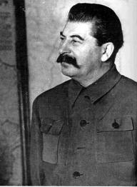
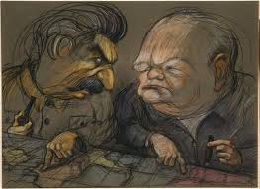
Stalin’s Reaction to the Speech
Within a week Stalin had compared Churchill to Hitler, seeing the speech as ‘racist’ and a ‘call to war with the Soviet Union’. Stalin then:
Withdrew from the International Monetary Fund (IMF)
Stepped up anti-Western propaganda
Initiated a new five-year plan of self-strengthening
The Iron Curtain speech was therefore significant in hardening opinions and defining the new frontline in what was being seen as a new war. The Grand Alliance was clearly now dead!

Slide 36
Plenary
What issues caused the most ‘tension’ between the Allies?
Which issues did the Allies manage to resolve?
What were the root, long-term, causes that lay behind most of the disagreements?
Who was more responsible for the breakdown of the Grand Alliance – Stalin or Truman?
Was the breakdown of the Grand Alliance inevitable? How could it have been avoided?
Did we meet our learning objective?
L/O – To identify how disagreements arising from the Second World War led to the Cold War

