Slide 1
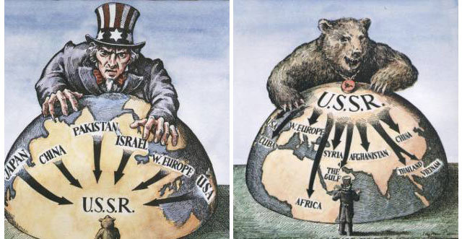
How did Confrontation lead to Containment?
L/O – To identify how and why the relationship between the USA and USSR intensified in the years 1947-48

Slide 2
Introduction
By the end of 1946, the Grand Alliance had broken down. Both sides now viewed each other with increasing suspicion.
Between 1947-49, political, economic and military divisions intensified as both sides sought to protect and extend their ‘spheres of influence’ in Europe.
Ignoring its commitment to democracy in Europe, the USSR attempted to increase its control over Eastern Europe. In response the USA attempted to consolidate its influence and ‘contain’ communism.
These two policies increased tensions dramatically, resulting in the first direct confrontation of the war – the Berlin Crisis of 1948-49.

Slide 3
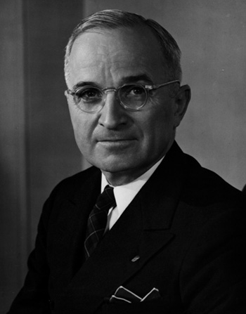
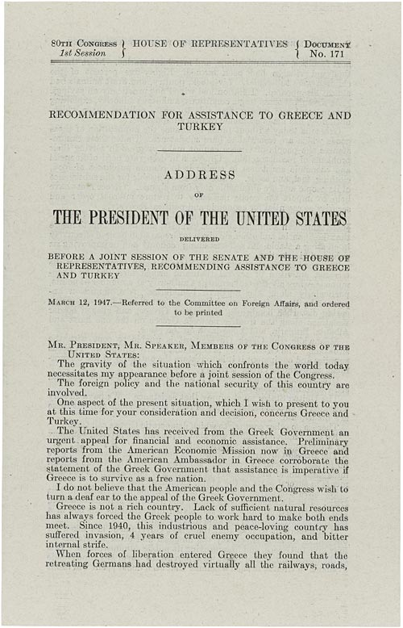
The Truman Doctrine
On 12th March 1947, President Truman gave a speech to the US Congress, stating his belief that the USA was obliged to ‘support free peoples who are resisting attempted subjugation by armed minorities or by outside pressures.’
This policy became known as the Truman Doctrine. It was a key turning point in the Cold War. The USA had traditionally followed an ‘isolationist’ foreign policy.
However in the face of communist expansion, it was clear that democracy in Europe could not survive without US support to ‘contain’ it.
Harry S. Truman

Slide 4
At the present moment in world history nearly every nation must choose between alternative ways of life. The choice is too often not a free one.
One way of life is based upon the will of the majority, and is distinguished by free institutions, representative government, free elections, and guarantees of individual liberty, freedom of speech and religion and freedom from political oppression.
The second way of life is based upon the will of a minority forcibly imposed upon the majority. It relies upon terror and oppression, a controlled press and radio, fixed elections and the suppression of personal freedom.
I believe that it must be the policy of the United States to support peoples who are resisting attempted subjugation by armed minorities or by outside pressures.
What justification does Truman give for his Doctrine?
What key words does Truman use to describe the West? What words to describe the countries under Soviet control?
Why do you think he uses this type of language?
How important is this document for explaining the development of the Cold War?

Slide 6
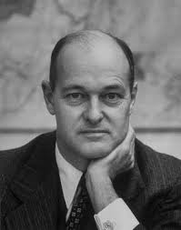
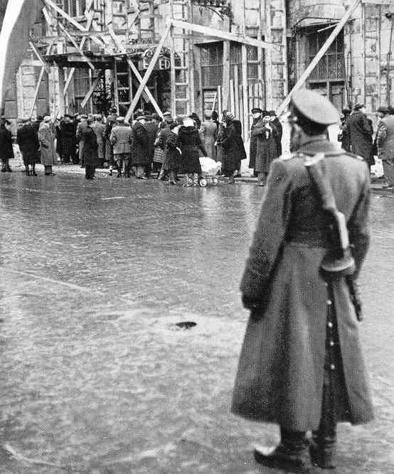
The Truman Doctrine
The idea of the Truman Doctrine was not new. It was a response to what was perceived as Soviet ‘aggression’ in Eastern Europe.
Fears over Soviet expansionism were made worse by Kennan’s Long Telegram and the Clifford-Elsey Report which in 1946 called for the USA to ‘resist’ Soviet aggression.
The Polish ‘free elections’ on 19th January 1947 proved to the US that Stalin had no intention of sticking to his promises on allowing democracy.
George Kennan

Slide 7
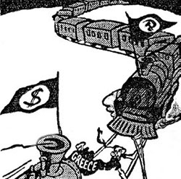
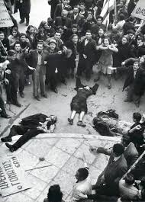
The Truman Doctrine
The final change in policy was triggered by the crisis over Greece and Turkey. At the end of WW2, Britain restored the Greek Monarchy however a Civil War erupted between the monarchy and communist guerrillas.
However Britain couldn’t afford to assist the Greek government. It was £3000 million in debt!
In February 1947, Britain announced to the USA that it could no longer maintain troops in Greece. Truman had to do something otherwise communism would win.

Slide 8
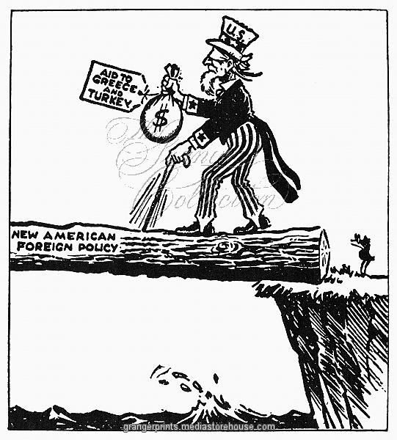
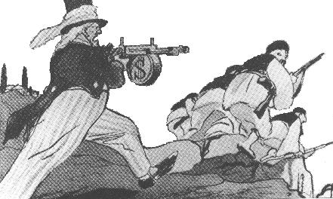
The Truman Doctrine
The Truman Doctrine was therefore issued to preserve democracy. US economic aid and military advisors were immediately sent to Greece and Turkey.
Stalin viewed this move as aggressive American ‘expansionism’.
The policy was a clear departure from isolationism. The US was now committing itself to preventing the spread of communism using any means necessary. This doctrine would dictate American foreign policy for the rest of the Cold War.

Slide 10
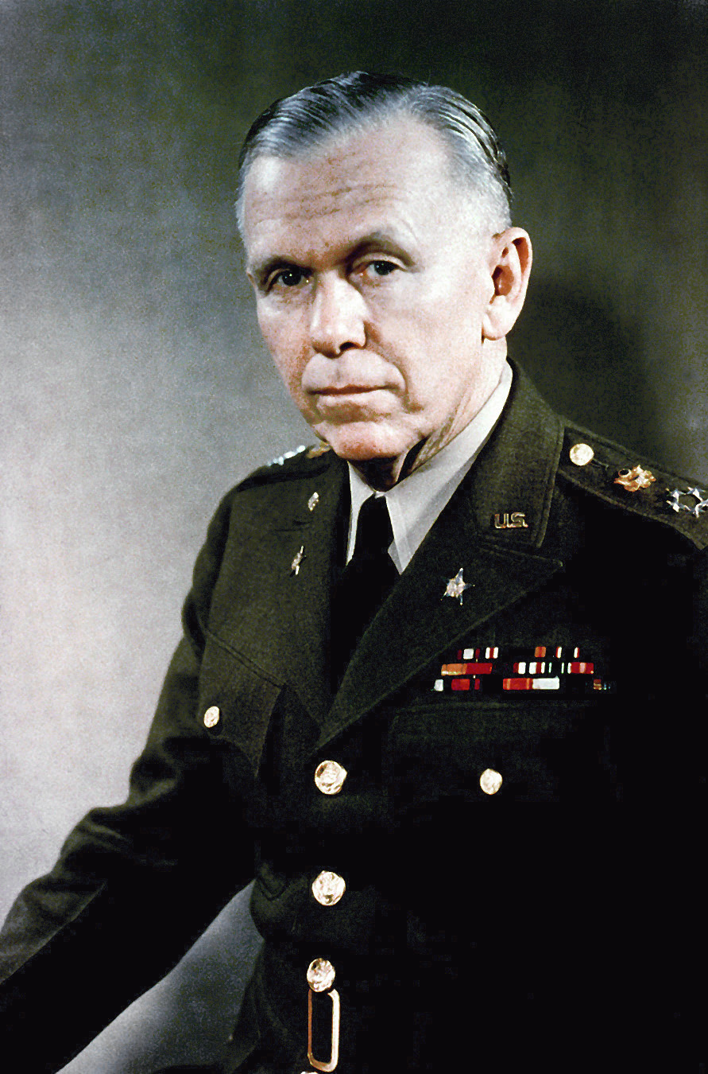
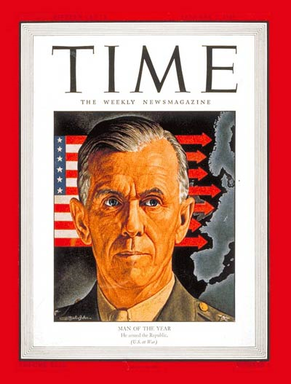
The Marshall Plan
In January 1947, General George Marshall became US Secretary of State. He believed that the economies of Europe needed drastic help – otherwise communism would flourish.
In a broadcast to the American public, he declared, ‘The patient is sinking while doctors deliberate’. The implication was clear – The USA had to compliment the Truman Doctrine with an economic policy as well.
Marshall introduced the plan in a speech at Harvard University on 5th June 1947.
George Marshall

Slide 11
“It is logical that the United States should do whatever it is able to do to assist in the return of normal economic health in the world, without which there can be no political stability and no assured peace. Our policy is directed not against any country or doctrine but against hunger, poverty, desperation and chaos.
Its purpose should be the revival of a working economy in the world so as to permit the emergence of political and social conditions in which free institutions can exist. Such assistance, I am convinced, must not be on a piecemeal basis as various crises develop. Any assistance that this Government may render in the future should provide a cure rather than a mere palliative. Any government that is willing to assist in the task of recovery will find full co-operation I am sure, on the part of the United States Government…”

Slide 12
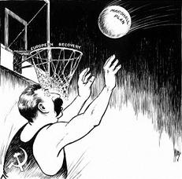
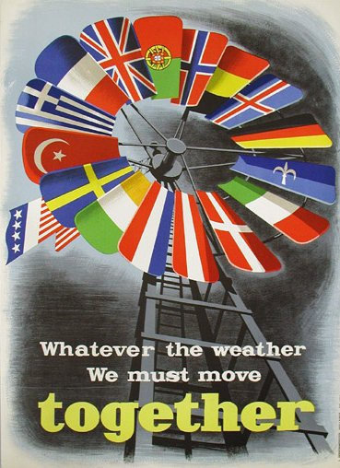
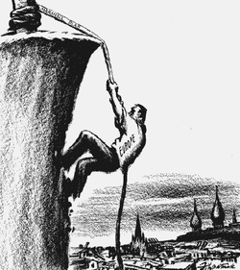
The Marshall Plan
The Plan was designed to give help to all countries in Europe but was carefully constructed to exclude the USSR.
Recipient countries had to allow their financial records to be investigated by the USA – Marshall knew the USSR would never accept this.
The USSR was therefore invited to join the Plan. Its stated aims were to:
Revive European economies so political and social stability could ensue
Safeguard the future of the US economy

Slide 13
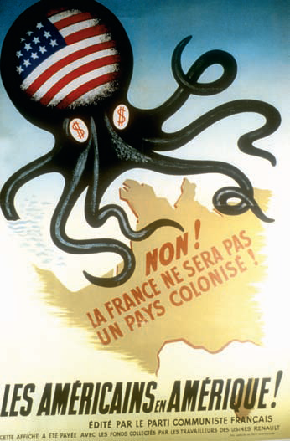
The Marshall Plan
The ‘European Recovery Programme’ bill allocating the four-year aid programme of $17 billion did not pass Congress until March 1948 with the Soviet take-over of Czechoslovakia in February 1948 persuading Congress to pass the Plan.
Stalin and the USSR viewed the Plan as American ‘dollar imperialism’ and rejected the Plan.
They felt that the US was attempting to establish economic and political domination over Europe.

Slide 14
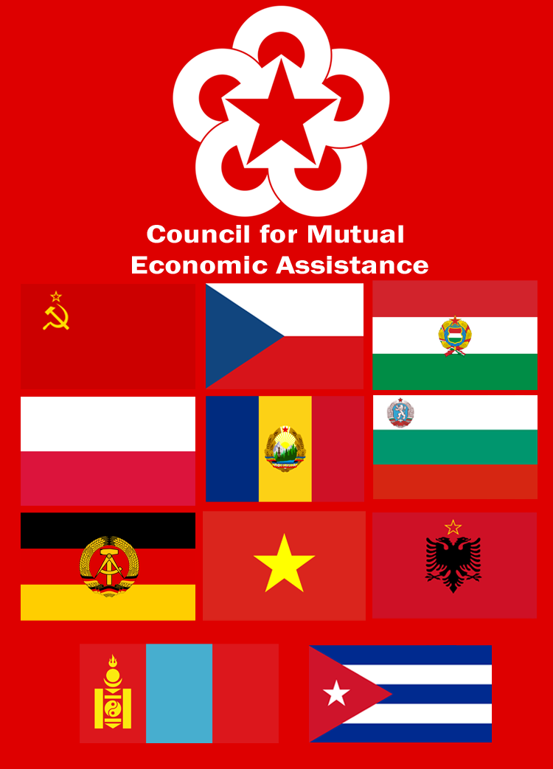
The Soviet Economic Response
The USSR immediately sought to tie the economies of Eastern Europe to them through their own economic links.
The result was the creation of COMECON in January 1949 – the Council for Mutual Economic Assistance.
This linked Eastern bloc countries to Moscow through economic interdependence, however this would follow communist policies like collectivisation of agriculture and development of heavy industry.

Slide 15
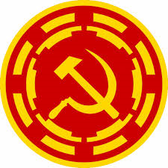
The Soviet Political Response
Stalin also responded to containment by tightening his political control over European communist parties.
In September 1947 he created COMINFORM – the Communist Information Bureau. This organisation comprised the USSR, Yugoslavia, France, Italy, Bulgaria, Hungary and Romania.
It enabled Stalin to control foreign communists parties and helped him to spread communism in Western Europe.

Slide 16
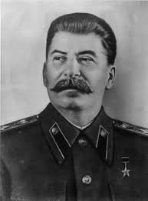
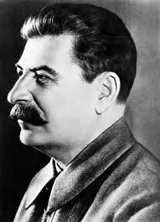
The Soviet Political Response
Soviet foreign policy also developed into what was called the ‘Two Camps’ Doctrine.
As early as the 1920s, Stalin had wanted to create two opposing camps in Europe and the world.
One would be the American dominated ‘anti-Soviet bloc’. The other would be the Soviet dominated ‘new democracies’ of Eastern Europe.
In this way, Stalin sought to ‘contain’ American influence whilst extending his own throughout the world.
Joseph Stalin

Slide 17
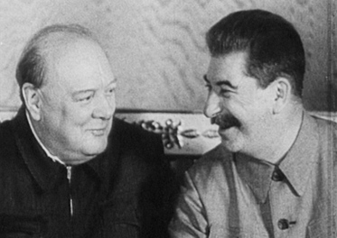
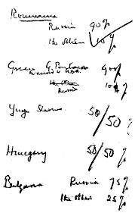
The Occupation of Eastern Europe
Since 1945, Stalin has been seeking to control Eastern Europe, as noted from the ‘Percentages Agreement’ with Churchill in 1944.
By 1947, most East European countries were under Soviet control and formed what became known as Stalin’s ‘satellite empire’.
The countries were officially independent, however they were clearly under Moscow’s sphere of influence.

Slide 18
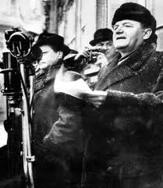
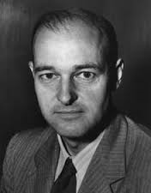
The Occupation of Eastern Europe
Moscow used military power, state police, COMECON and ‘salami tactics’ to steadily increase its control over Eastern Europe.
By the end of 1948, most East European countries had fallen under the control of Stalin, with Czechoslovakia falling in a communist coup in February 1948.
The West viewed these moves as an aggressive occupation and a breach of the agreements made at Yalta and Potsdam.
This view was hardened by George Kennan, who wrote the Long Telegram and ‘Mr X Article’ for Time Magazine in July 1947 – calling for a policy of ‘vigilant containment’ of the USSR.
George Kennan

Slide 19
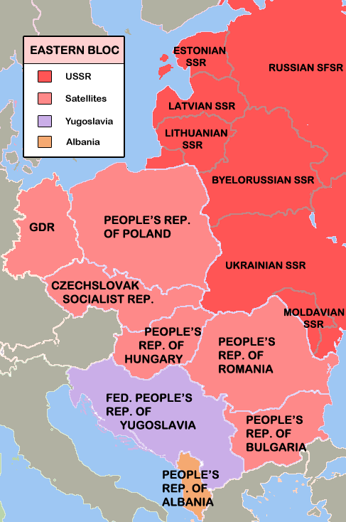
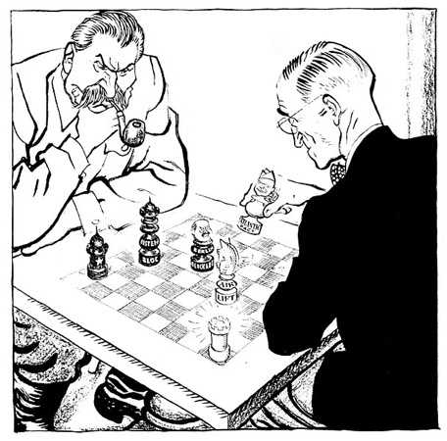
Conclusion
By 1948, Europe was clearly divided into separate political and economic ‘camps’ or ‘spheres of influence’, despite the agreements made at Yalta and Potsdam.
Both sides blamed each other for the growing hostility and both sides tried to ‘contain’ the other by locking their European allies into political and economic alliances.
The only question remaining would be whether this hostility would remain contained, or would it descend into open confrontation?

Slide 20
Discussion Question
Who was most responsible for the breakdown in trust between East and West up to 1948. The USA or Soviet Union?
You may like to consider the following events:
The Truman Doctrine and ‘Containment’
The Marshall Plan and ‘Dollar Imperialism’
Creation of COMECON (1949) and COMINFORM (1947)
Soviet Occupation and Take-over of Eastern Europe
Czechoslovakian Coup of February 1948
Kennan’s Mr. X Article of July 1947

