Slide 1
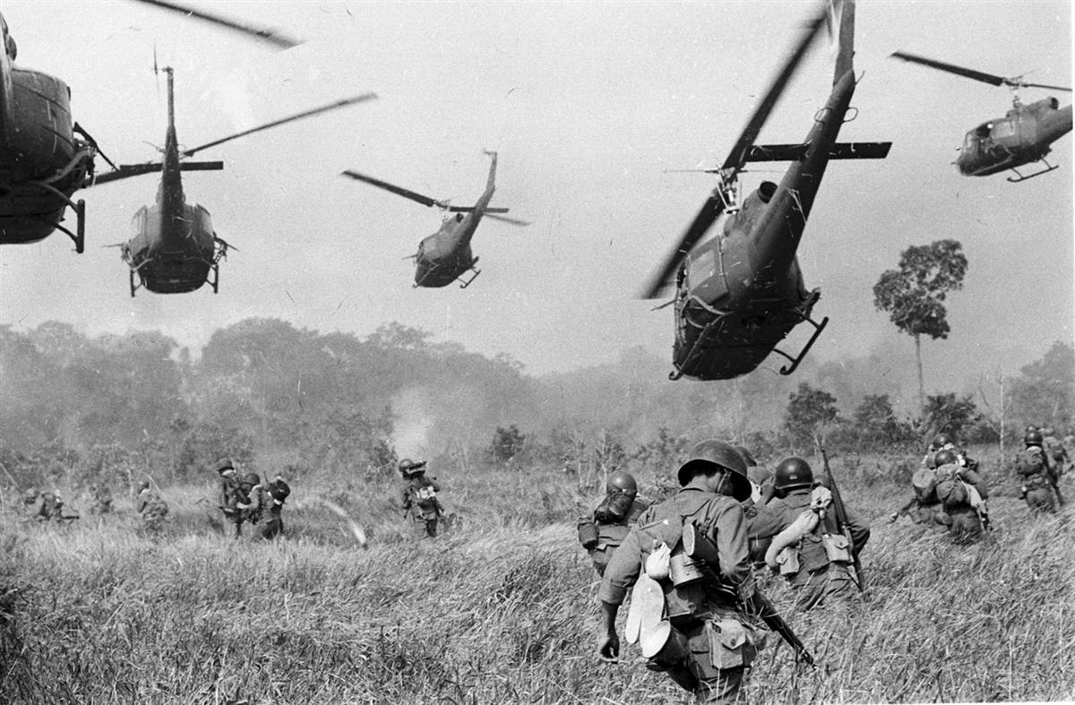
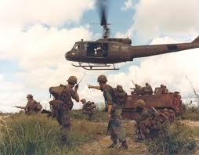
Why did Containment fail in Vietnam?
L/O – To analyse the War in Vietnam in order to evaluate the reasons for the failure of Containment

Slide 2
Research Questions
How did the United States become involved in Vietnam?
What was decided at the Geneva Conference of 1954?
Why did Ngo Dinh Diem refuse to hold promised elections in 1956?
How did President Kennedy widen the conflict?
Why did President Johnson continue the Vietnam War?
What was the significance of the 1968 ‘Tet Offensive’?
How did President Nixon achieve ‘peace with honour’?
What was decided at the Paris Peace Talks?
Conclusion – Why did containment fail in Vietnam?

Slide 3
1. How did the USA become involved in Vietnam?
Indochina (Vietnam, Cambodia, Laos) French colony. Nationalist movement led by Communist Ho Chi Minh, Vietminh, attacked Japanese. After 1945, he declared independence of Democratic Republic of Vietnam.
French fought Vietminh in 1946 to retain control. As Cold War intensified, Truman administration began emphasising Ho Chi Minh’s communist credentials. Assumed he was controlled by Moscow.
USA sent military aid to help France in March 1950. Eisenhower continued this, believing in Domino Theory. USA funding 80% of war by 1954. French finally defeated at battle of Dien Bien Phu in 1954.

Slide 4
2. What was decided at the Geneva Conference of 1954?
Geneva Accords decided France would withdraw; Vietnam would be divided at 17th parallel; Ho Chi Minh given control of North; ‘free elections’ to unite Vietnam in 1956; no foreign bases; Laos and Cambodia recognised as independent states.
USA refused to sign accords. Started to strengthen south of Vietnam and non-communist government led by Ngo Dinh Diem. Established SEATO in 1954 which included South Vietnam, Laos and Cambodia as ‘protected areas’ – USA and SEATO allies would respond to an attack on these areas.

Slide 6
3. Why did Ngo Dinh Diem refuse to hold promised elections in 1956?
In October 1955, Diem proclaimed the Republic of Vietnam (South Vietnam) with himself as president. US gave millions in economic support and trained South Vietnamese Army (ARVN). 1,000 US military advisors by 1960.
Diem (US educated, Catholic) and his brother Ngo Dinh Nhu (Chief of Police) were ruthless, crushed opposition, refused land reforms, promoted Catholic faith. Dictatorship emerged.
In 1956, Diem refused to hold elections, with US support. Claimed Communists couldn’t be trusted to hold fair elections in North, in reality afraid election would have led to Communist victory, estimated Ho Chi Minh had 80% support.

Slide 8
3. Why did Ngo Dinh Diem refuse to hold promised elections in 1956?
Military opposition to Diem only option left in South; communists formed military groups known as ‘Vietcong’ (VC); communist political wing became known as ‘National Liberation Front’ (NLF). North Vietnam supported VC, as did most of local population.
USA became increasing concerned by Diem’s popularity, doubted Diem’s ability to hold off communist growth.

Slide 10
4. How did President Kennedy widen the conflict?
Kennedy elected in November 1960; policy towards containment called ‘flexible response’; expanded mean of fighting against Communism:
Increased military advisors in South (17,000 by 1963); started counter-insurgency operations against VC in South; included ‘Search and Destroy’ missions; spraying chemical defoliants like Agent Orange to destroy jungle; resettled villagers in the ‘Strategic Hamlets Program’; created ‘Green Berets’ guerrilla fighting force; encouraged Diem to introduce social and political reforms.

Slide 11
4. How did President Kennedy widen the conflict?
Methods just alienated Vietnamese local peasants; Diem continued unpopular policies inc. anti-Buddhist policies; in 1963 there was crisis over banning celebration of Buddha’s birthday – monks began ‘self-immolations’ – led to international reaction.
Madam Nhu (Diem’s sister-in-law), ‘let them burn and we shall clap our hands’.
Kennedy cut off aid to Diem, but Diem and Ngo killed in 1963 coup, known about by CIA; replaced by unpopular military regimes; US forced to rely on them; Diem’s assassination, ‘morally locked us into Vietnam’ (Westmoreland)

Slide 12
5. Why did President Johnson continue the Vietnam War?
Lyndon Baines Johnson (LBJ) took over in November 1963; inherited Kennedy’s problems and advisors; likely he would continue war; determined to win war against communism; stop domino effect.
Situation deteriorating in 1964; needed Congressional and Public Support for increase in troops; Gulf of Tonkin incident on 2nd August 1964 gave him excuse; US destroyer Maddox fired upon by North Vietnamese Patrol boats; two days later, happened again (apparently, no evidence); Johnson – ‘open aggression on the high seas’, immediately bombed North Vietnam; addressed Congress next day.
Passed ‘Gulf of Tonkin Resolution’, President can ‘take all necessary measures to repel any armed attack against the forces of the United States and to prevent further aggression’ = Legal basis for War!

Slide 13
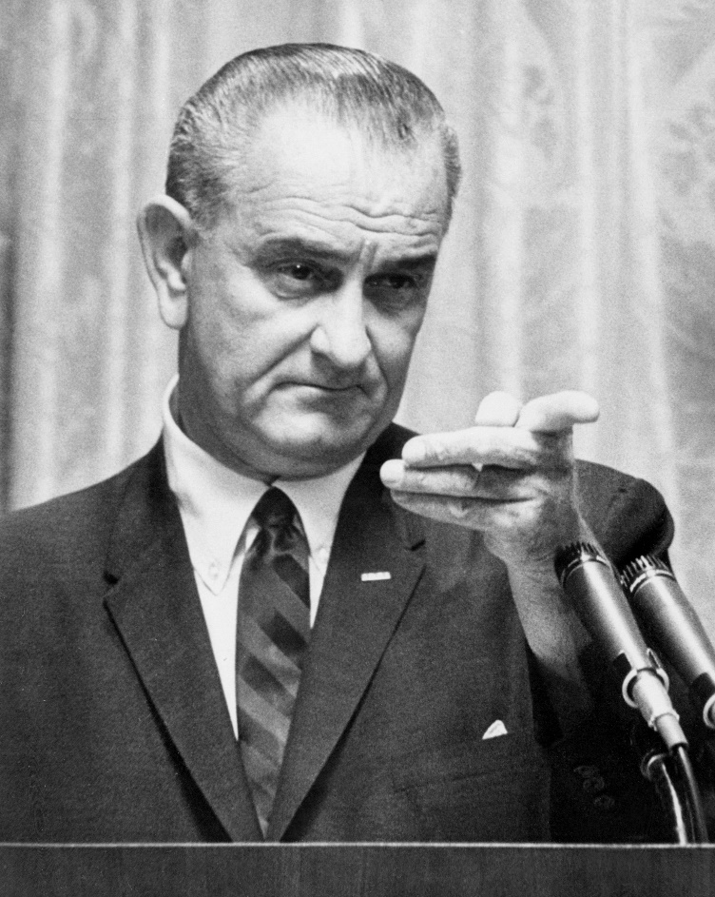

Slide 15
5. Why did President Johnson continue the Vietnam War?
US now launched ‘Operation Rolling Thunder’ – continual bombing of North Vietnam; sent 100,000 troops to South Vietnam in 1965, led by General Westmoreland; US soldiers carry out ‘search and destroy’ missions in South; 520,000 troops by 1968; Bombing of targets in South also increased; including napalm attacks; effected local population.
War diverted Johnson’s attention away from his domestic ‘Great Society’ agenda – civil rights, poverty, healthcare and education – failure of this led to a ‘credibility gap’ – he hid what was happening in Vietnam away from public debate – didn’t want to harm his policies at home.

Slide 25
6. What was the significance of the 1968 ‘Tet Offensive’?
War at turning point in 1968; General Westmoreland’s policy of ‘attrition’ (killing more enemy then they can kills of you) failing to defeat NLF/VC; growing anti-war movement at home; fuelled by growing US casualties and media reporting/civilian deaths; Johnson told public in 1967 that USA was winning.
31st January 1968 (Tet – lunar new year holiday); 70,000 Communists launch surprise attack in South; over 100 cities attacked; took 11 days for US/ARVN to regain control of Saigon; at Hue, half of city destroyed and 5800 civilians killed; military failure of Vietcong (40,000 casualties) but turned USA public opinion against war; public sickened by TV images; US embassy attacked in Saigon; execution of Vietcong prisoners in street; USA not winning! Growing anti-war protests.
USA halted bombing operations; peace talks initiated; 31st March 1968 – Johnson surprises everyone and announces he will not stand for re-election.

Slide 32
7. How did President Nixon achieve ‘peace with honour’?
Richard Nixon elected in November 1968; wanted withdrawal; ‘peace with honour’; wanted settlement that guaranteed South Vietnam survival (containment intact); took another 4 years and 300,000 Vietnamese/20,000 US lives.
Henry Kissinger his foreign policy advisor; advocated using force to get North to peace agreement; cover 14 month bombing campaign of Ho Chi Minh Trail in Cambodia; failed; Nixon’s ‘Vietnamisation’; gradual withdraw of US troops; handing war over to South Vietnam from 1969-1973; June 1969 – ‘Nixon Doctrine’ – nations of Asia should be more responsible for their own defence; move away from Truman Doctrine;

Slide 33
8. What was decided at the Paris Peace Talks?
Peace talks at Paris began on 13th May 1972 until January 1973; Henry Kissinger negotiated with North who were determined to also have ‘peace with honour’; deadlock; all sides trying to win advantage in the field; US increased bombing of North towards China border; US also pursued ‘détente’ with USSR/China; better relations to put pressure on North Vietnam
Settlement agreed on 27th January 1973; US troops withdraw from Vietnam; North and South respect border at 17th parallel; last US troops left only 2 weeks after agreement; North continued war; captured Saigon on April 1975; Cambodia, Laos and Vietnam all became Communist; Containment failed.

Slide 34
9. Conclusion – Why did containment fail in Vietnam?
USA – Truman (1950) & Containment/Aided France; Eisenhower (1952) & Domino Effect/Military Advisors/No Geneva 54/No elections 56/Support for Diem/SEATO; Kennedy & Flexible Response/Counter-Insurgency/Defoliants; LBJ (1963) & Gulf of Tonkin/Operation Rolling Thunder/Search and Destroy; Nixon (1968) & Vietnamisation/Nixon Doctrine/Peace with Honour
Foreign Support – USSR/China support for North Vietnam; Prevented US invasion; Cambodia/Laos supplied VC; Ho Chi Minh Trail
South Vietnam – Diem’s government unpopular; no land reform; anti-Buddhist policies; blocked elections; police state; Strategic Hamlets
North Vietnam – Popularity of Ho Chi Minh; Defeated Japanese; Nationalist – reunify Vietnam; Communist – social policies; Tet Offensive; Guerrilla Warfare
Success? – War in Vietnam gave Malaysian, Thailand and Singapore ‘breathing space’- Asian stability in face of Communist threats

