Slide 1
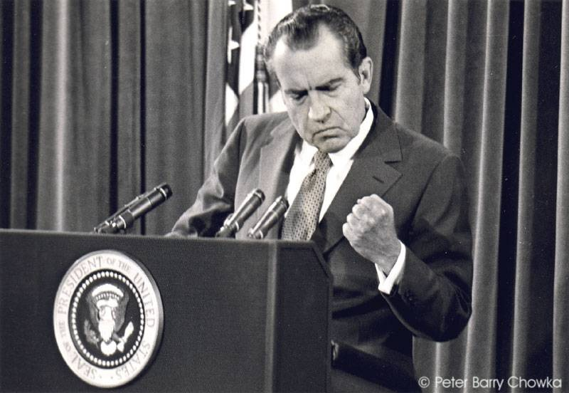
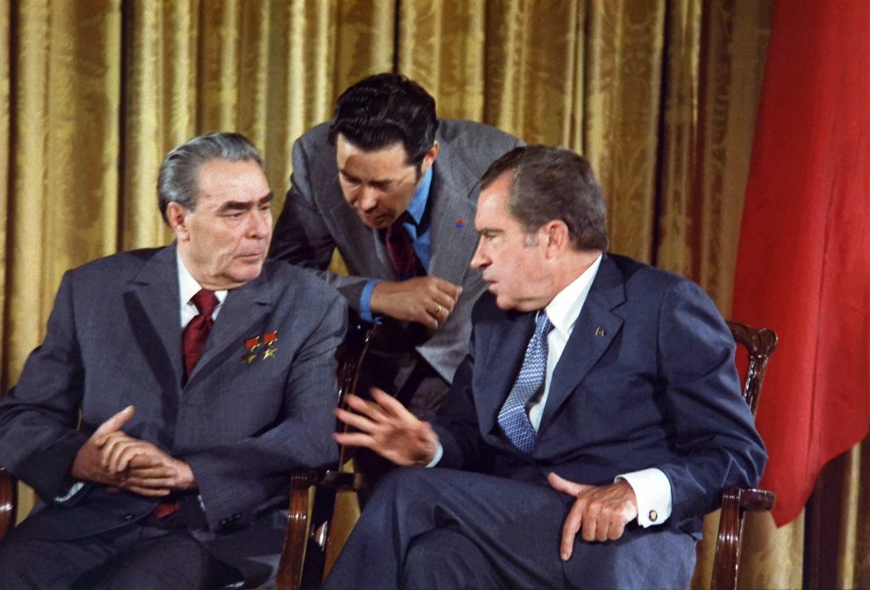
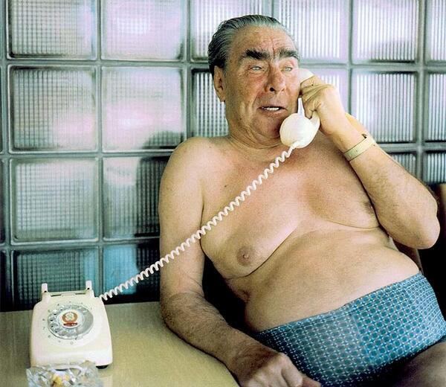
Was Détente a Success or Failure?
L/O – To identify the reasons for détente and evaluate the successes/failures in reducing Cold War tensions

Slide 2
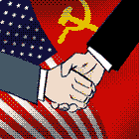
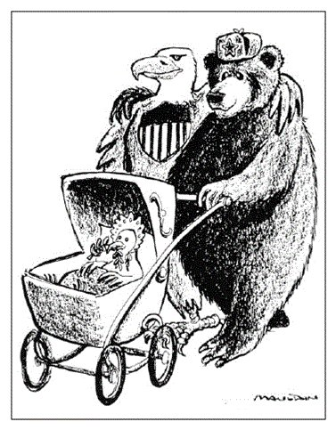
What was détente?
‘détente’ means a ‘relaxing of tension’. Between 1968 to 1980, the USA, USSR, PRC and European nations all pursued policies designed to establish more stable relations and reduce the threat of nuclear war.
Yet despite the policy successes of détente, it didn’t alter or alleviate the fundamental nature of the conflict.
Both sides were still competing for influence and power throughout the world, especially in the Middle East and Africa. Détente would finally collapse with the Soviet invasion of Afghanistan in 1979.

Slide 3
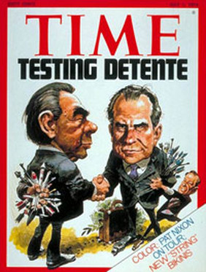
What was détente?
The key historiographical debate about détente revolves around whether détente was a success or not.
Success = reduced tensions, led to nuclear arms reductions, necessary strategy to manage Cold War competition, better relations with China, stability in Europe, never intended to end arms race
Failure = allowed USSR to strengthen economy and achieve nuclear parity with USA, seen as Soviet ‘trick’, Cold War moved to Middle East/Africa, Soviets invaded Afghanistan, continued arms race

Slide 4
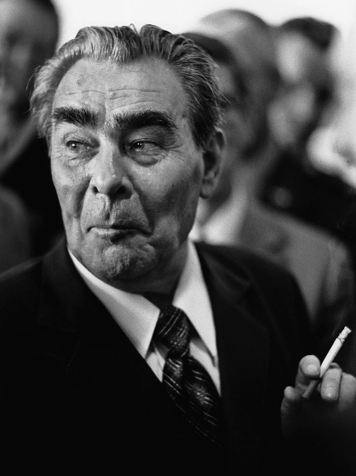
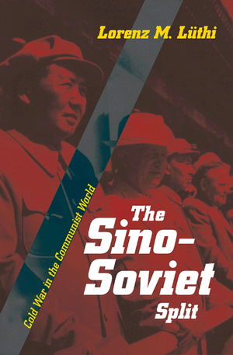
Soviet Reasons for détente
USSR’s economy was stagnating by the late 1960s. Its centrally planned economy prioritised arms production over consumer goods. The result was low living standards which fuelled unrest.
By 1969, the Sino-Soviet relationship was in tatters after the short border war. The USSR sought to isolate China. Better relations with the West could enable this.
By 1969 the USSR had also achieved nuclear parity with the USA. It could now negotiate from a position of strength.

Slide 5
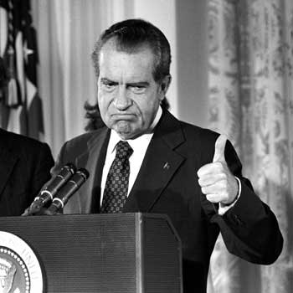
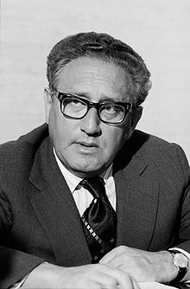
American Reasons for détente
The Vietnam War had isolated the USA internationally and caused tensions amongst its allies. It also sucked up billions of US dollars and seemed to be doing nothing to stop communism spreading.
The US needed a way to end the war. New President Nixon (1968) and his foreign policy advisor, Henry Kissinger, called for a new ‘realpolitik’ foreign policy that could more flexibly expose divisions between the USSR and China through negotiation.
They hoped détente with the USSR and China would put pressure on North Vietnam to end the war.

Slide 6
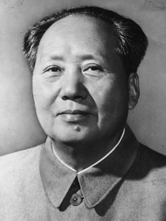
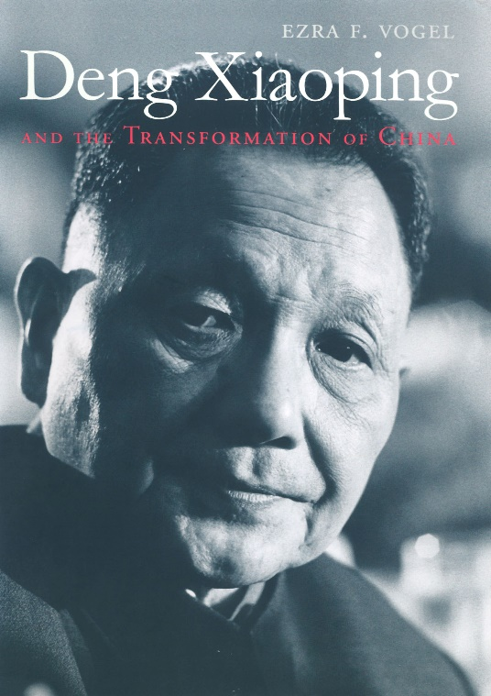
China’s Reasons for Détente
After the 1969 Border War with the USSR, China also sought better relations with the USA as a way to deter and gain leverage over the USSR.
Diplomatically, China hoped that better relations with the USA would help its long-term aim of regaining Taiwan.
Economically, China was keen to gain access to Western technology like Oil extraction. After 1976, the new reforming leadership in China also sought greater trade relations with the West. Détente would help achieve all these aims.

Slide 7
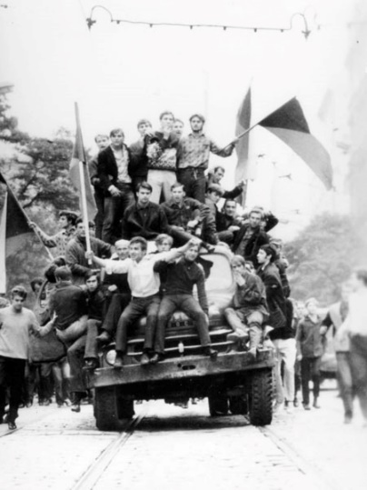
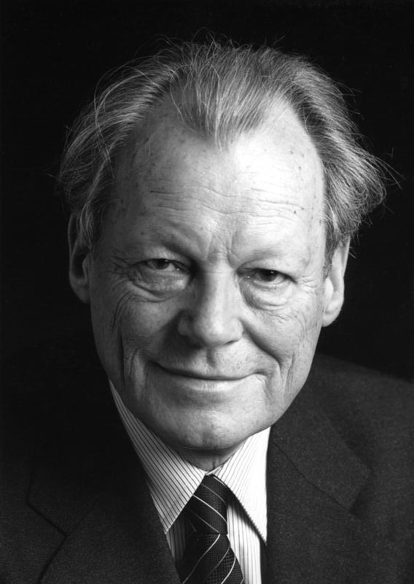
European Reasons for Détente
The crises of the 1960s over Cuba and Berlin had worried European nations who were on the front-line of any potential nuclear war. These tensions had encouraged protests in both Czechoslovakia and France in 1968.
Both East and West were aware of the need to improve relations for social stability. Chancellor Willy Brandt in West Germany called for ‘Ostpolitik’ in foreign policy.
The Soviet Bloc was also keen for a formal peace treaty accepting the new post-war borders in Europe – and to gain acceptance for the division of Germany – détente would therefore led to better economic and political relations for both sides.

Slide 8
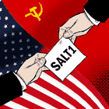
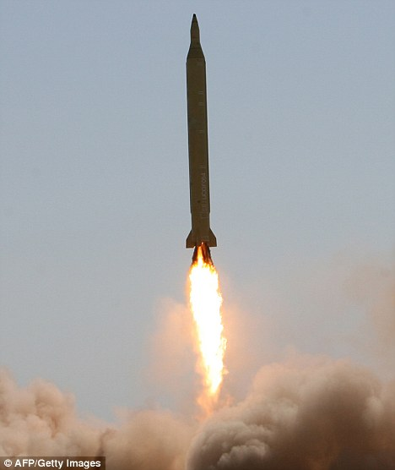
Successes of Détente – SALT 1
The biggest policy success of détente were in the area of nuclear arms reductions. The Strategic Arms Limitation Treaty (SALT1) in 1972 was a landmark treaty. It covered:
ABM Treaty – Anti-ballistic Missiles were allowed at only 2 sites, with no more than 100 missiles. To ensured the continuation of MAD as a deterrent = both sides felt secure
Interim Treaty – places limits on numbers of ICBMs and SLBMs.
Basic Principles Agreement – created rules for the conduct of nuclear war, committed both sides to promote ‘peaceful co-existence’.

Slide 9
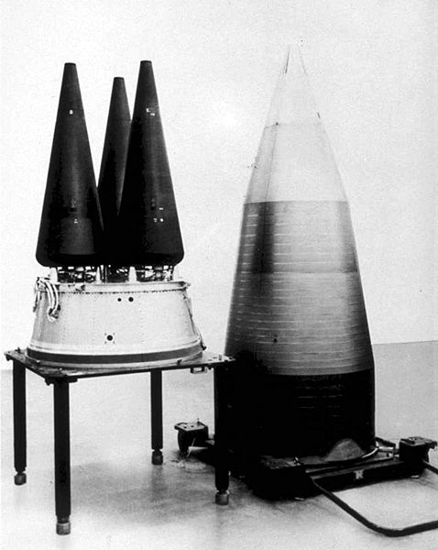
Successes of Détente – SALT 1
The spirit of co-operation achieved by SALT 1 was followed up by visits to Moscow by Nixon in 1972 and 1974. Brezhnev also visited Washington in 1973.
SALT 1 was a landmark agreement because it ‘institutionalised’ arms control and committed both nations to formal rules and goals.
However some criticised it for not going far enough – it only regulated nuclear war, it didn’t call for disarmament. It allowed both nations to maintain MIRVs – highly destructive!

Slide 10
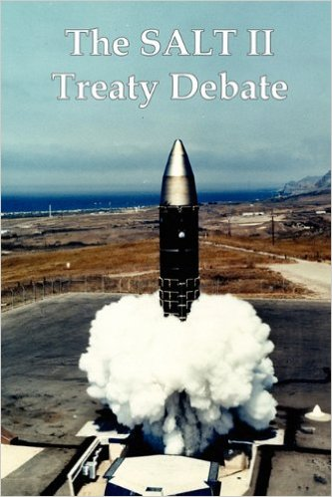
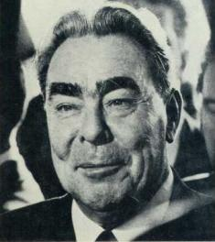
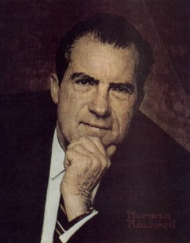
Successes of Détente – SALT 2
SALT 1 was quickly followed up by discussions over another treaty called SALT 2. Negotiations began in 1974 but dragged on until 1979 as relations stalled. It called for:
A limit on nuclear delivery vehicles like ICBMs, SLBMs and heavy bombers.
A ban on testing new types of ICBMs and new weapons systems.
Negotiations were criticised within the USA as many believed it only limited US power, enabling the USSR to catch up with the USA.

Slide 12
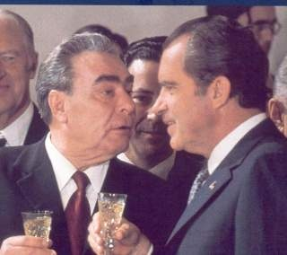
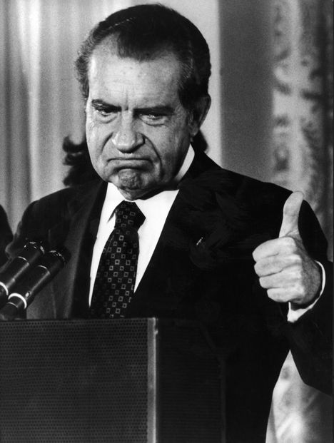
Successes of Détente – Europe
Moscow Treaty 1970 - was signed by the USSR, West Germany and Poland. It accepted the border between East/West Germany, and the post-1945 re-drawn border between Poland and East Germany.
Final Quadripartite Protocol 1972 – confirmed the division of Berlin and legally allowed Western access, thereby ensuring security.
Basic Treaty 1972 – signed by East and West Germany, both accepting the existence of each other. Both promised to increase trade links.
Agreement on the Prevention of Nuclear War 1973 – E & W. promised to enter consultations in the event of future crises

Slide 13
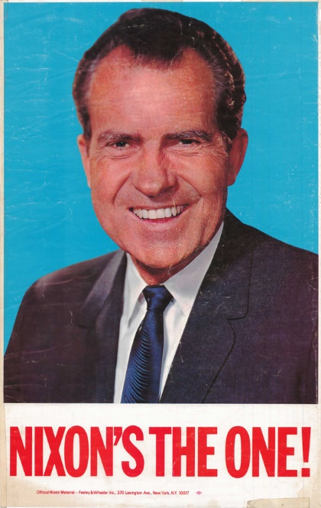
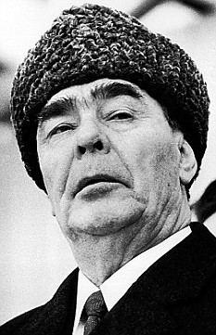
Successes of Détente – Europe
The agreements between the two Germany’s led to a huge reduction in tensions. Both sides began to normalise relations.
In 1973 the UN recognised both West and East Germany as sovereign states and East Germany was recognised by the USA. West Germany even stopped calling for reunification.
The USSR was happy as the West had accepted its control over Eastern Europe. However many in the West criticised the agreements as they gave legal recognition to Soviet control!

Slide 14
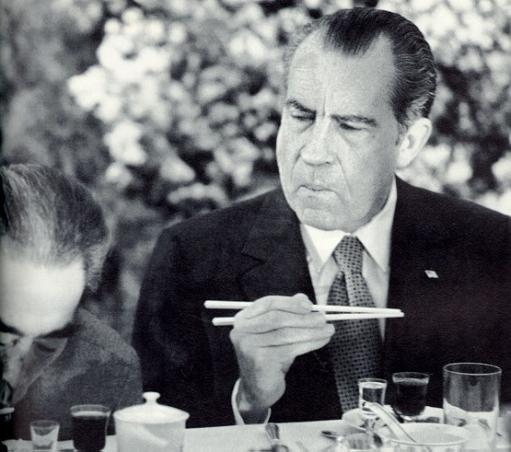
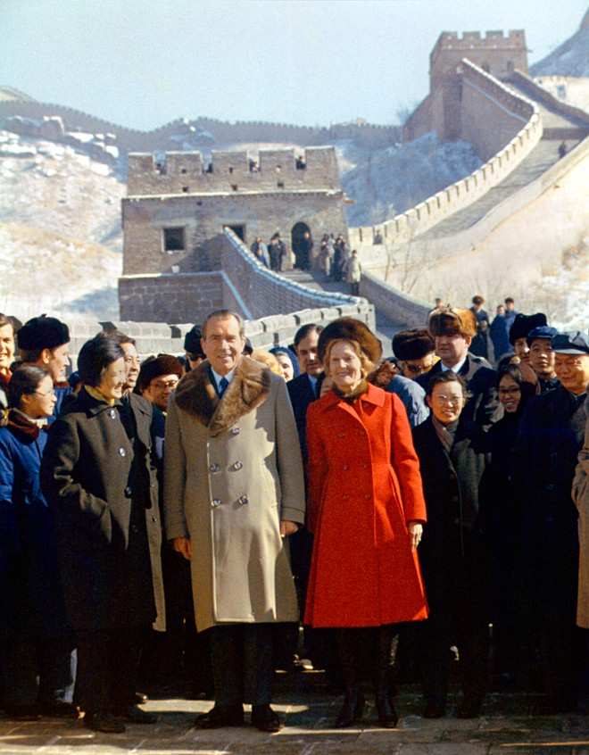
Successes of Détente – China
After the visit of Nixon to China in 1972, relations between China and the USA began to be normalised.
The USA dropped its objections to China taking a seat on the UN Security Council, replacing Taiwan as the official representative of China.
Trade and travel restrictions were also lifted and both nations began cultural exchanges. China even allowed students to study in the West. Better relations with China gave the USA leverage over the USSR in negotiations.

Slide 15
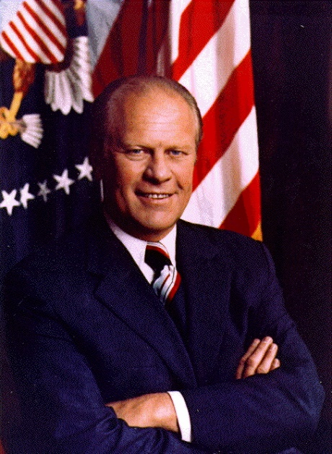
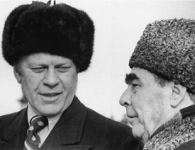
Successes of Détente – Helsinki
The Final Act Agreement of the European Security Conference that began in Helsinki in 1973 was signed on 1st August 1975. It was another landmark agreement committing both sides to co-operation:
Basket 1 - Security: Europe’s frontiers were ‘inviolable’ (national sovereignty and non-interference)
Basket 2 - Cooperation: Closer ties in economics, science, culture
Basket 3 – Human Rights: Respect for human rights and individual freedom on both sides

Slide 17
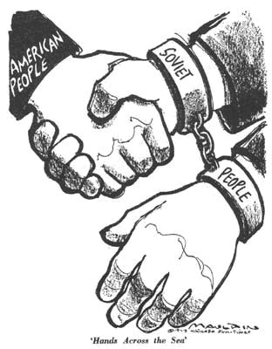
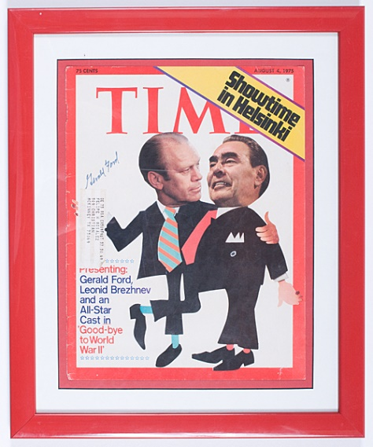
Successes of Détente – Helsinki
The Final Act was viewed as a success by both sides but for different reasons.
The USA believed it had committed the USSR to giving more political freedom to people in Eastern Europe – which would hopefully undermine Soviet control!
The USSR was pleased to gain acceptance of Eastern Europe’s borders, strengthening its control over the Eastern bloc – it thought it could ignore Basket 3 – however many dissidents within Eastern Europe would use Basket 3 to challenge Soviet control!

Slide 19
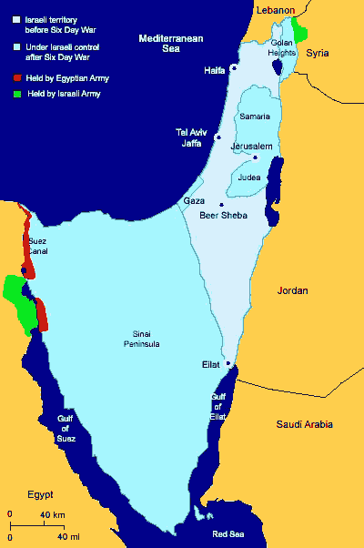
Why did détente fail? – Yom Kippur
Despite its successes, many right-wing politicians within the USA criticised the SALT and Helsinki agreements for giving strategic advantages to the USSR and for morally accepting Soviet domination of free countries.
Many feared the USSR was ‘tricking’ the USA. Events throughout the world seemed to confirm this.
In October 1973, the Yom Kippur War began when Egypt and other Arab states launched a surprise attack on Israel.

Slide 21
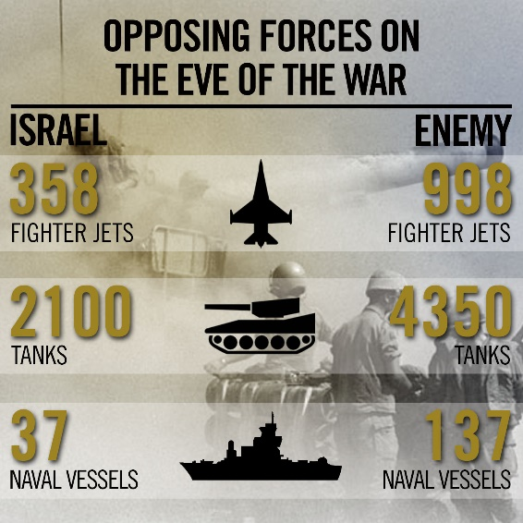
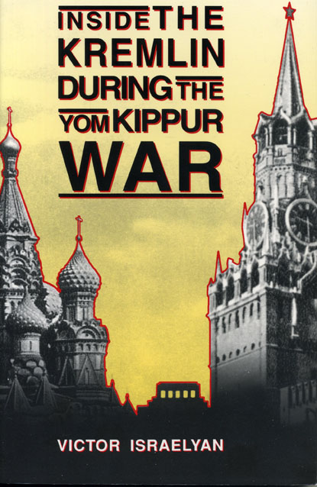
Why did détente fail? - Yom Kippur
Israel was a US ally in the region. Under the 1973 Agreement on the Prevention of Nuclear War, both sides promised to inform each other if a conflict threatened world peace.
Israel and the USA were shocked by the surprise attack by Soviet allies. It looked as if Israel was about to be wiped out by Soviet-backed forces.
Israel eventually won the war, yet the conflict had undermined US trust of the USSR and damaged the spirit of détente. Was the USSR really committed to peace?

Slide 22
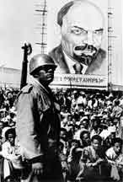
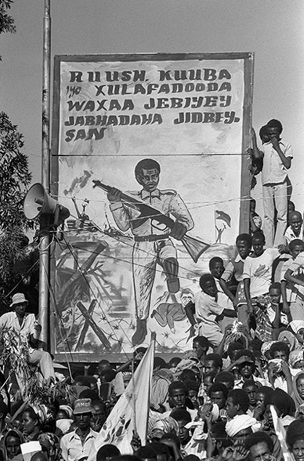
Why did détente fail? - Africa
In Africa, the USSR was also funding and supporting revolutionary movements that looked to upset the balance of power in the region.
In 1975, the USSR massive increased its funding for the Popular Movement for the Liberation of Angola (MPLA) during the Angolan Civil War. It looked as if the USSR was seeking to increase its influence in Africa.
This was repeated by the USSR in 1977 when it sent tons of military supplies to Ethiopia during its invasion of Somalia. It seemed to confirm Soviet intentions in Africa.

Slide 23
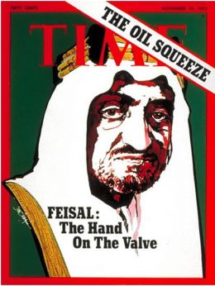
Why did détente fail? - Economics
Economic factors also led to the end of détente. By the late 1970s, the USA economy had recovered from the devastating oil price crisis of 1973 when OPEC launched an oil embargo against the Western allies of Israel.
The USA had begun to strengthen its economic allies around the world, setting up the G7 group. The USA therefore had less need for economic co-operation with the USSR.
The Soviet economy had also declined to 3% growth by the late 1970s. The USA was clearly in a stronger economic position and had less need for détente policies.

Slide 24
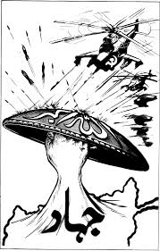
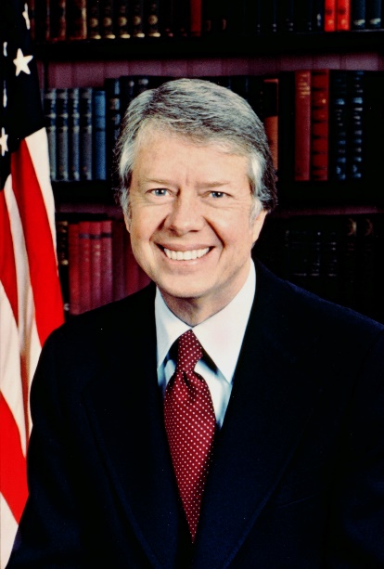
Why did détente fail? - Afghanistan
The final nail in the coffin of détente occurred in 1979 when the USSR invaded Afghanistan. The USA was already concerned about Soviet influence in the Middle East.
It confirmed to the Carter Administration in the USA that the USSR did indeed seek to undermine the balance of power in the world.
The USA responded to the invasion by refusing to sign SALT 2, stopping electronic exports to the USSR and boycotting the 1980 Moscow Olympics. The Carter Doctrine committed the USA to intervention in the Middle East to defend US interests in the Persian Gulf.

Slide 25
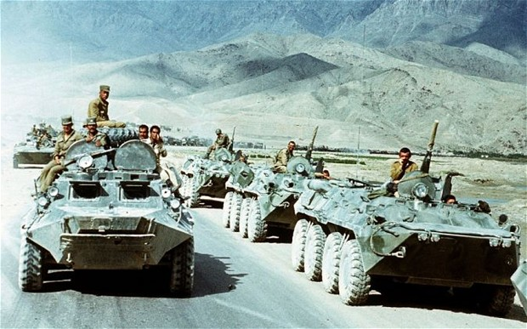

Slide 29
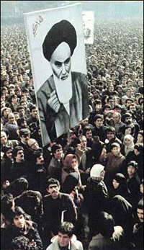
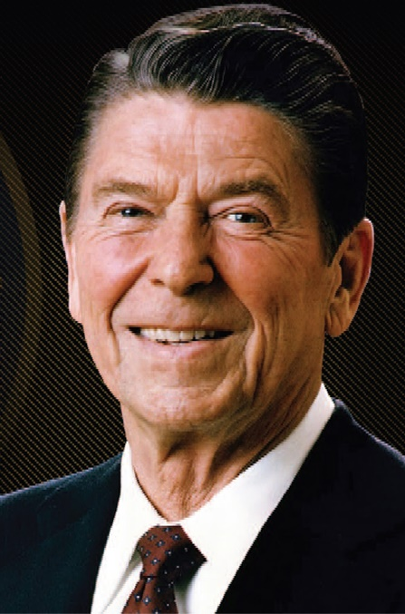
The Second Cold War – 1980s
However Carter was severely damaged by his handling of the Islamic Revolution of 1979 in Iran when Islamists led by Ayatollah Ruhollah Khomeini forced the anti-Communist US-backed Shah out of power.
With the end of détente in 1979, the USA reacted by electing the strongly anti-Communist Ronald Reagan to office in 1980.
Ronald Reagan had called the USSR an ‘evil empire’ and he believed détente had been a failure – He believed the USA could win the Cold War by being more aggressive!

Slide 30
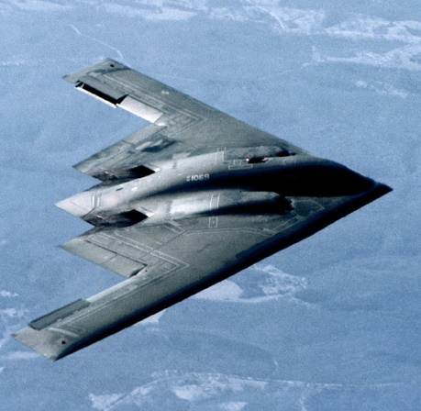
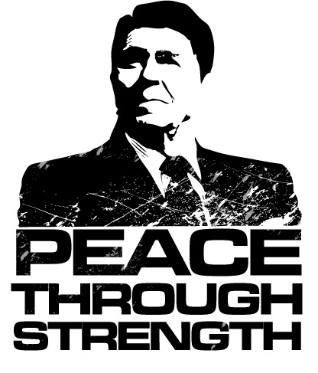
The Second Cold War – 1980s
Increased defence spending by 13% in 1982 and 8% for the following two years, developed new nuclear weapons, stealth bombers, Trident submarines, deployed new ICBMs to Europe.
Strategic Defence Initiative (Star Wars) was launched in 1983 to develop laser based defences to ‘shoot down’ Soviet nukes. This undermined the MAD deterrent.
Reagan Doctrine – increased global support for anti-Communist regimes in El Salvador, Nicaragua, Grenada and Afghanistan, restricted US trade with the USSR.

Slide 32
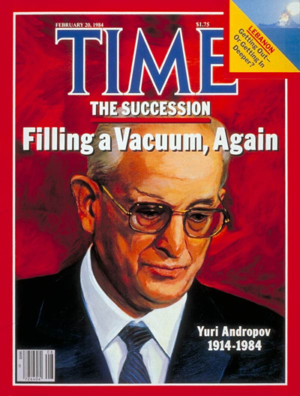
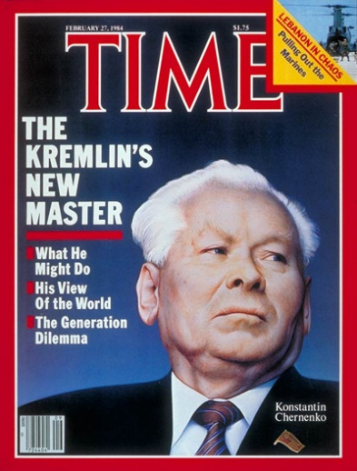
The Second Cold War – 1980s
It therefore seemed that détente had been a failure and the early 1980s were characterised by increasing tensions between the superpowers.
When Brezhnev died in 1982, he was replaced by Yuri Andropov and then Konstantin Chernenko in 1984. Both leaders were frail old men who did little to ease tensions.
Relations hit rock bottom in 1983 when the USSR shot down a Korean Airliner travelling from the USA to Seoul.

