Slide 1
Hitler-Germany

Slide 2
Authoritarian States Content
Emergence of Authoritarian States:
Conditions in which authoritarian state emerged: economic factors, social divisions, impact of war, weakness of political system
Methods used to establish authoritarian state:
Persuasion and coercion, the role of leaders, ideology, the use of force, propaganda
Consolidation and maintenance of power:
Use of legal methods, use of force, charismatic leadership, dissemination of propaganda
Nature, extent, and treatment of opposition
The impact of the success and/or failure of foreign policy on the maintenance of power

Slide 3
Authoritarian state content
Aims and results of policy:
Aims and impact of domestic economic, political, cultural, and social
The impact of policies on women and minorities
Authoritarian control and the extent to which it was achieved

Slide 4
Emergence of Hitler
Long Term:
Defeat of Germany in WWI and Treaty of Versailles
Weimar was group that surrendered in WWI after Wilhelm abdicates
Treaty of Versailles severely limits German growth and military might
Nazis use this as “stab in the back myth”
Weakness of Weimar Republic
Proportional Representation lead to coalitions and limited effective impact on legislative change
Article 25 President could dissolve Reichstag
Article 48 President sign emergency bills without Reichstag approval
Article 53 President appoints Chancellor
Economic collapse
Reparations already limited German economy, 75% of iron ore lost in loss of Rhineland
Hyperinflation = printing money to pay off reparations
Great Depression causes global economic collapse, further inability to pay back reparations
Hitler uses effective means of propaganda to draw attention to economic/political problems
Short Term:
1932 General von Schleicher replaces von Papen as Chancellor – von Papen lost favor as ineffective
Nazis had gained a majority with Catholic coalition during late 20’s early 30’s – Great Depression greatly lifts their ranks in Reichstag
President Hindenburg replaces von Schleicher with Hitler in Jan. 1933 – von Schleicher had proposed land reform efforts that Hindenburg and conservatives disliked
After appointed, Hitler and SA begin targeting Socialists and Communists
Feb. 1933 Reichstag Fire – Dutch communist accused of setting fire to Reichstag
Enabling Act 1933– legal basis for Nazi dictatorship – gives Hitler ability to pass laws without Presidential approval (SA may have intimidated voters by surrounding Reichstag)

Slide 5
Methods Used to Establish Authoritarian State
Persuasion and Coercion:
Appeals to elites – army, junker class with promised repeal of Treaty of Versailles
Appeals to rural voters – blood and soil, agrarian ideology
Appeal to bourgeois industrialists – return of industry; stable economy; regain Rhineland
Appeal to unemployed after Great Depression – ensures renewed German economy

Slide 6
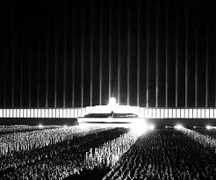
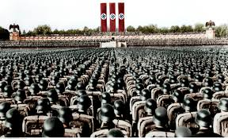
Methods used
Propaganda
Speeches – Hitler’s presence, emotion spilling from heart
Images – salute, swastika, uniformity of supporters (brownshirts), Heil Hitler greeting
Campaigns and marches – music, flags and banners waving/draped everywhere; delayed appearance, made crowd wait to build anticipation
Nuremberg Rallies – spectacle, marches from surrounding towns
Use of Force – Munich Putsch (Beer Hall Putsch)
Failed march on Munich to overthrow government
Subduing anti-Nazi forces and concentration camps

Slide 7
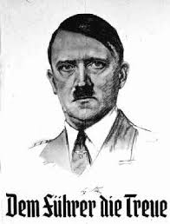
Methods Used
Role of Leader:
Hitler as supreme leader of Nazi party
Fuhrerprinzip – hierarchy of Nazi party, demand loyalty to all those beneath the leader of the organization/administrative unit
Ideology
Mein Kampf – dictated autobiographical book sets forth Hitler’s ideologies
Volksgemeinschaft – traditional German values would fix economic problems (peasant is noble)
Pan-Germanism – unify all German and German speaking peoples; including “lost land” Treaty of Versailles
Lebensraum – living space needed – Poland, Russia, Ukraine
Military nationalism – Prussia!
Social Darwinism – Aryan’s biologically superior
Socialism – dangerous to Germany, a Jewish belief

Slide 8
Consolidation of Rule
Use of Legal Methods
Reichstag Fire Decree – (For the Protection of People and State) – Feb. 1933
Communists removed from Reichstag; Nazis gain majority
Enabling Act March 1933 – gives Hitler power to legislate without Reichstag involvement
Communism/Socialism banned
Eliminates Reichsrat (state representatives)
April 1933 Law for the Restoration of Profession Civil Services (Jews and non-Aryans resign from administrative, court, universities, and schools)
July 14 1933 – Law Against Establishment of Parties

Slide 9
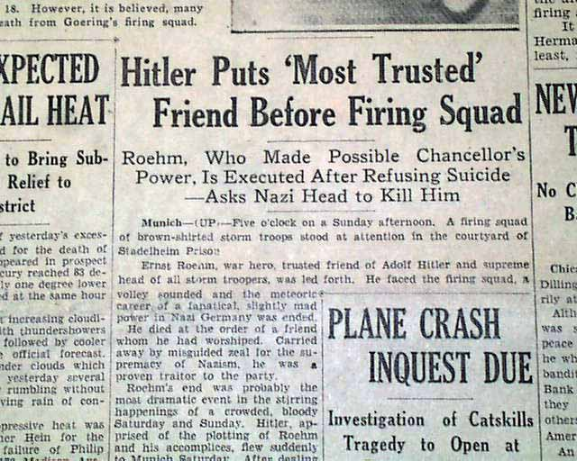
Consolidation
Use of Force
July 1934 Night of the Long Knives
Ernst Rohm and SA growing influence
SS told that SA is planning a coup
Rohm and 85 SA killed
Hitler hailed as heroric in time of emergency

Slide 10
Consolidation
Propaganda:
March 1933 – Goebbels becomes Minister of Propaganda and People’s Enlightenment
Newspapers – Nazis controlled to disseminate propaganda
Radio – becomes accessible to households, allows Nazis to reach broader audience
Film – Triumph of the Will 1934 Nuremberg Rally
Charismatic leader
Heil Hitler – reinforces cult of leader if all people greet in this manner
The forms of propaganda often build Hitler as the sole individual to save Germany

Slide 11
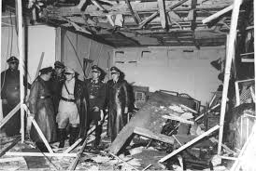
Consolidation
Treatment of opposition
Lawyers, teachers, judges, and other professionals had to sweat loyalty to Nazi state and become members of Nazi professional organizations
Concentration camps would be used to repress opposition → later turned into death camps
Small scale opposition – reading banned books (book burnings were all the rage)
Socialists distributed anti-Nazi propaganda
Munich University had organized opposition – responsible students executed
Several failed attempts at assassinating Hitler

Slide 12
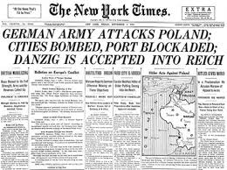
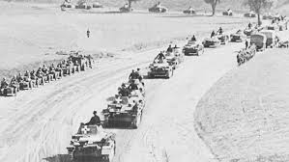
Consolidation
Foreign Policy
Jan. 1934 – Non-aggression pact with Poland
July 1934 – Austrian Nazis assassinate Chancellor Dolfuss and call for unity of Nazi states (Anschluss)
Between March and Jun 1935 – Luftwaffe formed, conscription started 750,000 strong army; and 35% Naval agreement with Britain; clear violation of Treaty of Versailles.
March 1936 – invades Rhineland, no action against from France or Britain
July 1936 – supports Franco in Spanish Civil War – tests weapons, army resolve
Nov. 1936 – Anti-Comintern Pact Germany, Italy, Japan
March 1938 – German troops sent to Austria to force Anschluss
May – Sept 1938 : Hitler eyes Sudetenland claiming Germans abused; France and Britain (appeasement) allow transfer by Octoboer
May 1939 – pact of Steel with Italy
Aug 1939 – Molotov-Ribbentrop Non-Aggression Pact with Soviets to split Poland
Sept. 1939 – Germany invades Poland, WWII begins

Slide 13
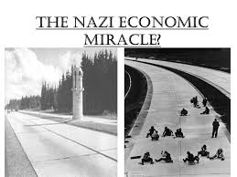
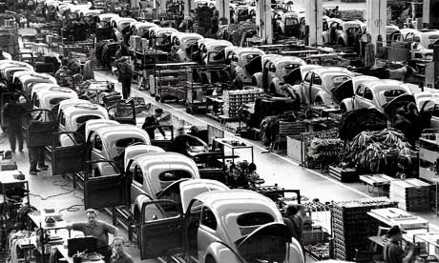
Aims of authoritarian state
Economy
Reduce unemployment (Great Depression, hyperinflation, Treaty of Versailles)
State run public works projects – Autobahn
Remove Jews from employment
Very limited unemployment by 1939
Expand Military
Industrial fuel of militarism – armaments and supplies – creates economic boom
Regain lost territory
Regain industrial heartlands lost to Treaty of Versailles

Slide 14
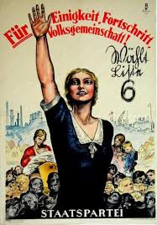
Aims
Social
Volksgemeinschaft (people’s community) build classless society by replacing individual liberties with securing of greater good – the will of the people
Youth – Hitler Youth – Camping, outdoor activities, strengthen young males into warriors and young females into housewives
Education – Nazi controlled textbooks and ideologies pervasive, teachers must join Nazi unions, purges of teachers who went against curriculum
Racially homogenous – Aryan, Nordic Volk

Slide 15
AIMS
Political
Nazify all of Germany – Gleichschaltung
“Coordination”
Bans socialism/communism
Bans political parties
Totalitarianism and return to strong central government like Prussia
Cultural
Promote Nazi ideals and ideology
Family life, blood and soil
Book burnings – fire
Literature – peasant life glorified

Slide 16
Impact on women and minorities
Women
Returned to traditional values
Law for Encouragement of Marriage – new married couples given 1000 mark loan
Women could also bear children for the state – Lebensborn – end goal, raise the birth rate
Minorities
Elimination from German society
Deportation to work camps
Concentration camps
Holocaust
Jews 6 Million
Poles 1.8 million*
Soviet citizens 7 million*
Serbs 312000
People with disabilities 250,000
Roma (Gypsies) 220,000
Total including Prisoners of War: 18.5 million

