Slide 1
Mao - China

Slide 2
Authoritarian States content
Emergence of Authoritarian States:
Conditions in which authoritarian state emerged: economic factors, social division, impact of war, weakness of political system
Methods used to establish authoritarian state:
Persuasion and coercion, the role of leaders, ideology, the use of force, propaganda
Consolidation and maintenance of power:
Use of legal methods, use of force, charismatic leadership, dissemination of propaganda
Nature, extent, and treatment of opposition
The impact of the success and/or failure of foreign policy on the maintenance of power

Slide 3
Authoritarian states content
Aims and results of policies:
Aims and impact of domestic economic, political, cultural, and social policies
The impact of policies on women and minorities
Authoritarian control and the extent to which it was achieved

Slide 4
Emergence of Mao
Long Term
Qing Dynasty losing power
Opium Wars
Unequal Treaties
1824 Treaty of Nanking opens ports, Hong Kong ceded
1858 Treaty of Tientsin free travel to internal China, 10 more ports open, 4 embassies
First Sino-Japanese War – loss of Korea as vassal 1894-95
Boxer Rebellion 1898-1900
Anti-imperialist, anti-western
Chinese Revolution - 1911
Sun Yat Sen - Nationalists
Warlord Period – 1916-1928
1919 – Treaty of Versailles – German territorial claims in China given to Japan
1921 First National Congress Shanghai – formation of Communist Party in China
Short Term
1925 – Sun Yat Sen dies, replaced by Chiang Kai-shek
Northern Expedition – defeat warlords (Communists and Nationalists together)
1927 Shanghai Massacre
1927-1949 Civil War Nationalists vs Communists
WWII – power of Communists in peasant regions
Civil War restart –
Long March and Mao’s role
Nationalists eventually lose out
Mao’s prominent role in Civil War catapults him to lead the newly established People’s Republic of China - 1949

Slide 5
Methods to Establish Authoritarian State
Persuasion and Coercion/Role of Leader
Mao’s efforts during Civil War cement his relationship with peasant classes
Long March – Mao’s choices during march prove he is best to lead – (Zhang (rival of Mao) choice to go West, instead of North)
Distrust of “urban red” – communists from cities
Their lack of understanding of the peasant class causes Mao to force them from the party
Post Civil War – Mao attempts to agree to peaceful end to Civil War with Chiang

Slide 6
Methods to Establish
Ideology
Marxism-Leninism
Peasant class vital to revolution
Collectivization, land redistribution, modernization
Centralized Democracy – CCP represents the will of the people
The Use of Force
See Civil War
Hundred Flowers Campaign – Let 100 schools of thought contend…then crack down against opposition
Re-education/rehabilitation of opponents and urban intellectuals

Slide 7
Methods
Propaganda
Think of the Chinese Posters activity
Posters abounded, images of Mao (establishing Cult), collectives, happy Communists
Little Red Book of Mao quotes
Control of media and education (We learned to write Mao’s name before our own)
Film, theater, and arts focus around revolutionary topics over individualism

Slide 8
Consolidation and Maintenance of Power
Use of Legal Methods
As leader of CCP, Chairman Mao implements campaigns
Hundred Flowers Campaign
Cultural Revolution – 4 olds campaign
Five Year Plans
Use of Force
Party Purges or rehabilitation – Liu Shaoqi, Lin Biao, Deng Xiaoping
Especially true during Great Proletariat Cultural Revolution after being pushed aside
Propaganda teams, struggle sessions, destruction of 4 olds

Slide 9
Consolidation and Maintenance of Power
Charismatic Leadership
Cult of Mao
Held charisma naturally from Civil War, Long March, WWII efforts
Little Red Book of Mao Quotes
Mao Thought – his political stances
Propaganda
Ever present
Rehabilitation campaigns
Cultural Revolution
Media, film, music, theater, all directed towards Communist hero

Slide 10
Consolidation and Maintenance
Nature, extent, treatment of opposition
Post Civil War – cleansing of those with Nationalist ties 1950-51
3 Anti and 5 Anti campaigns 1952-1953
3 Anti – embezzlement, waste, bureaucracy to be eliminated
5 Anti – bribery, tax evasion, theft of state property, stealing economic info, and cheating on gov’t contracts
Hundred Flowers Campaign 1956
Seeks to identify those with counter revolutionary thought
Anti-Rightist movement follows initial liberalization
Capitalist Roaders – Great Leap Forward and Cultural Revolution
Identified by Mao as those who supported Capitalist economic forces
Rehabilitated or purged – Deng Xiaoping, Liu Shaoqi, Lin Biao
Forced Labor camps similar to Soviet gulags (Laogai)
Struggle Sessions – admit to crime in front of public

Slide 11
Consolidation and Maintenance
Foreign Policy
Korean War – 1950-1953
Chinese communists support N. Korea through ground troops
Invasion and occupation of Tibet (1959) – revolutionaries overthrown
Border clashes with India (1962), Vietnam (1979)
Worsening relations with Soviet
Post Stalin’s 1953; death destalinization by Khrushchev - also atomic bomb – Sino-Soviet Split
Self-sufficiency was goal of domestic policies – foreign trade limited to USSR or other communists
Ended relationship with U.S.
Revitalized 1972 Nixon visit – we use as triangle diplomacy (putting pressure on USSR through China)

Slide 12
Aims and Results of Policies: economic
Goals – catch up to the West in levels of development
Means:
Land reform: 300 million farmers granted 47 million hectares of land (1 hectare = 10000 sq m of land)
5 Year Plans
1953-1957
Expansion of Industry – mining, cars, rail, steel, iron ore, etc.
Income increases 8.9% per year

Slide 13
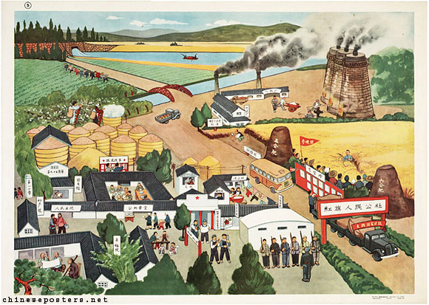
Aims and results: Economic
Second Five Year Plan (AKA The Great Leap Forward) 1958-1963
Goal – propel China to level of Western development
Agricultural reform – Communes and collectivized farm (5000 people per)
1958 700 million people on 26,500 communes
Propaganda and loud speakers would encourage work for the Chinese people!
Industry and agriculture work hand in hand
Backyard furnaces created for increased steel production
Famine 1960 – 9 million thought to starve to death
Rationing 1959-1962
Mao steps aside

Slide 14
Aims and Results: political, cultural, social
Great Proletariat Cultural Revolution
Mao returns 1966-1976 (death) to return to basic tenets of revolution! Anti-Rightist campaigns ensue
Red Guard – student groups – oppose authority
4 Olds Campaign – old habit, old beliefs, old customs, old ideas
Including party members! Lui Shaoqi – moving down the “capitalist road”
Goals – create classless society
Social goals – condition devotion to state and communist party over rightists and capitalism
New Democratic Youth League (14-25 year olds) Children’s Pioneer Corps (9-14 year olds)
Thought Reform Campaign 1951 – intellectuals study communist thought, art themes are now class struggle and CCP

Slide 15
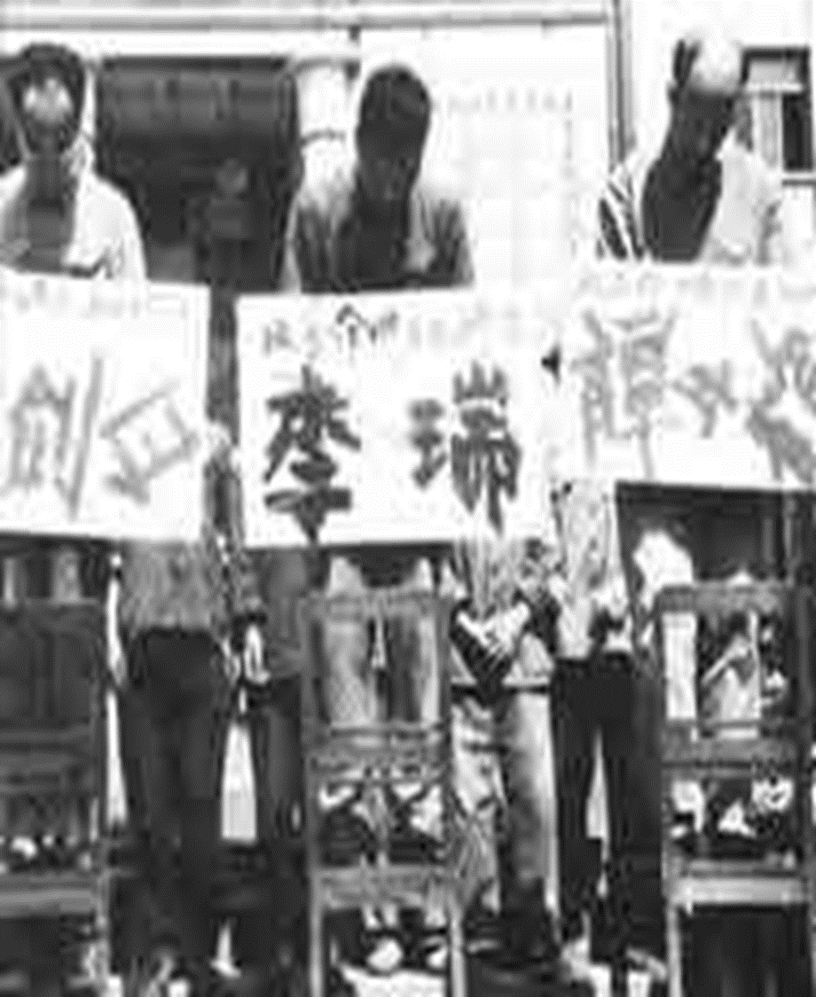
Impact on Women and Minorities
Minorities – Non Han Chinese (Tibetans, Mongols)
Party knows what is best for minorities
Initial promises for self-rule or independence, then shift to autonomy (see Tibetan Revolution and Occupation by China)
Cultural Revolution shifts this towards repression
Forced labor camps for political minorities/political opponents
Numbers dead estimated at 40- 60 million

Slide 16
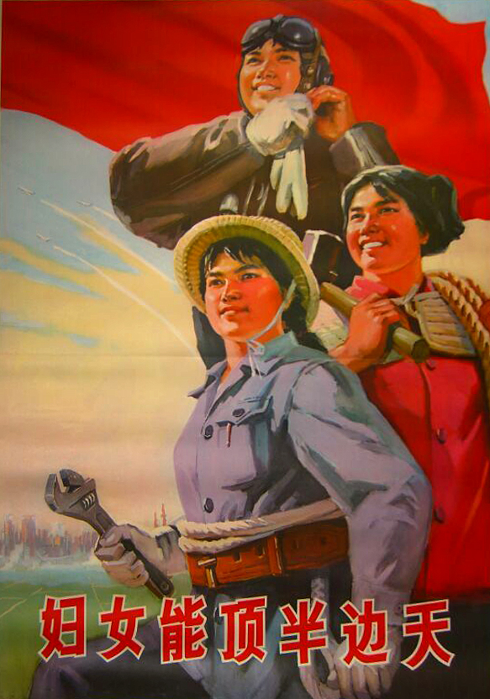
Impact on women and minorities
Women: feudal role; Confucian role. No education, limited social activities; inferior to men; no property or inheritance rights..etc.
1949 Ends feudal system and gives women equal political, economic, social rights
1949 ban on prostitution
1950 Marriage Law abolition of feudal marriage system; divorces/annulments ensue.
Land reform applies equally to women
Universal voting 1953
1957 – 70% of rural women and 3.2 million urban women working (increase 5 fold from 1949 levels)
Illiteracy eradication campaigns target women starting in 1950-1956. By 1968, 16 million had learned to read.

