Slide 1
Authoritarian States
Paper 2 Topic 3
Hitler, Stalin, Mao

Slide 2
Political Ideologies
Left | Right
Progressive; Radical | Reactionary
Optimistic view of human nature | Pessimistic view of human nature
Equality as social imperative | Equality as impossible goal and pursuit socially disruptive
Rejection of the past | Respect for the past
Belief in future | Lacks confidence in future
History predetermined | History contingent upon play of events
Alienation from society | Society is accumulated, lasting values
Change is essential | Change is disruptive
Perfectibility of society through revolution | Humans incapable of social perfection
Ideological | Suspicion of ideology
Lack of realism | Rooted in realism
Socialist | Conservative
Compromise = weakness | Compromise preserves social stability
Right wing –reactionary (opposed to change), conservative
Left wing – radical (change at roots of society), revolutionary
Create a T-chart. In small groups, decide what characteristics constitute the typical attitude of a left-wing and right-wing individual.
Views of human nature
Is equality attainable?
How do we view the past?
Is change good for society?
How do they view ideology? Realism? Compromise?
What can the future bring?
Social perfection?

Slide 3
Political Ideologies
As we study the authoritarian states keep these questions in mind:
Are the ideological characterizations accurate?
Is there overlap in practices of ideologically opposed societies?
Does the use of broad generalizations aid in our investigation of or hinder our understanding of the past?

Slide 5
Political Ideologies- Terms
Socialism – typically understood to mean government action on the structure of society and the economy
Communism – Karl Marx – history is class struggle; utopian idealism; common ownership of the means of production and lack of social class and state
Nationalism – devotion to the interests and culture of one’s nation
Nazism – National Socialism in Germany from 1933-1945
Fascism – ultra-nationalist party within Italy, but broadly applied to far right wing totalitarian regimes (Nazis)
Democracy – a system where power rests with the governed
Liberalism – greater freedom of the individual from gov’t control
Authoritarianism – where power rests with a group of people or a person without subjection of decision to a power below themselves
Totalitarianism – an extension and intensification of authoritarianism that includes a monopoly of powers

Slide 6
Misconceptions and their impact
Cultural norms dominate our understanding of terminology
Democracy
West – truest form of individual power; largely based in power to vote.
East – truest form of group power; largely based in equity in relationships within society. (remember democratic centralism)
Socialism
West – defame as totalitarian in means and end
East – proselytize to gain moral appeal in developing world

Slide 7
Content for Authoritarian States
Emergence of Authoritarian States:
Conditions in which authoritarian state emerged: economic factors, social division, impact of war, weakness of political system
Methods used to establish authoritarian state: persuasion and coercion, the role of leaders, ideology, the use of force, propaganda
Consolidation and maintenance of power:
Use of legal methods, use of force, charismatic leadership, dissemination of propaganda
Nature, extent, and treatment of opposition
The impact of the success and/or failure of foreign policy on the maintenance of power

Slide 8
Content for Authoritarian States
Aims and results of policies
Aims and impact of domestic economic, political, cultural, and social policies
The impact of policies on women and minorities
Authoritarian control and the extent to which it was achieved

Slide 9
Emergence of Stalin
Short Term:
War Communism 1918-’21 – central planning of economy during Civil War under Lenin
Kronstadt rising March 1921 – Lenin’s failure in economic policy
New Economic Plan (NEP) 1921 – movement towards capitalism
Lenin – Communism viable through peasants (skip capitalist stage); internationalist (Trotsky)
Lenin bans factions in party 1921- democratic centralism (votes on matters would occur, once voted on, whole party must be behind decision)
1922 Lenin falling ill; 1924 dead – Testament (Stalin is not to be trusted) Trotsky “missed” funeral; Zinoviev, Kamanev and others vote not to release testament to public
Stalin – administrative positions within party – General Secretary
Triumvirate succeeds Lenin – Stalin, Zinoviev, Kamanev
Many underestimate Stalin’s political wherewithal
As General Secretary Stalin oversaw party membership and positional appointments – meaning he could place people into positions of authority → voting on matters of importance would go his way
Stalin uses ban on factions to defeat opposition groups
Left opposition – Trotsky, Kamanev, Zinoviev defeated first → change in ideology Socialism in one state vs. internationalism
Right defeated next – Bukharin and supporters of NEP (NEPmen, Kulak class) targeted by Stalin as opponents of the party and the people
Long term:
Russian Empire failing – loss of Russo-Japanese War 1905
Nicholas II a very weak, ineffective leader
1905 Revolution – Priest Gapon leads workers strike to Winter Palace; massacre occurs (Bloody Sunday)
Nicholas responds with state Duma (Legislative assembly), which holds limited power → short term placation of population
Growing middle class (still extremely small)/educated class calling for reform
World War I – Russia losing war, rationing of food causes unrest, mutinies and desertion rise
Russian Revolution 1917 – Feb (see above for why) March 15 Nicholas abdicates throne (family killed)
Russian Revolution 1917 – July Days – Provisional Government (Kerensky – Menshevik) vs. Petrograd Soviet (Lenin and Trotsky) vying for official power in Russia
Russian Revolution 1917 – October – Bolsheviks only organized party against Provisional Gov’t (PG), which promises to remain in WWI for land grab if victorious. Lenin and Bolsheviks revolt Oct. 25 against PG and replace with Soviets
Russian Civil War – Reds vs Whites. Lenin “Peace (Treaty of Brest-Litovsk 1918 ends WWI for Russia) land (agrarian reform) , bread 1922 Civil War over

Slide 10
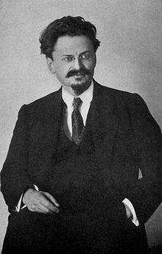
Consolidation of rule
Ideology
Internationalism vs Socialism in One State
Major goal of Bolsheviks and Communists was encouraging revolution on global scale
Stalin views this as counterproductive, especially as war looms on horizon
Socialism in one state would, by design, bring the USSR to self-sufficient levels of economic production in Agriculture and Industry
USSR needed this to catch up to the West
Centralized state, no parties or factions (banned by Lenin), democratic centralism
NEP vs 5 year plans (NEPmen, Kulaks)
Paranoia
Use of force/Treatment of Opposition
Gulags and show trials
Kirov Affair – 1934
The Great Terror/Purges – Trial of 16 (‘36), Trial of 21 (‘38)
Assassinations/executions of political opponents (Trotsky, Kirov, Zinoviev, Kamenev, Rykov, Bukharin)
CHEKA (Lenin), NKVD, then KGB
Spying on political opponents and citizens leads to greater repression of thought against Stalin
Notes:
Trotsky – internationalism, leader of left opposition to Stalin: does not foresee Stalin’s power within the political structure. Is eventually exiled, assassinated in Mexico.
Kirov – Leader of Leningrad party structure, seen as greatest threat to Stalin. Assassinated on streets outside of his office. Stalin uses the assassination within the show trials against later political opponents.
Zinoviev and Kamenev – join left opposition after initial involvement in the Triumvirate with Stalin. Both are executed.
Rykov – Right opposition, NEP supporter, Bukharin supporter

Slide 11
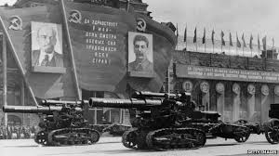
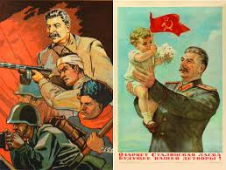
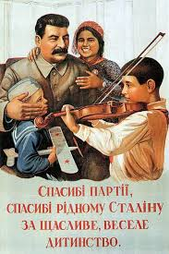
Consolidation of Rule
Propaganda
Trotsky eliminated from photos
Books edited to include more about Stalin
Lies about Stalin’s roles in the Revolutions and Civil War
As Lenin’s right hand man, then Stalin in foreground as leader
In text showing changes to Communist philosophy, demonstrating Stalin first as tutor, then as successor to state leadership role
Posters, songs, books, Pravda (“Truth”, Newspaper)
National Anthem
Flag (hammer, sickle union between rural and urban society)
Cult of Personality/Role of Leader
Manufactured charisma
Stalin did not have leading roles in Revolution, Civil War
Propaganda
People see Stalin as omnipresent, omnipotent

Slide 12
Consolidation of Rule: Foreign POlicy
Aims:
Soviet Union behind the rest of the world (50-100 years, according to Stalin)
Modernize and industrialize: capitalism vs communism threat
Methods:
Collective Security (Hitler 1933, Japan 1931) encroaching on Soviet power
1932-33: Non-aggression pacts with France, Italy, Poland
1934 – Join League of Nations; worsening relations between USSR and Germany
1936 – Stalin supports Republican in Spanish civil War against Hitler’s Nationalists support
1938 – 1939 - Hitler invades Czech lands; USSR, UK, France talk about mutual alliance against Hitler
1939 – Failure of collective security leads to Molotov-Ribbentrop Pact – treaty of non-aggression between Germany and USSR.
1939 – Anti-Comintern Pact between Germany, Japan, Italy signed- pact against the Communist world
1939 – Poland invasions: Germany West, Soviets East.

Slide 13
Foreign Policy Overview
Successes: German, Soviet Non-aggression allows Stalin to industrialize and revamp military production; Buffer zone (Poland) gained.
Failures: Collective security with West. Pact between Germany/Soviets could be argued to start WWII.

Slide 14
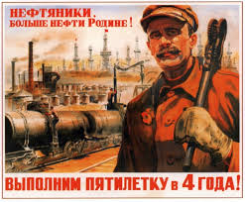
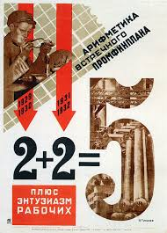
Aims and Results: Domestic Policies Economic
NEP
Ended NEP because of rising social divisions (NEPmen, Kulak class)
Begins forced collectivization of agriculture/industry
5 Year Plans
1928-1932 Focus on industrial growth – successful expansion
1933-1937 further expansion of rail, iron, steel to become self sufficient (Stakhanov)
1938-1942 “Move to full blown Communism” “Disrupted because of German invasion”
Agricultural growth –
widespread famines initially because of confusion of collectivization
Forced Collectivization – kolkhoz (collective farms) formed – those against labeled kulaks and are purged from society
By 1935, agricultural production surpasses pre-collectivized levels
25 million small family farms recommissioned into 200,000 kolkhoz
Surplus sent to cities, exported to “catch up to West industrially” → import necessities for industrial growth

Slide 15
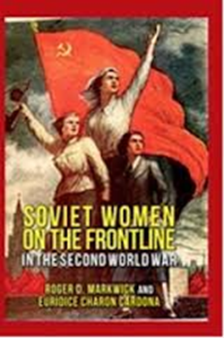
Aims of policies: Domestic Policies
Women
Family Codes – legalize civil marriages, divorce, abortion, educational equity grows
1918 – Women equal under law, legal status to civil marriages, no grounds divorce allowed – “withering away of family to be replaced by free unions based on mutual love and respect…” Goikhbarg
1926 – De facto marriage (cohabitation) recognized, alimony increased for divorced family
1936 – Stalinism – focus on family and replacing withering away principles, encourage pregnancy and child birth – elevation of motherhood to Stakhanovite levels
AS WWII approaches, a return to traditional family values returns and family codes are tightened
Reward women for large families, encourage women to work – men at war
No real change in domestic positions under Stalin, despite initial laws meant to change
Minorities
Russification of minority populations
Religious centers converted, wealth devoted to state
1.5 million ethnic minorities also forcefully deported to Central Asia republics – Crimean Tartars, various Turkish groups (Muslims, oftentimes)

