Slide 1
Nazi Germany - Emergence

Slide 2
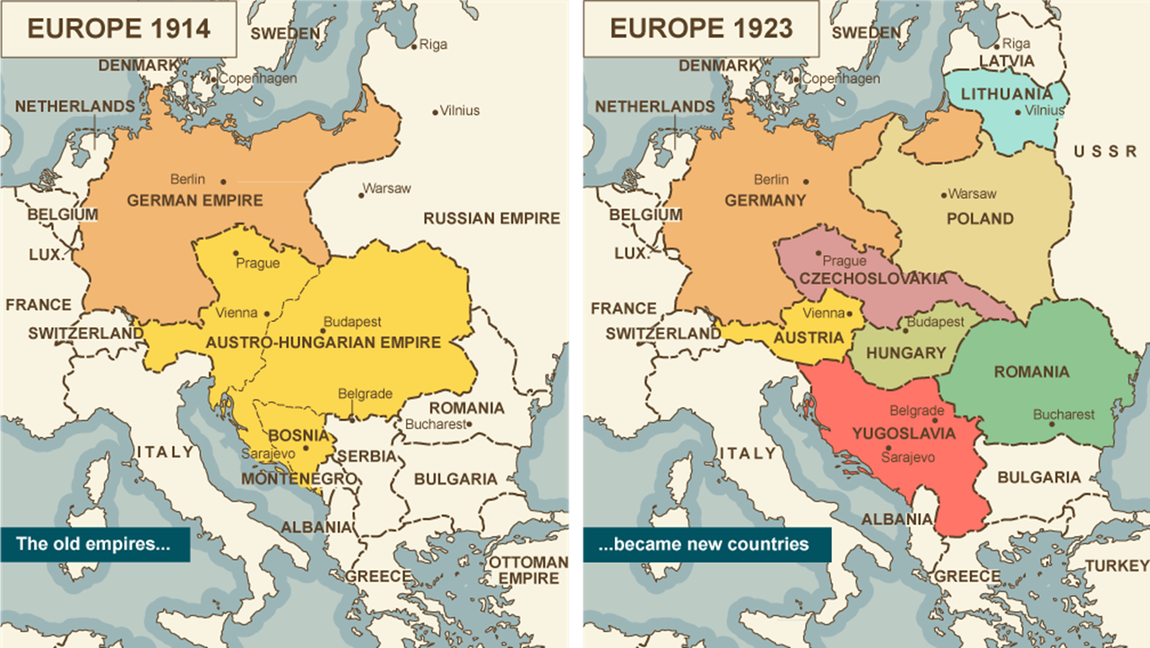
German Empire
German Unification 1871
Previously, a collection of various kingdoms, free cities, duchies, and other governing systems.
Late arrival as a powerful, unified nation-state and late to the colonial scene – will grow to third largest colonial state
41 million people to 68 million by 1913
Rapid industrialization and urbanization from 1850 onwards
1880 – 1913 German share of world trade increases 17.2% to 26.6%
Manufacturing and steel outstrip UK for top place globally
Involvement in WWI leads to collapse of German Empire via the November Revolution (German Revolution) of 1918.
Replaced by the Weimar Republic August 1919.

Slide 3
Impact of War
WWI- Abdication of Wilhelm II
Replaced by Weimar Republic and the Weimar Constitution
Armistice Day 11/11/1918 – 11th hour of the 11th day of the 11th month.
Many Germans felt upset by this decision; Nazis would use this to establish the myth that the Germany was winning the war and was “stabbed in the back.”
Treaty of Versailles set the terms of surrender

Slide 4
Treaty of Versailles
June 28, 1919
War Guilt clause – Germany takes sole responsibility (for their allies, too) of damages and losses
Disarmament – 100,000 man army and significant prohibitions on military equipment/arms trade
Mandates – all colonial territories ceded to League of Nations mandates (or otherwise ceded – Chinese territories to Japan – May 4th Movement)
Reparations – 20 billion marks ($5 billion)
Territorial loss – 13% of European territory, 1/10 of its population, locations of heavy industry and economic production
For a specific list, see map in Kognity
Hitler and Nazis would consistently refer back to these terms as unfair and the cause of economic despair in Germany

Slide 5
German Territorial Losses (Europe)

Slide 6
Weakness Political System – Weimar Republic
Proportional Representation in the Reichstag (parliament)
Number of seats held by a party or group in the Reichstag determined by the number of popular votes received
No one party could hold a majority in the Reichstag, as there were not enough votes to do so
Coalition governments form, requiring many compromises between various parties and policies

Slide 7
Weimar Structure

Slide 8
Weimar Republic
President – elected by popular vote by the people (von Hindenburg 1925-1934)
President’s role changes over time – b/c Reichstag was ineffective in generating legislation the president began to use emergency powers to issue decrees
President could: appoint chancellor to the Reichstag and cabinet and dismiss them (1919-1926 there were 8 different chancellors)
Could dissolve the Reichstag and call for new elections (1930, 1932, 1932) often in times of political impasse
Commander in Chief powers could be used to suspend constitution and rule by decree via Article 48 of the constitution
President von Hindenburg will make use of the article but would always cede power back to the Reichstag
Article 48 will be deployed in the Nazi rise to power, as successive Chancellors use the tactic to govern

Slide 9
Descent into Authoritarianism

Slide 10
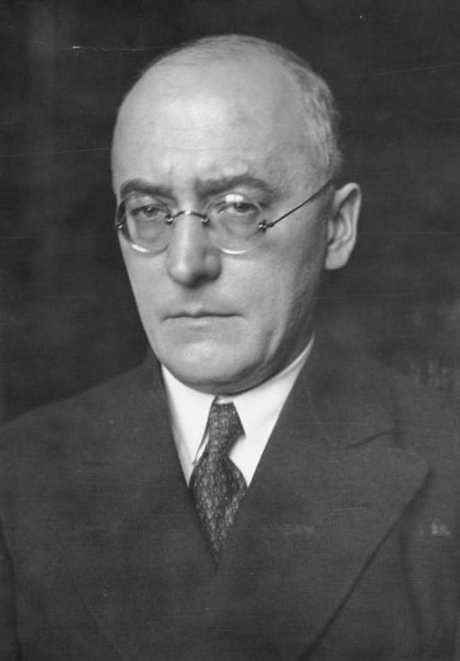
Brüning
1930-1932 – Great Depression
policies of credit restrictions/benefits restrictions
land redistribution made him increasingly unpopular
begins to use “presidential government” by issuing decrees via President Hindenburg – who eventually refuses to issue decrees due to their unpopular nature
replaced by: von Papen

Slide 11
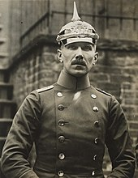
von Papen
von Papen: May 1932-Nov. 1932; (Vice-Chancellor to Hitler ’33 - ‘34);
only far-right parties committed to serving/voting as his cabinet was largely aristocratic or industrialists;
Very little accomplished as Reichstag does not vote
replaced by: von Schleicher

Slide 12
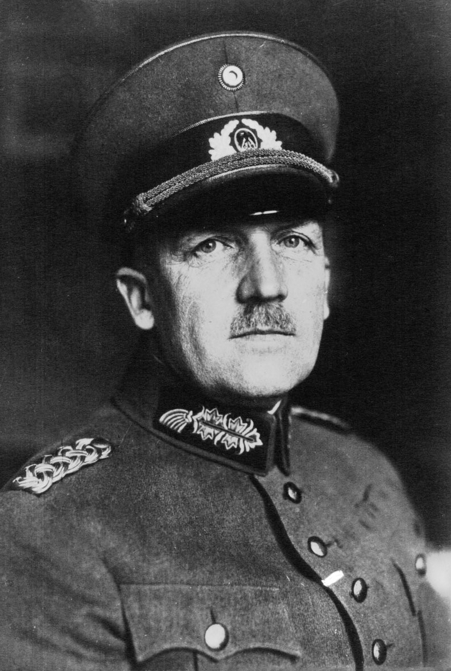
von Schleicher
von Schleicher: Dec. 1932-Jan. 1933;
Despite a large public works project being initiated that brought 2 million jobs, von Papen and Hitler worked tirelessly to convince Hindenburg that Schleicher’s government would fail to work;
von Papen continues to try to convince Hindenburg of Hitler’s ability to unite the country;
Hindenburg refuses decree powers to Schleicher, rumors swirl that Schleicher is attempting a putsch…replaced by: Hitler: Jan 1933-April 1945

Slide 13
Social Division
Germany was advanced capitalist/industrial country
Main social division was based in class
Minorities were still treated poorly
Junker –landowning Prussian
Military elite held political power – Bismark’s consolidation of German people into the German state
Anti-Socialist laws until 1890’s limited worker power
Social Democratic Party does become largest party in Reichstag by 1914, though.

Slide 14
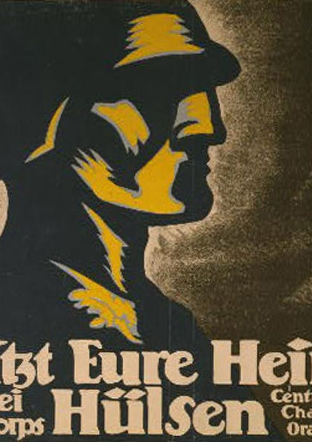
Social Division: Coup Attempts
Spartacus Rising (Jan 1919) – German Communists attempting to recreate the Russian Revolution; freikorps called in to defeat them
Freikorps – paramilitary anti-communist group – many ex-military from WWI; later assassinate some members of the Weimar Republic
Kapp Putsch (March 1920) – freikorps refusing to disband, 12000 men marched on Berlin and appointed Dr. Kapp as Chancellor; a general strike by workers ended the attempt at establishing a new government → Freikorp disbanded; many later join SA and SS.
Beer Hall Putsch (Nov 1923) – March on Munich; 200 NAZIs march on military base in Munich, where police open fire; Hitler arrested

Slide 15
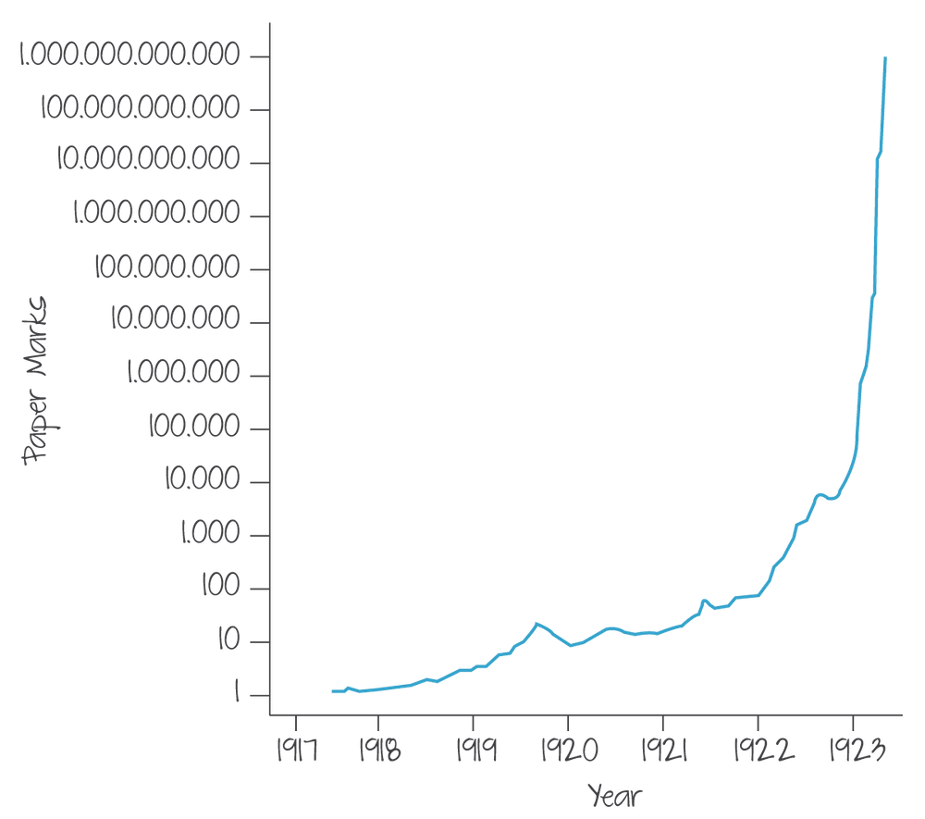
Economic Factors
Ruhr Crisis – after a failure to pay reparations, France and Belgium occupied the Ruhr – a key industrial production area for Germany
German gov’t encourages passive resistance
Workers strike; Gov’t prints money to meet their needs → Hyperinflation

Slide 16
Dawes (1924) and Young Plan (1929)
Dawes Plan – US Loans money to Germany to pay reparations; France, Belgium remove troops from Ruhr
$2 Billion loan; $1 billion to reparation, other invested in economic growth and capital goods
Young Plan – reduction of reparations amount and payments spread over 59 years
Both plans reinforce Germany’s commitment to abiding by Treaty of Versailles

Slide 17
Stock Market Crash
Gov’t cannot agree on how to address crisis
Spend without raising taxes → But where do we get the money?
Lack of demand for German goods, lack of faith in providing Germany a loan
Dawes and Young plan were short term loans – by 1931 they were ended
Nazis begin to gain seats in the Reichstag throughout this tumultuous period:
March 1924 – 6.7% of votes; December ’24 – 2.9%; May ’28 – 2.6%; Sept ‘30 – 18.3%; July ‘32 – 37.3%; Nov ‘32 – 33.1%

