Slide 1
Imperial Japan
Paper 1: Assess the origins of Japanese nationalism and militarism

Slide 2
Move to global war workbook
Pages 18-51
Reading days – 6 (not including meeting days) (due 1/19 or 1/20)
Pages 55-96
Reading days – 6 (not including meeting days) (due 1/30 or 1/31)
Will do a sample Paper 1 from the Chapter Activities throughout.

Slide 3
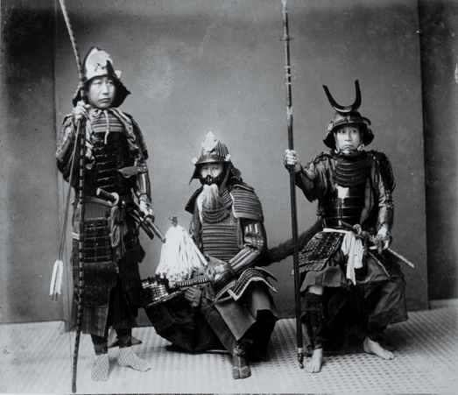
Pre-1868 japan
Feudalism – agricultural, weak military
Strict hierarchy of classes – hereditary
Tensions between classes
Merchants do not wish to give money to Samurai
Tensions between parts of the daimyo
Feudal lords from around Japan
Shogun – most powerful daimyo
Lacks central tax, national army, heavy isolationism

Slide 4
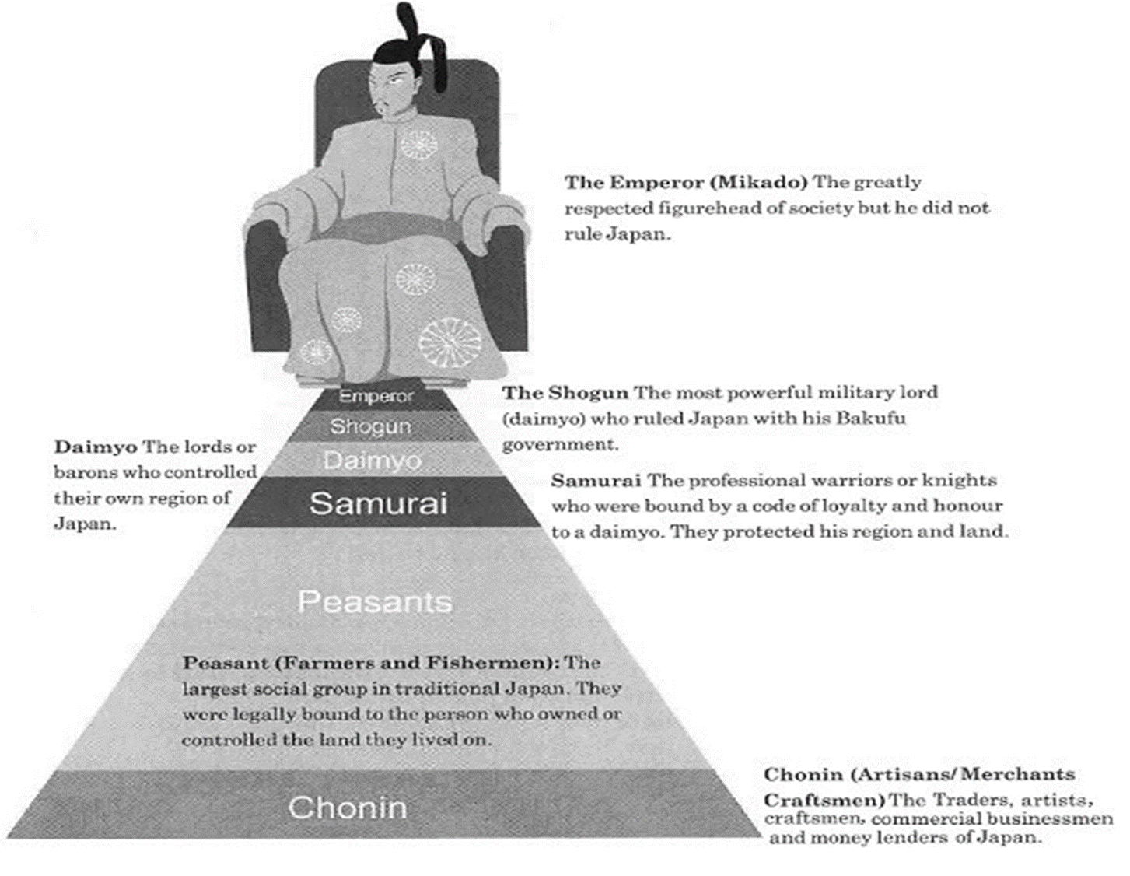

Slide 5
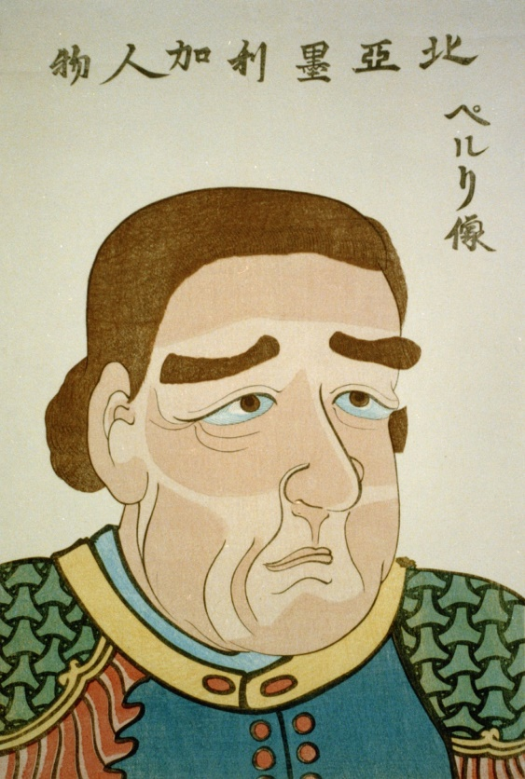
pre-1868 japan
1853 – US Commander Perry arrives to Japan with the intention of opening Japan to US trade
US “black ships”
What happened when China attempted to resist? (Opium Wars)
Japan forced to sign humiliating treaties (similar to those of China; aka unequal treaties)

Slide 6
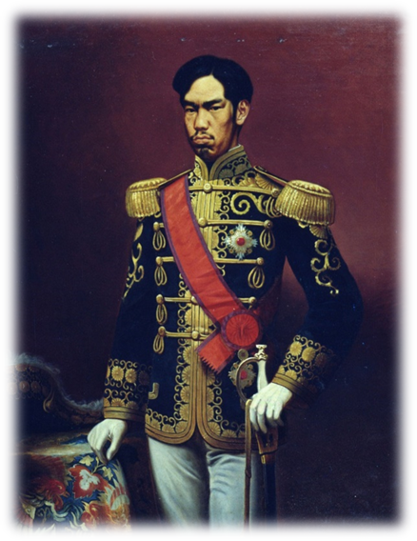
1868-Meiji (May-G) Restoration
New emperor Meiji wants modern/civilized country
Reformers unify under the phrase “rich country, strong army”
Japanese nationalism = Western Ideas + Japanese culture
Western ideas
National army – conscription
End hierarchy system
Mass education
Economic privatization – Zaibatsu – huge corporations

Slide 7
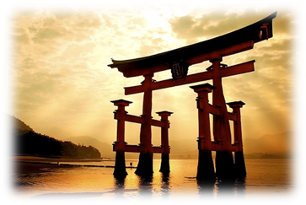
1868 – Meiji restoration
Japanese Culture + Western Ideas
Japanese Culture
Emperor Worship – divine origin, descended from the Sun goddess
Reintroduction of Shinto as state religion
Remained unconquered by foreign powers – repelled Mongols
By 1905, only non-European power to defeat a Great Power – Russo-Japanese War

Slide 8
Coal production in japan 1875-1913
Period | Coal production (metric tons)
1875 | 600,000
1885 | 1,200,000
1895 | 5,000,000
1905 | 13,000,000
1913 | 21,300,000

Slide 9
Size of Japanese merchant fleet 1873-1913
Period | Number of Steamships
1873 | 26
1894 | 169
1904 | 797
1913 | 1514

Slide 10
Road mileage in japan 1873-1913
Period | Track (miles)
1872 | 18
1883 | 240
1887 | 640
1894 | 2100
1904 | 4700
1914 | 7100

Slide 11
Modern Japan and imperialism
The Strong Eat up the Weak
Social Darwinism
Japan needs an empire to survive, or will be eaten up
Ex. China and humiliating treaties
Japan would turn to Asia to “eat up”
“Throwing off Asia”

Slide 12
From “On throwing off asia” by fukuzawa yukichi
We must not wait for neighboring countries to become civilized so that we can together promote Asia’s revival. Rather we should leave their ranks and join forces with the civilized countries of the West. We don’t have to give China and Korea any special treatment just because they are neighboring countries. We should deal with them as Western people do. Those who have bad friends cannot avoid having a bad reputation. I reject the idea that we must continue to associate with bad friends in East Asia.
So what exactly does Yukichi mean by throwing off Asia?

Slide 13
1882 – Imperial rescript
Emperor sends Imperial Rescript to Soldiers and Sailors.
Personal loyalty to the emperor
Avoid politics
Live simply
Respect civilians
Memorization required
‘Duty is weightier than a mountain, while death is lighter than a feather’.

Slide 14
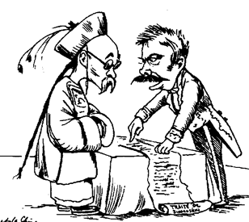
Review first sino-Japanese war
1894-95
Japan vs. Qing China
Korea ceded as territorial domain of Japan
Treaty of Shimonoseki
Japan gains Korea, Taiwan, Manchuria
Liaodong Peninsula given to Russia (Russia, Germany, France proposal)
Why?!

Slide 15
Impact of sino-Japanese conflict
“Affinities of race and culture between Japan and her colonial peoples…made possible the idea of a fusion of the two and suggested that ultimately Japanese colonial territories had no separate, autonomous identities of their own, but only a destiny that was entirely Japanese.” E.P. Tsurumi (historian)
Japanese empire
End unequal treaties
1902 defensive treaty with Britain against Russia (comes to play in 1905….)
Ultra-nationalism and racism in Japan
Japanization of people (kominka) through assimilation (doka)

Slide 16
Russo-Japanese War 1905-06

