Slide 1
Leading to the Revolution
Tsar you Ready to Learn?

Slide 2
Government in 1900
Patrimonial – inherited
Absolute monarchy
Hierarchical
Bureaucratic
Medieval

Slide 3
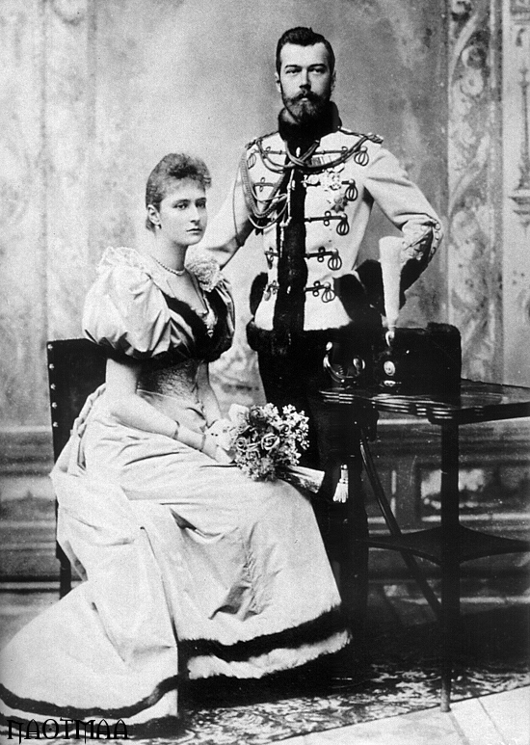
Government in 1900
Ineffective rule
Visited UK and US, saw democracy in action, refused to allow representatives in Russia
Khodynka Tragedy 1896 – festival celebrating coronation, 1,300+ people die rushing for free bread and free booze

Slide 4
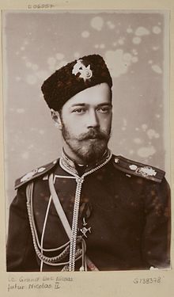
Government in 1900
Tsar (Czar) ruled in absolute monarchy
Russian Administration was to serve ambitions of the Tsar
Bureaucratic obedience led to promotion

Slide 5
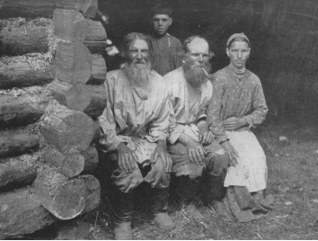
The People 1900
80% peasants
Limited private ownership
Serfdom existed until 1861
Promotion of nationalism for expansionist policies as population grows

Slide 6
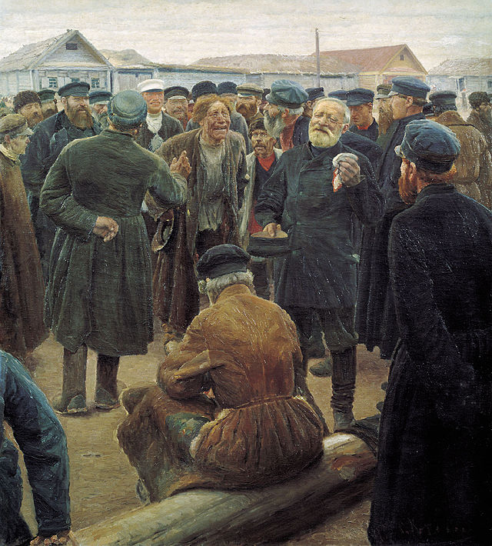
Village Structure 1900
The Mir (obshchina) – rural community of agricultural ownership
State would re-allocate land based on census information to ensure state tax was accurate
People hoping for reform of the system, for more private ownership, Tsar Nicholas does not come through
Allows revolutionaries to gather peasant support later
Obshchina Gathering, by Sergey Korovin

Slide 7
Leading to Revolution
Tsar was an incapable ruler, even losing a war against a new Imperial nation, Japan.
Much of society was strictly hierarchical, including the Mir and the government, to take power all you need was a change in power holders
Little democratic traditions in Russia
Peasants mostly concerned with Land Issues – not concerned with political rights, etc.
Absolute monarchy means absolute authority. The Revolution, then, seeks to focus the struggle on Tsar Nicholas and how to remove him from power.

Slide 8
Major Issues
Agrarian Problems – serfdom abolished, but no real shift in power for the peasant populations. Could not sell or mortgage, poor lands, and not given enough to survive on. Population growth outpacing agricultural production.
Nationality – Jews & Poles = people not to be trusted. Russification, 2nd half of 19th C.
Labor – new classes of individuals created with liberalization of the economy and expansion of industries in the late 19th C. Early 1900 industrial depression.
Educated class – student radicalism grows after reforms allow universities to be freer/more independent of gov’t influence

Slide 9
Revolution
Three Separate Revolutions

Slide 10
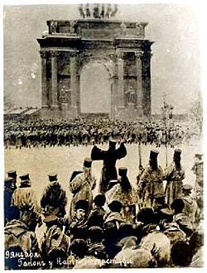
1905
War with Japan – army is away, cannot deal with internal conflict; lose and tsar is now weaker (or at least appears to be)
Growth of strikes pre 1900, Gapon, Russian priest concerned with worker conditions, creates Assembly; 1905 Jan 4 workers fired for Assembly membership/ties. Strikes throughout St. Petersburg
Jan 19 1905, meeting at “Gapon Hall” ends with petition to tsar – promote working conditions, fair wages, reduction to 8 hour work days; end Russo-Japanese War and bring universal suffrage.
Tsar was not at Winter Palace, 4,000 dead after confusion, panicked crowds. “Bloody Sunday”
People bitter with Nicholas’ troops and their callous nature, “we no longer have a Tsar.” abandoned by father figure.
http://en.wikipedia.org/wiki/Bloody_Sunday_(1905)

Slide 11
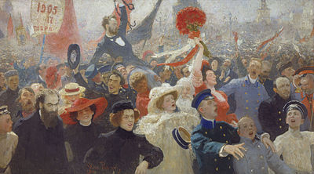
1905 Revolution
Liberal groups seeking limits on tsar’s power grow
Bloody Sunday – culminates in nearly 2 million workers on strike
Defeat in Russo-Japanese war – tsar’s power weakens
Oppression of Nationalities – Russification, Jewish pogroms
Agrees Feb. 18 to State Duma of the Russian Empire, but with limited power – people still upset.
St. Petersburg Soviet forms, Oct. general strike, refuse taxes, withdraw bank deposits
October Manifesto – civil rights, Duma as central legislative body, universal suffrage. Signed Oct. 30
Russian Constitution 1906 – follows October Manifesto and created Imperial Duma.
Ilya Repin, 17 October 1905
http://en.wikipedia.org/wiki/Russian_Revolution_of_1905

Slide 12
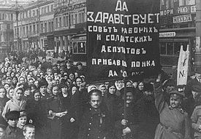
Why the 1917 Revolution?
Bloody Sunday and 1905 Revolution still relevant, problems not solved by Constitution
World War breaks out in 1914
Ineffective wartime leadership, poor weather and harvests, lack of food as it moves to front, inflation
Growing unrest with army’s losses, lack of bread, mutiny in local police and military begin tearing down the tsarist regime
Nicholas abdicates March 15
http://en.wikipedia.org/wiki/Russian_Revolution

Slide 13
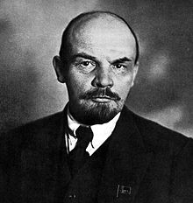
1917 Revolution Power
Provisional Government and Petrograd (St. Petersburg) Soviet of Worker’s Deputies – act as lobby for democratic principles
Losses on front, soldiers dissatisfied (being sent back to the front), calls for end to war, food and consumer product shortages
Lenin arrives…April 1917 with help of the Germans…no really
Bolsheviks (majority, also believed peasants could bring Marxist Socialist revolution) gain power and Mensheviks lose power (minority, Orthodox Marxism, backward Russian peasant society could not satisfy Revolution, must go through stages of bourgeois capitalism)
http://en.wikipedia.org/wiki/Vladimir_Lenin

Slide 14
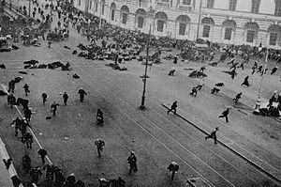
July Days
Bolshevik power swells, membership grows
Demonstrations against Provisional Government
“All Power to the Soviets” – rally calls provided by the Bolsheviks
Provisional Government arrests Trotsky, Lenin flees to Finland
Kerensky Prime Minister, Menshevik
http://en.wikipedia.org/wiki/July_Days

Slide 15
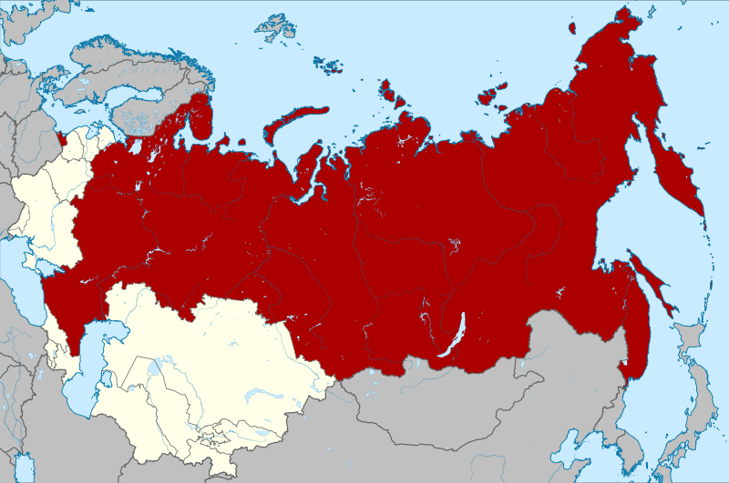
October Revolution
Bolsheviks remain only organized party opposed to Provisional Government
People still feel the government is not meeting their needs
Oct. 25, 1917 Lenin leads revolt against PG and replaces it with government by soviets
Red Army vs. White Army Russian Civil War 1917-1922, also included non-Bolsheviks, who could not hold power in soviets
Lenin Treaty of Brest-Litovsk March 3, 1918 ends Russian involvement in WWI
Soviet Union solidified 1922 after provisional pronouncements by Lenin Nov. 7 1917.
http://en.wikipedia.org/wiki/Russian_Socialist_Federative_Soviet_Republic

