Slide 1
China - Mao
20th C History

Slide 2
Conditions in which the state emerged (Late 1800’s – 1949)
Qing Dynasty 1644-1912 (Pu Yi – born 1906 - last Emperor)
Held onto to Confucian Examinations for bureaucratic administration
Height 18th C and steady decline
Imperialism and influx of outside forces exacerbated the internal conditions

Slide 3
Economic conditions – Qing Mid-1800’s-1912
Population soars
Mid-1800’s 450 million people (3x that of 1500)
Land shortages, famine, impoverished rural population
Heavy taxes – through extralegal means
Inflation
“Greedy local officials”
1/10 of land in China arable
Farmers had average of 3 acres, though many had as little as 1 acre

Slide 4
Economic Conditions –Warlord Period 1916-1928
Various Warlords controlled part of China following the collapse of the Qing Dynasty
Cliques and interwarlord struggles for complete control of China dominate the era
Taxes and opium sales fund these wars

Slide 5
Economic Conditions – KMT 1926-1949
Growth in industrial output and GDP throughout (Downturn of 1930’s)
28.8 Billion 1932; 21.3 1934; 23.7 1935
Rural economic gains bare
Increase in production, oversupply, rural income decreases 57% in some regions from 1931-34
WWII impact –
Major setbacks; industries operating at 20-25% of pre-war levels.

Slide 6
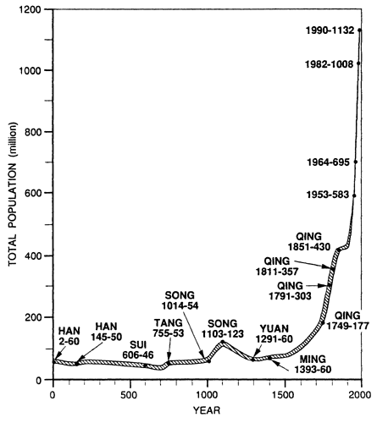
Weakness of political system - Qing
Administrative bodies did not increase despite growth in population
No official local-level finance; extra legal taxes form de-facto administrative budget
Number of taxable heads and land tax fixed and immutable for all time
Local corruption
Army remains relatively small
Rebellions occur in 1796, 1813 in response to taxes; continued rebellions and uprisings throughout 1800’s in response to weakness of system

Slide 7
Weakness of political system - Qing
Taiping Rebellion 1850-1864
Response to losses in 1842 Opium War
Southern provinces
30 million subjects at height
Christian kingdom
Boxer Rebellion 1899-1901
Revolt against Western influence in China
Each rebellion signifies the lack of control China held over portions of their territory and population

Slide 8
Weakness of political system – Republic/Warlord Era – 1911-1928
Sun Yixian (Sun Yat-sen)(dies 1925) proclaims self president following abdication of Pu Yi
Chinese Republic Established under Koumintang (KMT)
General Yuan Yuxian monopoly power over military
Declares self emperor for 100 years
China devolves into Warlord states
Enters WWI – 1916 – territories ceded to Japan despite China being on winning side
May 4th Movement – upset with loss of territories despite being on winning side. Formation of Chinese Communist Party 1921.
Warlords vying for control and power over feudal territories/all of China
Form cliques, rule over their territories separately

Slide 9
Weak Political system – KMT 1926-1949
First United Front – KMT and CCP 1924
Formed to attempt to reunify China under Nationalists KMT and groups of CCP
Northern Expedition 1927 – the military campaigns of KMT and CCP to unify China
Shanghai Massacre – April 12, 1927 – purge of CCP from the Northern Expedition
Chinese Civil War – 1927-1937; 1945-1949
Two phases: First period of war after Shanghai massacre
Second period of war begins after WWII
CCP uses guerilla warfare tactics, supports rural areas with land reform efforts, focuses on peasant struggles; KMT defends cities and industrial areas, noted for corruption in requisition of materials for Civil War.

Slide 10
Northern Expedition

Slide 11
Weak Political system – KMT 1926-1949
Second United Front – 1937-1945
Xi’an Incident – Chiang is kidnapped by a general who received no support in his efforts against the CCP and forces Chiang to agree to a second united front to fight off the approaching Japanese.
Another period of unity between KMT and CCP
Fight off the Japanese in WWII
Not allied but not fighting each other…

Slide 12
Impact of War - Qing
First Opium War 1839-1842
Qing wishes to end sale of Opium
Britain wishes for free trade and end to Canton system (sole port for Western trade)
Britain wins – begins Unequal Treaty period
Treaty of Nanking
4 Treaty Ports opened for trade
Reparations for seized opium
Hong Kong ceded to Britain until 1997
Taiping Rebellion in response
Considered the beginning of “Modern Era” for China

Slide 13
Impact of War - Qing
Second Opium War – 1856 – 1860
Britain and France
Britain pursuing further trade expansion; France join in response to execution of a French missionary. US and Russia send envoys to ensure territorial and trade gains.
Treaty of Tientsin
11 more ports open to Western trade
Britain, France, Russia, US can establish embassies in Peking
Foreign vessels have free navigation on Yangtze
Foreign travel to interior of China
Indemnity payments to Britain and France
Convention of Peking officially ends war after second phase of conflict
China signs Treaty
Freedom of religion
Opium trade legalized

Slide 14
Opium Wars Impacts

Slide 15
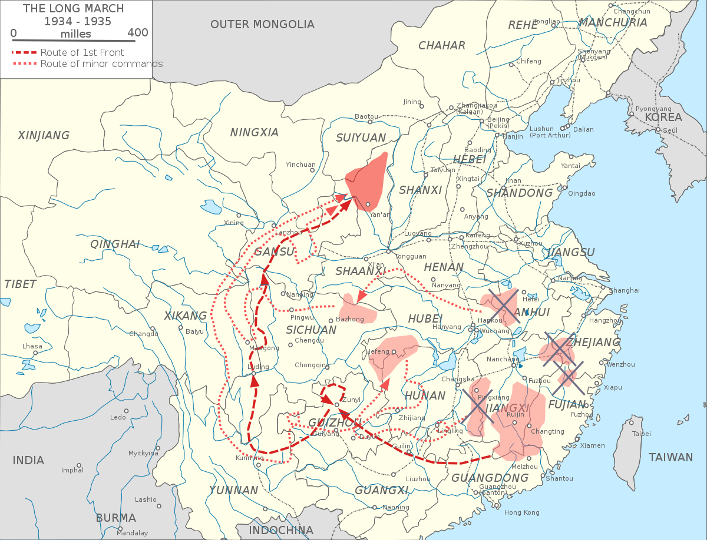
Impact of War – Warlord Period and civil war
WWI – Loss of territorial claims in Treaty of Versailles to Japan → May 4th movement
Civil War – KMT and CCP split; KMT unifies most of China
CCP – defends peasants and rural locations; guerrilla warfare
KMT – defends cities and industrial heartlands; more traditional methods of warfare
Long March – various retreats from Jiangxi – the central base of CCP - to avoid KMT encirclement campaigns during Civil War – Mao makes choices that prove pivotal to survival of CCP and capturing of cities for new base of operations
Ends in CCP victory and declaration of Communist China 1949

Slide 16
Warlord period

Slide 17
Impact of war - WWII
Second United Front
Puts a hold on direct confrontation between KMT and CCP
CCP focuses on rural areas, refines tactics of guerilla warfare, distributes land via land reform to gain wide support among peasants
KMT focuses on urban areas and industrial centers, uses traditional military tactics (loses many battles to Japanese)
10 million casualties, 50-60 million homeless, taxation and conscription into KMT, Japanese easily defeating KMT, scorched earth policy of KMT
CCP successes in land and tax reform gain foothold among peasants; successful campaigns against the Japanese also made CCP popular

Slide 18
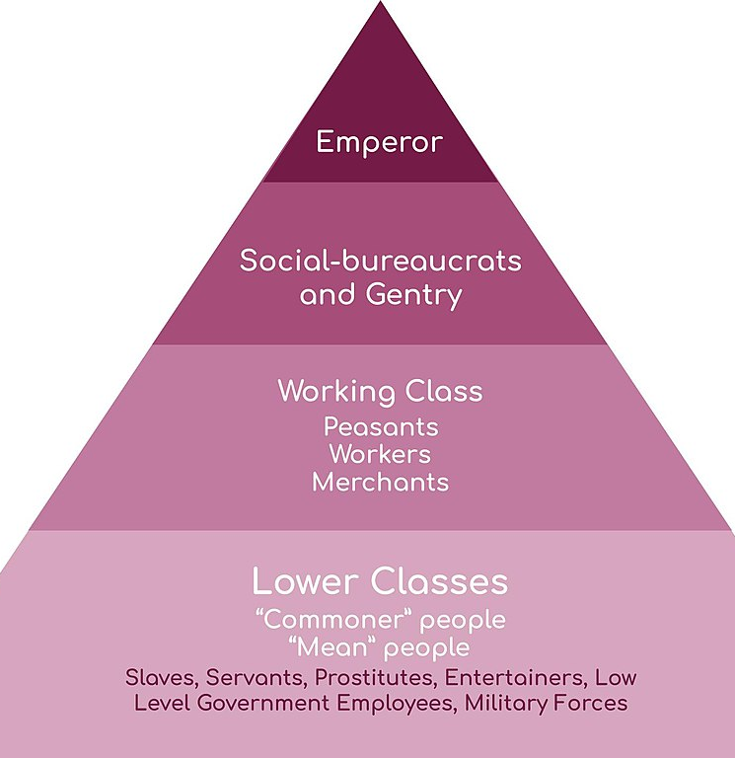
Social Division - Qin
Largely peasant society
Lack of land reform and growth in population puts strain on peasant class
Growth of a rising industrial class in urban areas puts pressure on Qin
Education reforms to westernize introduce various ideas to counter empire
Women subservient to men – foot binding
Local landlords extract additional taxes (extralegal methods) to fund local administration
Four large classes historically: landlord, peasant, merchant, craftsman
Five classes in Qin – Emperor and family; Gentry (landlords); Social-Bureaucrats; working class – peasants, workers, merchants; lower classes – soldiers, prostitutes, slaves, low level gov’t officials, etc.

Slide 19
Social division – warlord, civil war, WWII
Peasants hardest hit by increase in conflict in each of these periods
These conflict exacerbate differences among classes
Former gentry and gov’t officials lose positions after collapse of Qin- would support warlords bent on establishing an empire
Military restructuring places emphasis on this as a means of economic prosperity and gains in title/prominence

