Slide 1
Aims and Results of Policies - Mao

Slide 2
Political Policies - Aims
Establish a socialist country and apparatus in China
Implement Marxist-Leninist principles in Chinese governance (Socialism with Chinese characteristics)
Democratic Centralism, Anti-Imperialism, Anti-Capitalism
Implement New Democracy

Slide 3
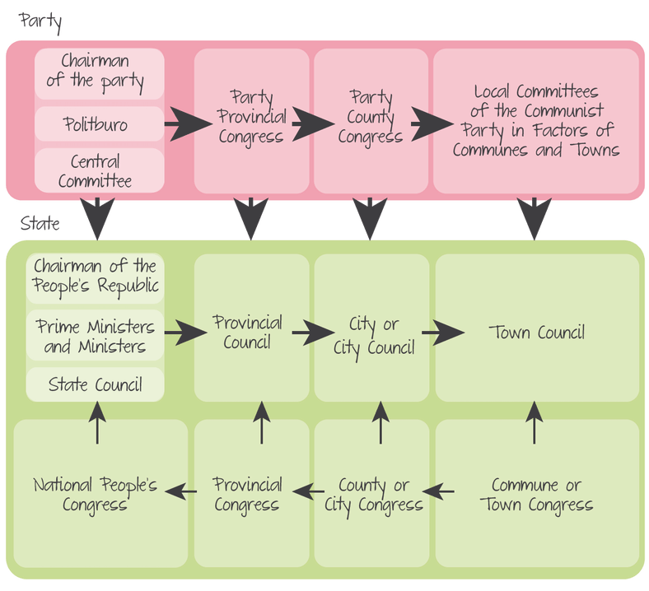
Political Policies - Results
Democracy: flows of requests and concerns from workers and peasants through the hierarchy
Politburo overwhelmingly holds the power
National People’s Congress never refused or voted against Politburo policies
Politburo does communicate with NPC and goes through amending process with requests

Slide 4
Political Policies - Results
Campaign Against Counter-revolutionaries, 3 and 5 Antis Campaigns, Hundred Flowers Campaign, Cultural Revolution
Secured socialism within the country
Eliminated former KMT bureaucrats from CCP hierarchy
Eliminated individuals identified as capitalist-roaders/rightists
Reinforced Mao as leader of the CCP

Slide 5
Economic Policies -Broad Aims
Improve agriculture, reform land distribution
Provide economic stability vs flux in Warlord/Civil War era
Increase industrialization

Slide 6
Economic Policies - Agriculture
Land Reform – 1950 – Agrarian Land Law
Aims: equitable distribution of land; confiscate land from landlords and distribute to peasants; modernize agriculture
Results: Within a year 40% of means of production was with 60% of the peasants; CCP says fully complete 1953
Mutual Aid Teams – 1951
Aim: share resources, techniques, tactics among peasants to improve agricultural output
Results: 40% of peasants joined by 1952; agricultural production improve slightly

Slide 7
Economic Policies - Agriculture
Agricultural Producers Cooperatives
Aims: begin process of collectivization
Results: Not mandatory, peasants do not join
1955 forced collectivization
Aims: collectivize and expand agriculture; end private property (private ownership of means of production)
Results: Jan 1956; 63% of peasants belonged to APC – 75 million households; late 1956 97% belonged. 3.8% increase in productivity of agriculture

Slide 8
Economic Policies - Industry
Aims: increase industrial output to match the West and USSR; catch up
Method: Five Year Plans
First Five Year Plan (1953-1957)
Industrial output doubled, annual growth at 16%
Light industry increased by 70%
Steel production 1.3 tons in 1952 to 5.2 million in 1956
Steel, coal, petrochemical growth largest
Coal – increased 98% between 1952-1957

Slide 9
Economic Policies - Industry
Second Five Year Plan: Great Leap Forward 1958-1962
Aims: overtake UK and US; “walk on two legs” by improving agriculture and industry at the same time; free up peasants to work in various areas – reclamation of lands, irrigation, train in military tactics, etc.
Results:
Organized agricultural cooperative into 26,000 communes.
Four Pest Control – exterminate mosquitoes, flies, rats, and sparrows
Ecological damage – locust eaten by sparrows swarmed crops
Great Famine – agricultural and environmental collapse, peasants working outside of agriculture, poor weather in all of China (Drought N and C; typhoons and floods in S)
Poor quality industrial production
Trade agreements for grain export kept collection high
Mao pushed aside politically

Slide 10
Economic Policies - Industry
Recovery 1963-65
Aims: Allow a recovery of agriculture and industry; introduction of mixed economic systems under Deng Xiaoping and Liu Shaoqi
Results:
Peasants sent back to countryside, private property reestablished
Rural markets reopened
Grain production recovers by 1965
Industry output doubled that of 1957
Heavy industry grows at 17%

Slide 11
Economic Policies - Industry
Third Five Year Plan – 1966-1970
Recovery period took precedence to establish normalcy prior to another 5 year plan
Aims: agricultural security, national defense and technology related to arms/armaments; self-reliant economy in industry, commerce, education, science
Results: Industrial growth exceeded expectations gross 21.2% (8.6 million kilowatts electricity; 27 million tons of oil; 6.5 million tons steel; 35 million tons iron ore; around 4,000 kilometers of new railways; 31000 kilometers of new highway)
Agricultural growth exceeded goal by 14.1%; but only rose in production by 2.2%.

Slide 12
Economic Policies - Industry
Fourth 5 Year Plan (1971-1975)
Aims: Infrastructure improvements; continued growth of industry and grain production
Results: Growth rate of both industry and agriculture during period (average annual growth) was 12.5% during this period.

Slide 13
Social Policies - Aims
Expand education
Equal rights for women
Eradication of diseases
Promote better health

Slide 14
Social Policies - Education
Conditions: 80% illiterate; 20% of children went to primary school; 1% to secondary. Average years of school: males – 4, females – 3; imperial examinations only passed by 5%
Aims: reform education to be less elite; reform writing to become simplified (Pinyin); expand technical and college based education
Results:
Towns with primary schools – 50% 1950-90% 1970
450,000 → 21 million rural graduates from elementary schools between 1965-1977
Literacy rate 64%

Slide 15
Social Policies - Youth
Aims: promote and teach communist values and ideology.
Results:
Chinese Communist Youth Movement membership grew 5.1 million in 1951 to 25 million by 1962
Youth (Young) Pioneers – Children aged 9-15; aided in literacy efforts and organization of small scale efforts of 5 year plans

Slide 16
Social Policies – Health Care
Aims: eradicate diseases that were non-existent in Western countries (cholera, dysentery, typhoid); train doctors in basic health to prevent disease spreading
Results:
Barefoot Doctors campaigns – trains youth with basic knowledge of hygiene and sanitation to spread to rural communities
Patriotic Health movement – posters and other education methods to spread awareness of disease prevention
Smallpox, cholera, typhus, and plague almost eradicated
Life expectancy rose, infant mortality declines

Slide 17
Cultural Policies
Aims: replace traditional cultural forms with art, literature, etc. to educate rather than entertain. Socialist Realism from USSR. Send messages to the peasants and people.
Results:
Yangbanxi – political art – operas written by Madame Mao
The East is Red- revolutionary song
Film – must carry political messages and revolutionary thought

Slide 18
Policies on Women
Conditions: women inferior, obedient, passive. No rights, role of bearing children, especially male heirs. Arranged marriages, foot binding, divorce only initiated by male, child marriage, dowries, polygamy, no right to own property.
Aims: Change these older conditions to provide greater equity to women in China via legal protections and opportunities in the economic sectors of a new China.
Results: Marriage Reform Law 1950
Ends arranged and child betrothals
Rights of divorce to both parties
Increased age of marriage to 18 for women, 20 for men
Ownership of property, right to vote, join government and PLA, communal nurseries and kindergartens to ensure women could work after child birth
Large increase in divorces; women have double duty – social change slow; women in work increased drastically
All China Women’s Federation journal Women of China and magazines like Women of New China offered a feminist perspective of gender conflicts in the party and provides the state with strategies in pursuit of women’s liberation.
Iron Women – a redefined femininity; no longer fragile, weak, but a strong revolutionary force.

Slide 19
Policies on Minorities
Aims: retain territories on the peripheral areas of interior of E. Asia through relationships with minority populations who were majorities in those regions.
Results:
1952 Enforcement of Nationality and Regional Autonomy gave localities self-governance so long as there was no threat to the PRC.
Policies shift from assimilation during Cultural Revolution to self-governance and releasing of assimilation policies.

Slide 20
Extent of Authoritarianism
Access to documentation is severely limited and restricted. Historians must use second-hand accounts of those who have fled or sources that are close to Mao – Mao’s writings, memoirs of high ranking officials.
Linz Model – See to the right.
Totalitarianism | Authoritarianism
Ideology plays a strong role, provides legitimacy | Role of ideology is weak
Goals of the regime are social revolution via-mass mobilization, aiming to transform human nature | Goal is to depoliticise and demobilise society producing a sense of political impotence
Regime has a high level of organisation and total control over society | Regime does not exercise total control over society; masses have some political power
Strategy to achieve these goals is to subject society to terror | Terror and propaganda may be used, but not to the same extent as in totalitarian regimes
Key holders of power are the leader, secret police, and party | Small degree of pluralism is allowed. Political parties, if they exist, are devoid of ideology and may not play an important role in the regime

