Slide 1
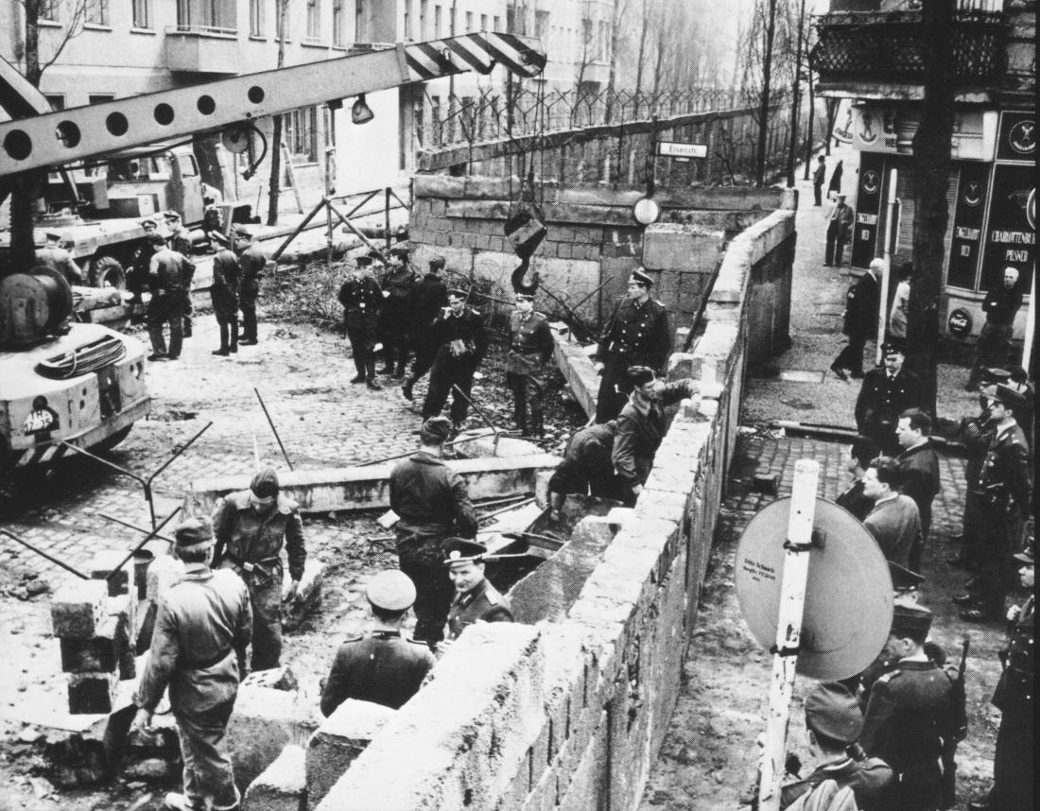
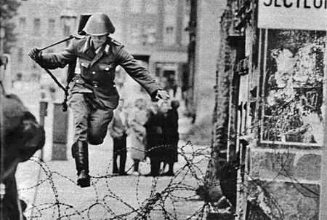
Why was there a crisis over Berlin in 1961?
L/O – To identify the causes, key features and consequences of the Berlin Crisis

Slide 2
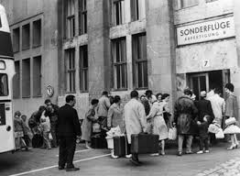
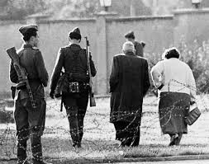
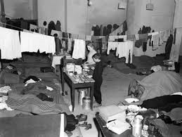
The Refugee Problem
The Berlin Blockade (1948-49) was a failure for the USSR and by the end of 1949, Germany had been officially divided into the FDR (West Germany) and GDR (East Germany).
In 1952 the inner German border between the countries had also been sealed. However the border between West and East Berlin remained open. West Berlin at this time developed rapidly with high standards of living and freedom. East Germany had the opposite. Lack of jobs, poor wages, no consumer goods, forced collectivisation and no political freedom.
Refugees took advantage of this and between 1949-1961 an estimated 2.7 million people escaped to the West through West Berlin. Many were highly skilled doctors, engineers, managers and scientists.

Slide 3
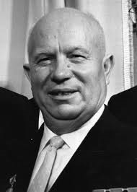
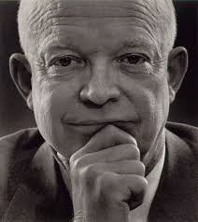
Khrushchev’s First Ultimatum
Khrushchev had to act and in November 1958 he declared that the whole of Berlin officially belonged to East Germany and demanded that the USA withdraw its troops and Berlin to be a ‘free city’ administered by East Germany.
Eisenhower refused but did not want to start a war so it was agreed to hold an international meeting on Berlin’s future.
This led to the Geneva (Switzerland) and Camp David (USA) meetings of 1959. No solution appeared but it was agreed to hold FURTHER talks in 1960.

Slide 4
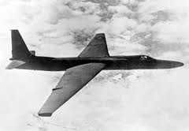
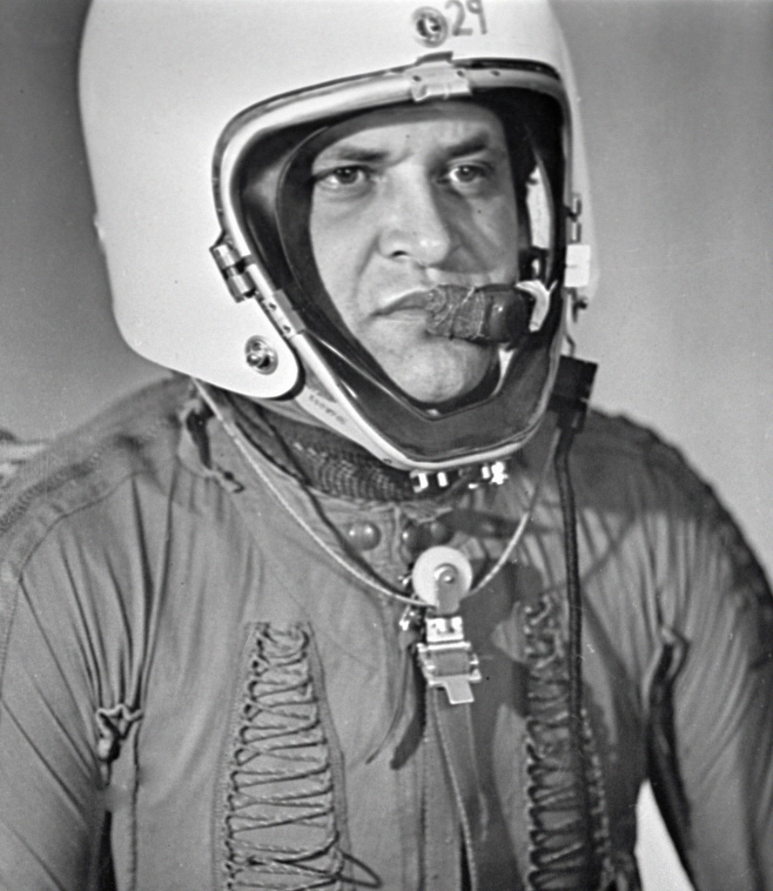
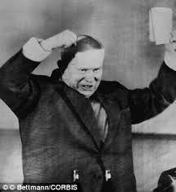
The U2 incident – May 1960
In May 1960, the USSR shot down an American U2 spy plane over Russia. The pilot, Gary Powers, was captured.
Khrushchev used this incident to expose America’s spying programme to the world. It was excellent propaganda for the USSR and strengthened Khrushchev’s negotiating position.
The 1960 Paris Conference on Berlin was therefore doomed to fail. Khrushchev was enraged by the U2 incident and demanded that Eisenhower punish the leaders of the U2 programme. Eisenhower refused and Khrushchev walked out.

Slide 5
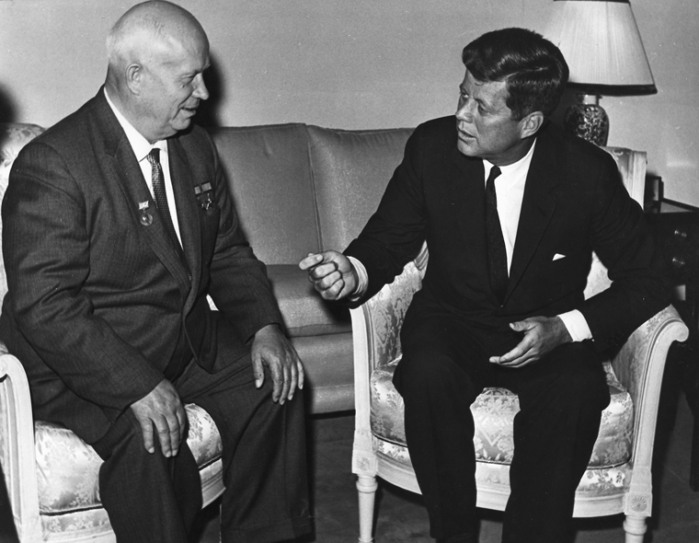
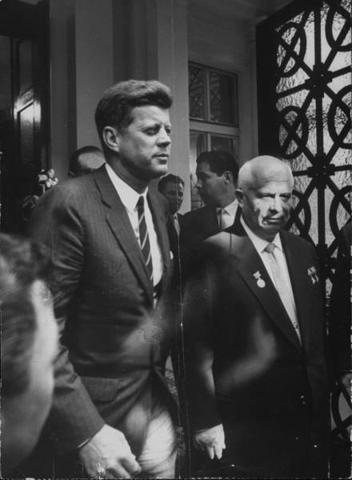
Khrushchev’s Second Ultimatum
At the Vienna (Austria) Conference of 1961, Khrushchev challenged the new US President John F. Kennedy (JFK) to withdraw US troops from Berlin within 6 months or declare war.
JFK refused to remove his troops and also started to prepare for war, committing the US government to an additional $3.2 billion of defence spending and $207 million on nuclear fallout shelters. The USA also had more nuclear weapons than the USSR.
Khrushchev was therefore forced to either declare war or back down. He backed-down but still had the Berlin refugee problem to solve.

Slide 6
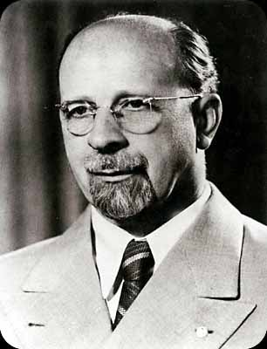
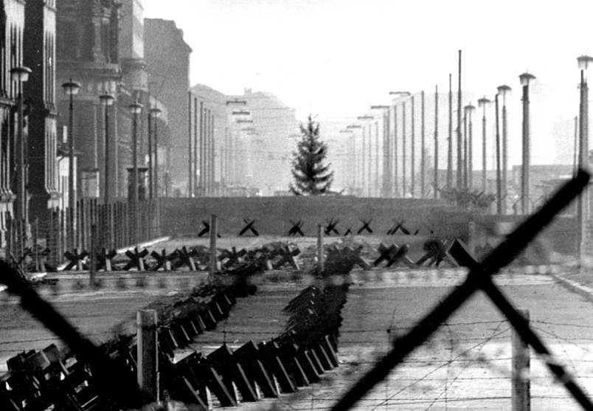
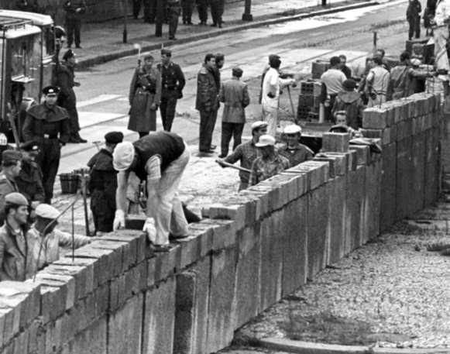
The Berlin Wall
The refugee problem had become serious. The East German President, Walter Ulbricht, was demanding that Khrushchev do something otherwise he would use force to close the border. This might risk war.
Khrushchev’s solution was to build a wall separating East and West Berlin – therefore solving the refugee problem.
On the night of 12th August 1961, East German troops erected a barbed wire fence around the whole of West Berlin. Over time a brick wall was built.

Slide 9
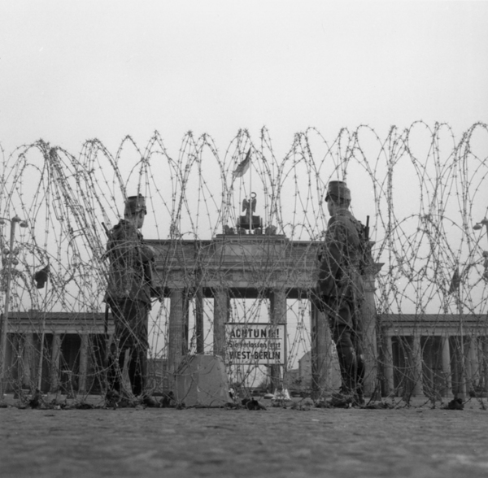
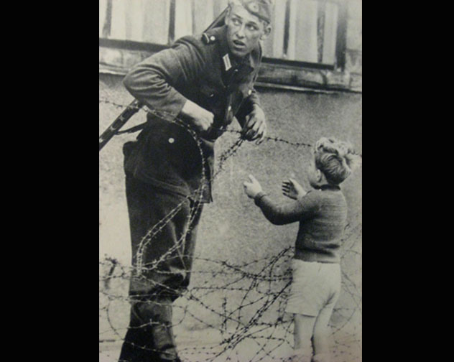
The Berlin Wall - Consequences
Tensions reduced - the refugee problem had been solved which reduced tensions. East Germany no longer feared a brain drain and Eastern Europe would no longer be exposed to the attractions of capitalism.
Propaganda Victory for USSR - It allowed Khrushchev to avoid war whilst appearing strong.
Propaganda Victory for USA - Kennedy visited West Berlin in 1963 to show his solidarity with the people there. Ich bin ein Berliner – propaganda victory – Soviets had to wall people in to win.

Slide 10
Long-Term Causes
Refugee Problems – 2.7 million escaped to West between 1949-1961, many highly skilled (brain drain). Attracted by high wages and freedoms in West Berlin. East German government unpopular – embarrassment to USSR.
West Berlin was positive propaganda for the West - Proved that capitalism was better, could lead to unrest in Eastern Europe, had to be dealt with.
West Berlin was a base for Western spies since WW2. Posed problems for the USSR and had to be dealt with.
Short-Term Causes
U2 Incident, May 1960 – led to the failure of Paris Conference on Berlin – Khrushchev walked out – less willing to compromise over Berlin.
Failure of Khrushchev’s 2nd ultimatum – Khrushchev gave JFK 6 months to leave West Berlin or declare war (Vienna Conference June 1961). Kennedy’s refusal called Khrushchev’s bluff – led to wall as alternative.
Pressure from East Germany – East German President Walter Ulbricht pressured Khrushchev to make a decision, suggesting that force would be used if the USSR did nothing to stop refugee’s escaping.

Slide 11
Ways to Link Causes
Refugee crisis was the long-term reason for tensions over Berlin but the decision to build the wall was triggered by the U2 incident – it led to the breakdown of peace talks leaving the construction of a wall as the only sensible option for long-term peace in Berlin.
The main reason for building the wall was the attraction and success of West Berlin itself. The existence of West Berlin was a propaganda victory for the West and could lead to social disorder and protest in Eastern Europe. This island of capitalism produced a disruptive effect in East Germany and had to be closed down. The final trigger for the wall was the pressure put on Khrushchev by Walter Ulbricht. Khrushchev had to act and the construction of the wall was thus the only option left rather than war.

