Slide 1
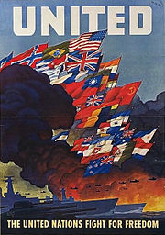
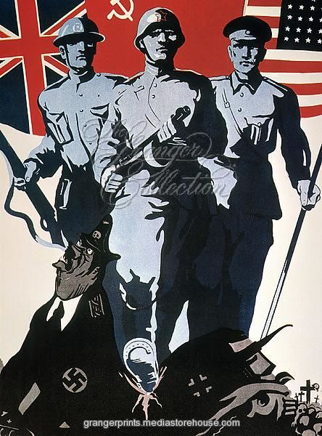
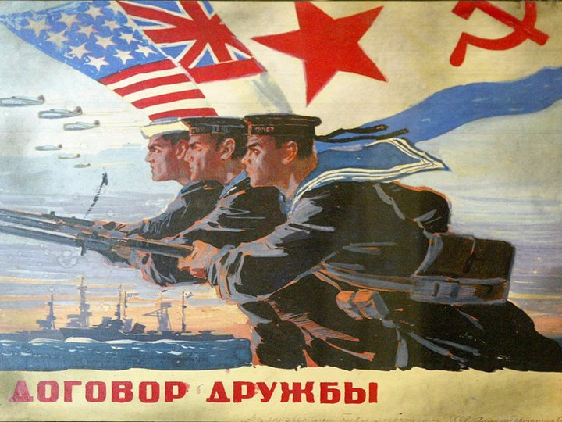
Why was the ‘Grand Alliance’ formed?
L/O – To identify the reasons for the creation of the Grand Alliance, and to evaluate its key documents

Slide 2
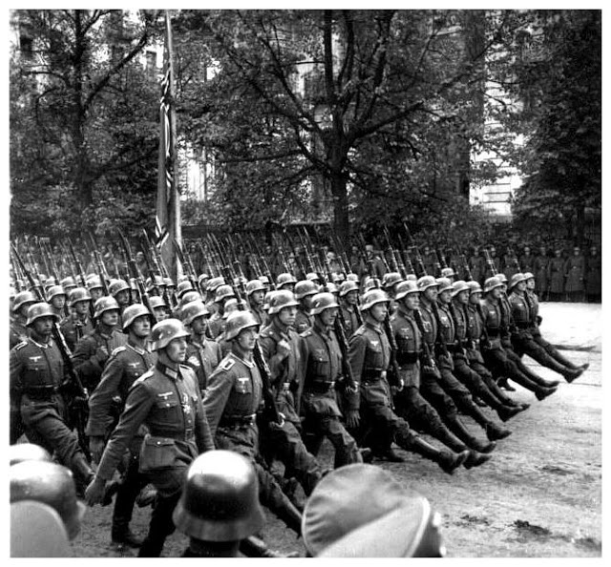
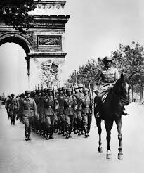
The Beginning of the War
In 1939, the UK and France (and their empires) declared war on Germany for invading Poland.
Initially Germany seemed overwhelmed, but from 1940, Germany began to invade Western Europe, capturing Norway and Denmark in April 1940. By June 1940, Germany had invaded France, Belgium and Holland.
The French and British armies were quickly defeated, with France surrendering to Germany and with Italy quickly joining with Germany. Britain was left alone in Europe to face Hitler.

Slide 5
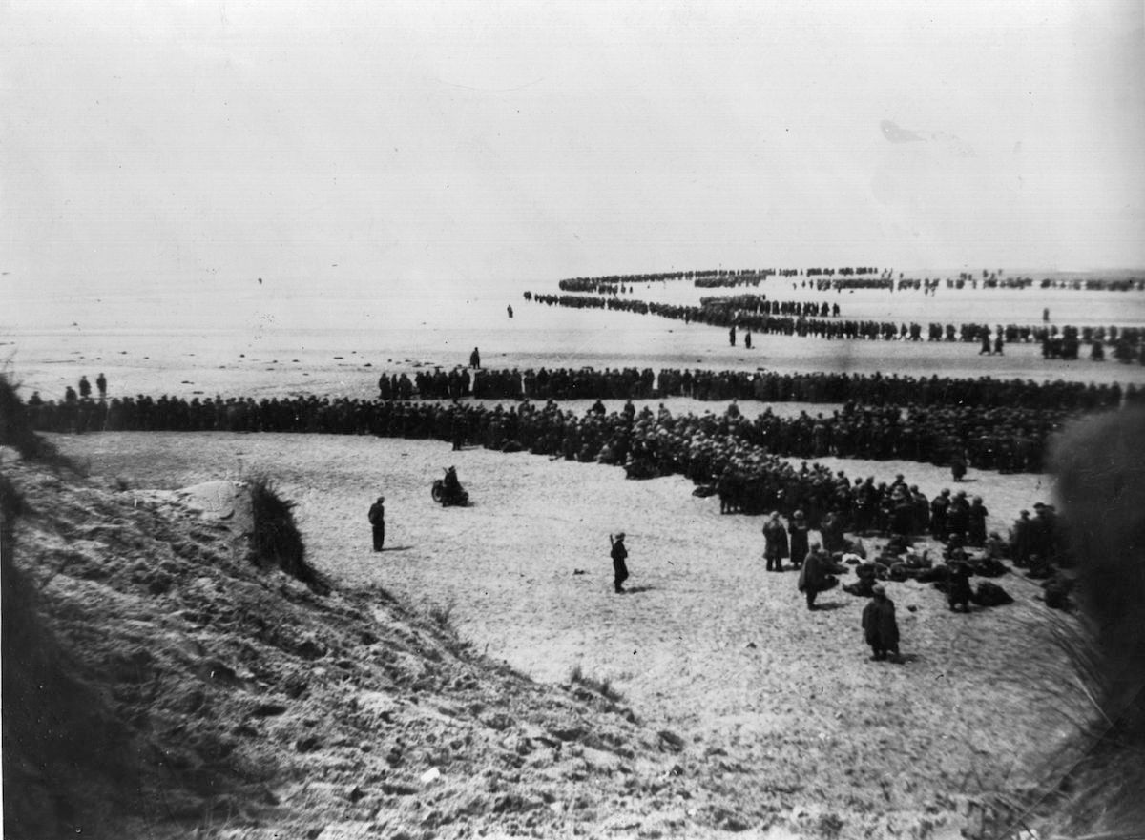
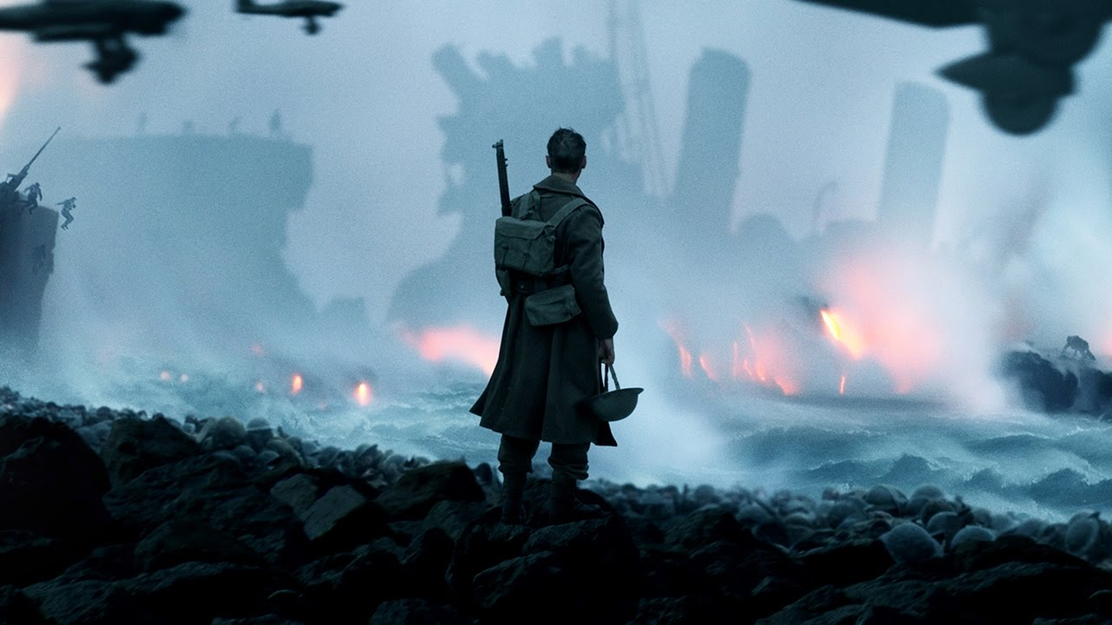
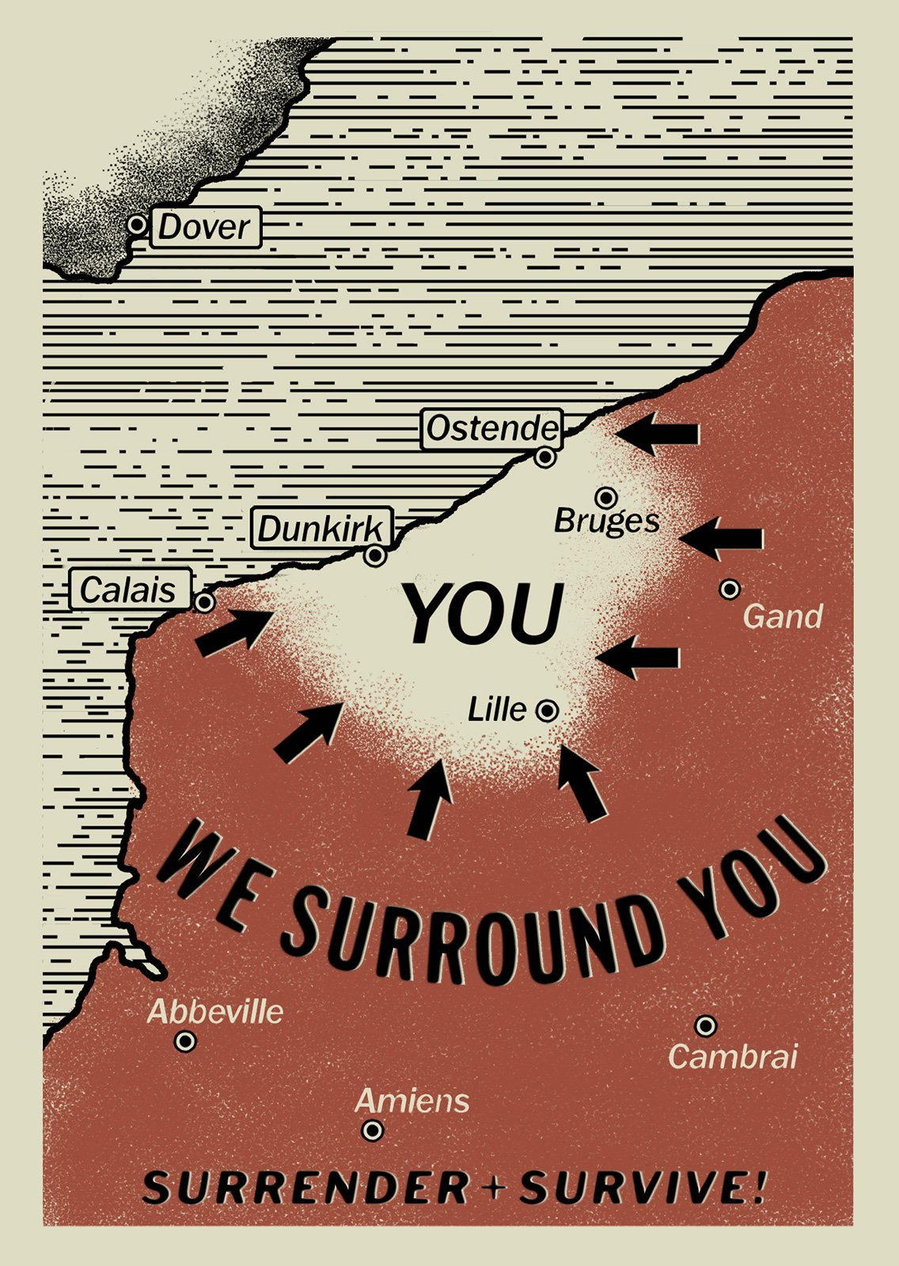

Slide 7
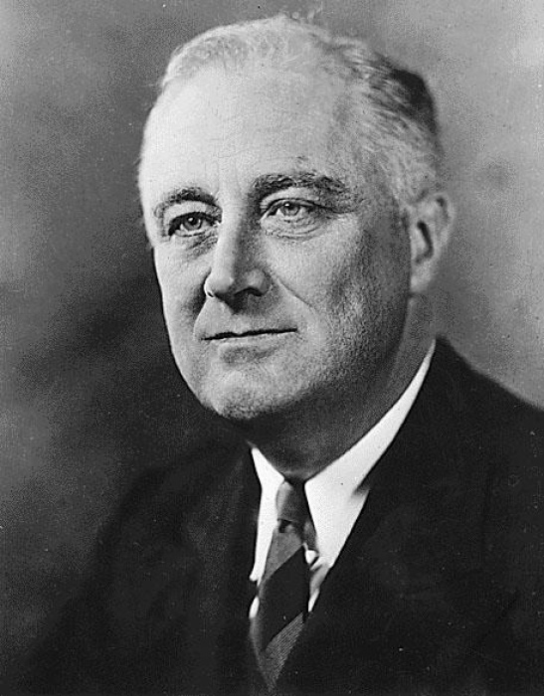
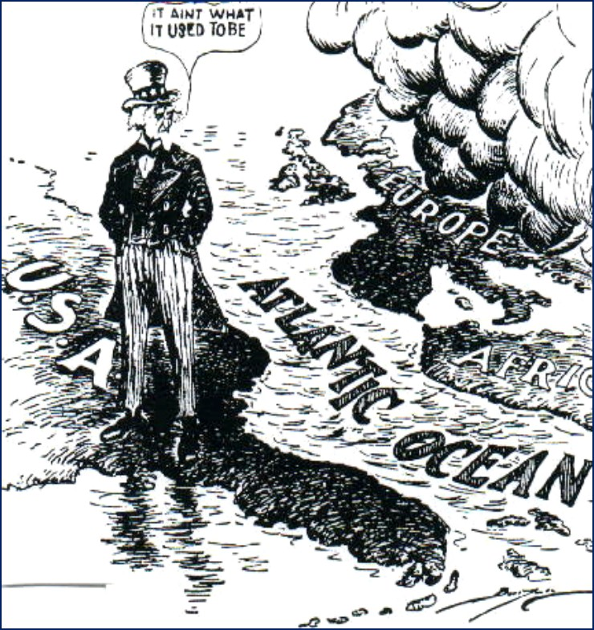
The Role of the USA
Although the USA officially remained neutral, it increasingly began to support the UK.
During the 1930s, the isolationalist US Congress had passed a number of Neutrality Acts, preventing the US from trading with any side during war.
These were amended in 1939 to allow belligerent nations to buy weapons from the US as long as they paid in cash and used their own transports. This helped out the UK tremendously.

Slide 9
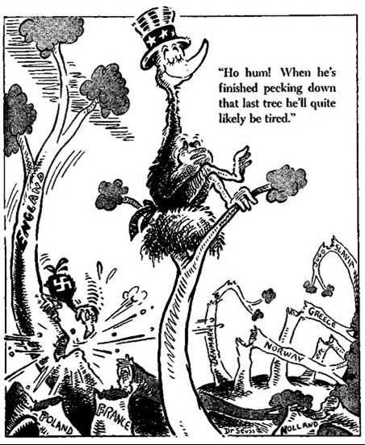

Slide 10
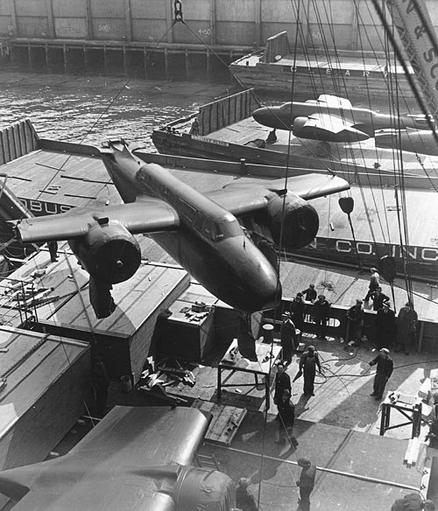
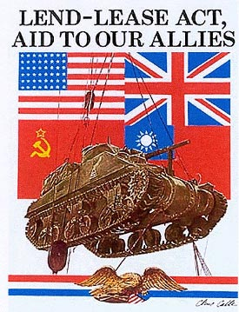
The Role of the USA
This ‘cash and carry’ system was replaced by the Lend-Lease Act of March 1941. This enabled the British to defer payment on supplies of weapons until after the war.
In return, the UK allowed the US to use many of its territories and bases throughout the world.
Thus by the end of 1941, although the USA was not in the war, it was increasingly supplying forces fighting Hitler with over $50 billion in aid ($750 billion today!) - $31 billion to Britain and $11 billion to USSR.

Slide 11
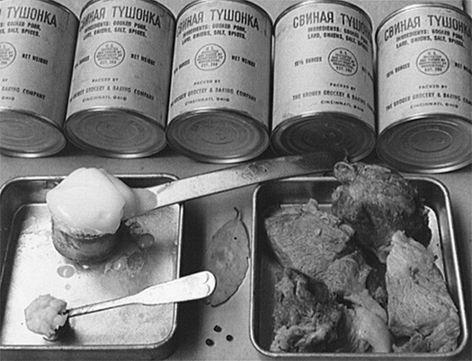
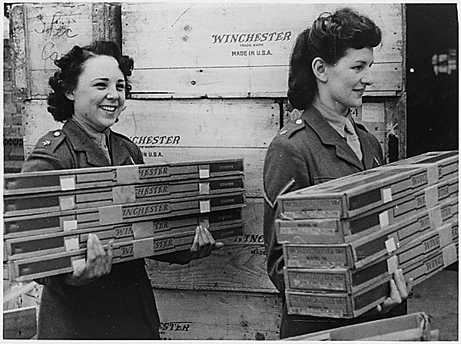
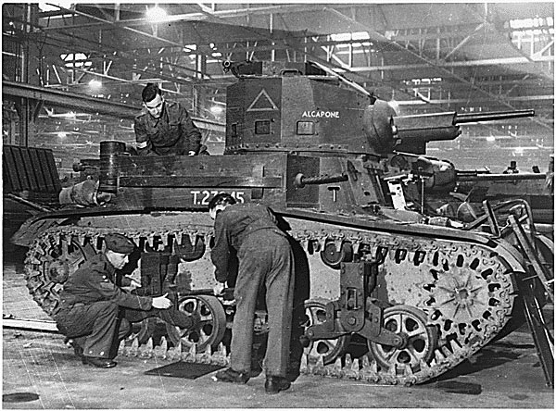

Slide 12
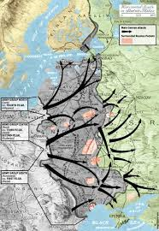
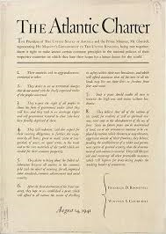
Formation of the Grand Alliance
In June 1941, Nazi Germany launched ‘Operation Barbarossa’ – the invasion of the Soviet Union. Britain and the USA immediately began supplying the USSR.
However the USA was not involved in the war at this time. In August 1941, Winston Churchill secretly met with US President Franklin Roosevelt. Churchill was hoping to persuade the USA to join the war.
Instead, they agreed on a policy statement that became known as the ‘Atlantic Charter’.

Slide 13
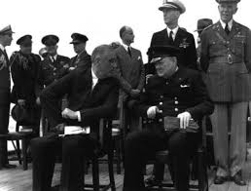
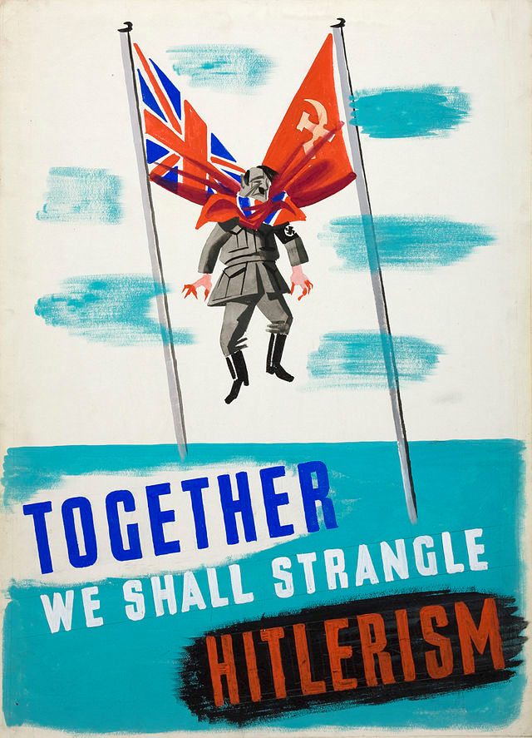
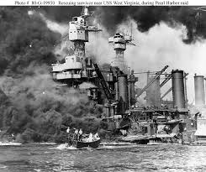
Formation of the Grand Alliance
The eight-principles of the Atlantic Charter defined the Allied goals for the post-war world, presenting the unity of Britain and the USA.
In September 1941, the Soviet Union and other countries fighting Nazism agreed to the principles set out in the Charter - however this was not a formal alliance.
This changed in December 1941. Japan and Germany declared war on the USA, bringing America into the conflict.

Slide 14
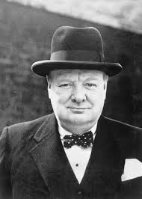
Formation of the Grand Alliance
By January 1942, the Allies issued a joint ‘Declaration by United Nations’ – this military union between the USA, UK and USSR became known as the ‘Grand Alliance’.
It was essentially a ‘marriage of convenience’ as all three had a common enemy. But it had shaky foundations – it united the world’s greatest capitalist state, the greatest communist state and the greatest colonial power.
Churchill retained his dislike of Stalin, remarking: ‘If Hitler invaded Hell, I would make at least a favourable reference to the Devil in the House of Commons’.

Slide 15
Wartime Disagreements
1. The Second Front – Stalin demanded that the Allies open a ‘second front’ in Western Europe to relieve pressure of the Soviet Union. The USSR faced over 80% of all Nazi military resources.
In 1942 and 1943, the UK and USA decided to invade North Africa and Italy first. These delays made Stalin suspicious, believing that the Allies wanted the USSR to be weakened.
When the Second Front was opened with the D-Day Landings in France in June 1944, there were 228 Axis divisions on the eastern front, compared to 61 divisions in Western Europe.

Slide 17
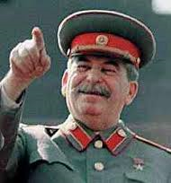
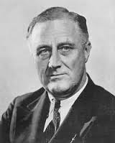
Wartime Disagreements
2. Ideological Suspicions – Despite agreeing to the principles of the Atlantic Charter with the West, Stalin had concerns over Roosevelt’s foreign policy.
Roosevelt’s ‘Open Door’ policy was based on ‘free’ world trade and ‘equal’ access to raw materials – Stalin feared this would only benefit capitalist countries like the USA.
The Allies attempted to resolve their differences at three wartime conferences. The failure of these conferences would ultimately lead to the Cold War.

Slide 18
Plenary
How did Lend Lease benefit the Allies?
Describe at least 3 terms of the Atlantic Charter
What was the purpose of the Atlantic Charter?
What does OPCVL stand for?
What did the Declaration of United Nations do?
What caused the US to support the UK/USSR?
To what extent was the Second World War won by economic means?
Did we meet our learning objective?
L/O – To identify the reasons for the creation of the Grand Alliance, and to evaluate its key documents

