Slide 1
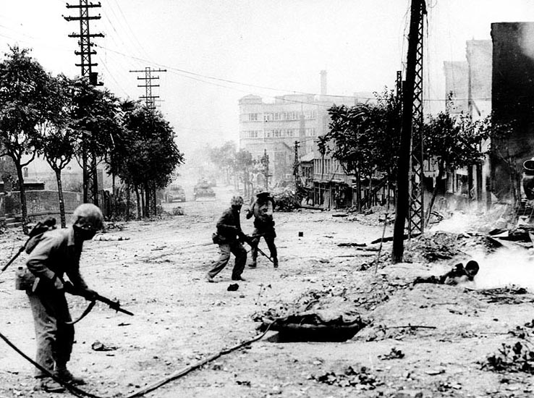
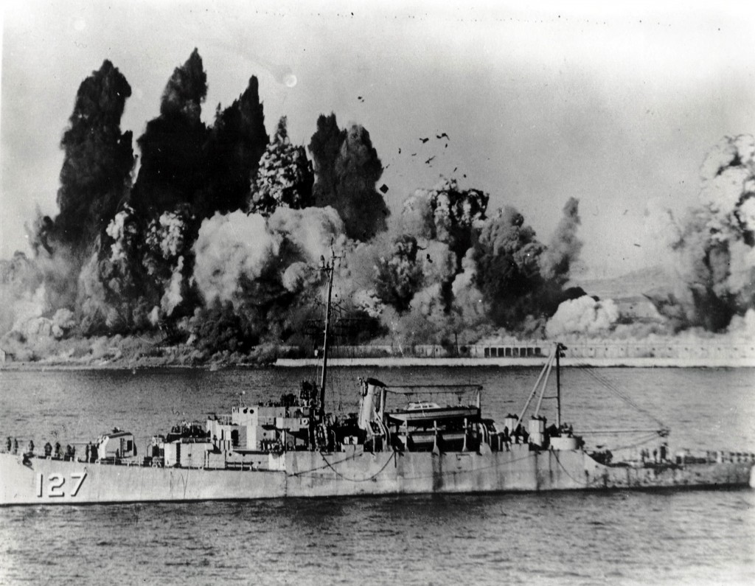
What were the causes and effects of the Korean War?
L/O – To identify the causes and consequences of the Korean War and evaluate its impact on the Cold War

Slide 2
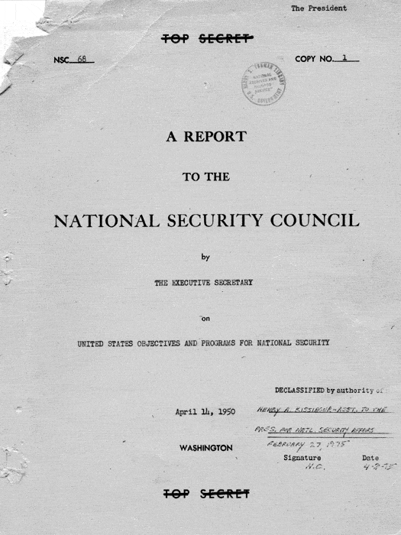
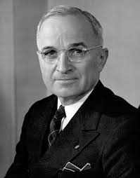
What was the Korean War?
The Korean War started on 25th June 1950 when over 90,000 North Korean soldiers launched an invasion of South Korea.
It occurred during a time of debate over the future course of US foreign policy. Many in Washington advocated a massive re-armament programme to confront Communism globally, as seen in NSC-68.
President Truman realised that a failure to take action would undermine the credibility of the US policy of containment.

Slide 3
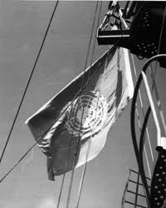
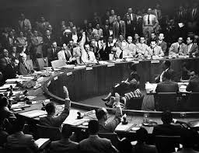
What was the Korean War?
The USA immediately sent aid to South Korea and called on the United Nations to sanction military action against North Korea.
A resolution sanctioning a UN-mission against North Korea was passed on 27th June 1950.
This was a rare occasion when the Security Council voted unanimously. The USSR was boycotting the Security Council over the USA’s refusal to recognise Communist China, therefore did not have a vote.

Slide 4
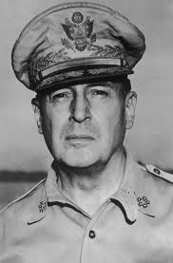
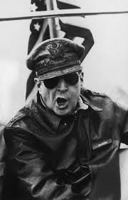
What was the Korean War?
Troops from the US and 15 other nations arrived on the 1st July 1950. They were led by a UN Commander – the American General Douglas MacArthur.
America now found itself at war again, which persuaded the US government to accept the recommendations of NSC-68 – to raise the military budget significantly.
The Cold War had now become a global war as the USA sought to confront Communism in Asia as well as Europe.

Slide 5
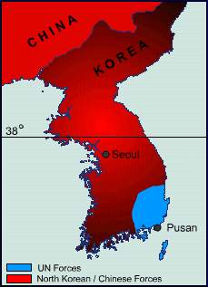
The Korean War – What happened?
The Korea War started as a war of movement with dramatic changes in its first year however this was followed by a stalemate that lasted until its end in 1953.
Stage 1 – North Korean Invasion: An initial push by the North Koreans resulted in them capturing almost the entire Korean peninsula apart from a small pocket of land in the South-East around the city of Pusan.

Slide 6
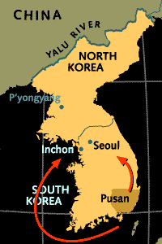
The Korean War – What happened?
Stage 2 – UN Counter-attack: MacArthur led UN forces in a daring amphibious assault on Inchon, hoping to split North Korean forces in half.
Within a month he had recaptured Seoul and driven the North Koreans back past the 38th parallel.
The US then decided on a policy of ‘rollback’ – to cross into North Korean territory and reunite Korea. Pyongyang was captured by October.

Slide 8
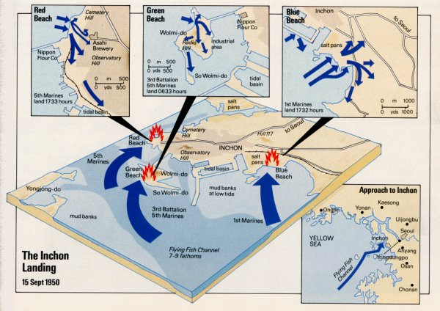

Slide 9
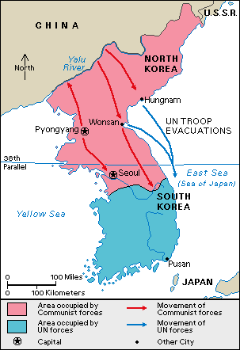
The Korean War – What happened?
Stage 3 – Chinese Counter-attack: Despite warnings from the Chinese, MacArthur pushed on to the border with China at the Yalu River.
On 27th November 1950, over 200,000 Chinese and 150,000 North Korean troops counter-attacked, pushing UN forces into retreat.
By December 1950, Pyongyang and all of North Korea was recaptured. UN forces suffered heavy casualties.

Slide 10
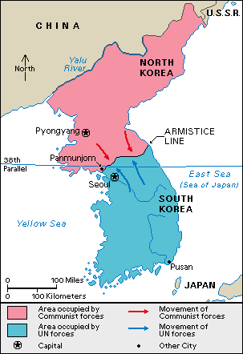
The Korean War – What happened?
Stage 4 – Stalemate: The war quickly descended into stalemate along the 38th parallel.
Truman decided to revert to a policy of ‘containment’. MacArthur disagreed and even threatened the use of atomic bombs against China. He was then fired by Truman!
Peace talks began in 1951 but war continued until 1953 when an armistice was signed at Panmunjom in July.

Slide 12
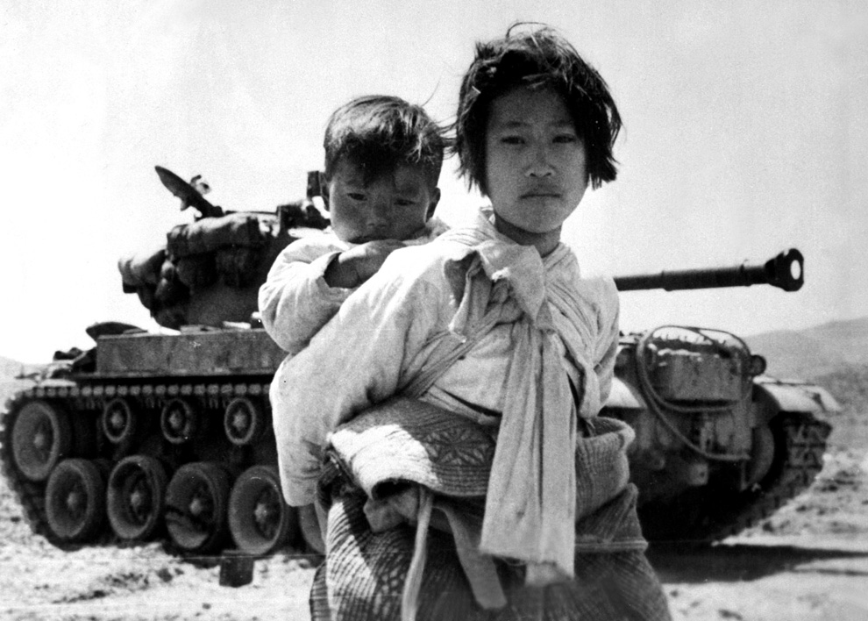
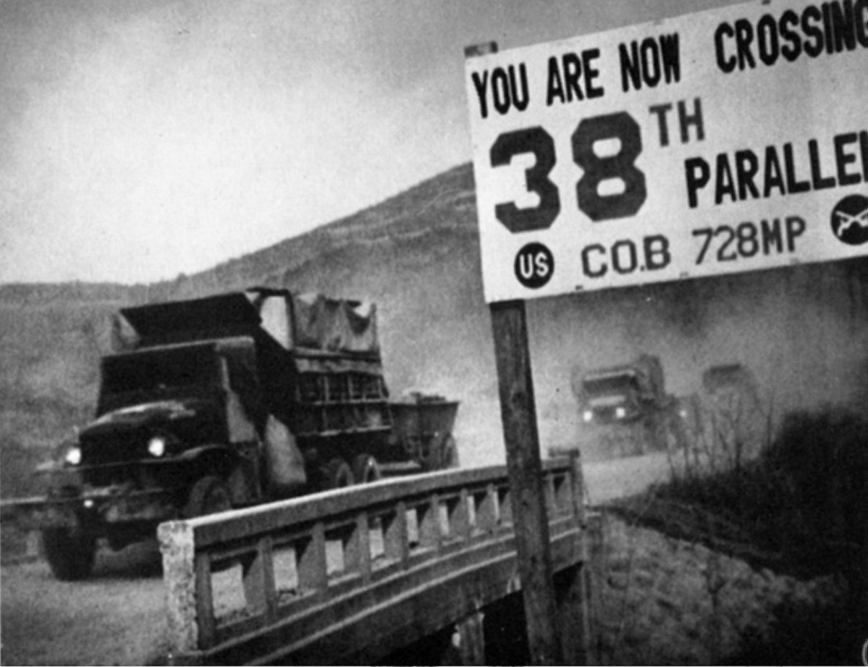
What were the causes of the Korean War?
Content – Economic, Political, Ideological, Social
Time – Long-term, Short-term, Immediate
Role – Trigger, Catalyst, Pre-condition, Multiplier
Importance – Necessary, Sufficient

Slide 13
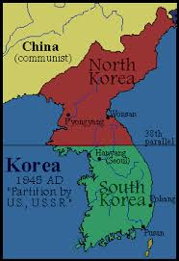
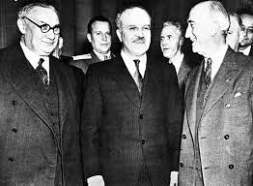
1. Failure to unite Korea after WW2
In 1945 it was agreed by the superpowers to temporarily divide Korea and take joint responsibility for repatriating Japanese forces there.
The 38th parallel was taken as dividing line with the USSR occupying the north and the USA the south.
At the Council of Foreign Ministers’ Moscow Conference in December 1945, the USA and USSR agreed to create a provisional government in Korea, leading eventually to independence.

Slide 14
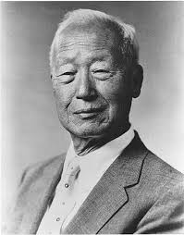
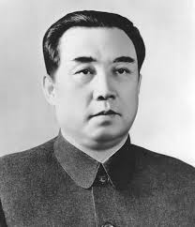
1. Failure to unite Korea after WW2
However independence was never achieved. As the Cold War developed the superpowers became less willing to co-operate.
Despite the Moscow Agreement, separate governments emerged on either side. In the South the US appointed Syngman Rhee, an anti-communist. In the North, the USSR supported a communist faction led by Kim Il Sung.
Both had fought the Japanese and both wanted to end the division of Korea. However both had very different ideologies.

Slide 15
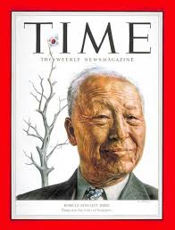
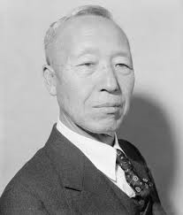
1. Failure to unite Korea after WW2
Due to Cold War tensions, both superpowers agreed to divide Korea in 1947.
The Americans persuaded the UN to establish a commission to supervise Korean elections. It was refused entry to the North but observed a separate election in the South in May 1948.
The Republic of Korea (ROK) was set-up in the South led by Synghman Rhee. It was undemocratic and anti-communist but recognised as legitimate by the UN General Assembly.

Slide 16
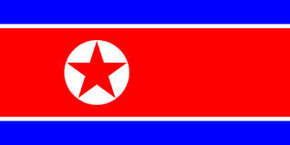
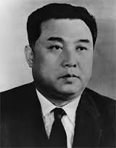
1. Failure to unite Korea after WW2
In response the Democratic People’s Republic of Korea (DPRK) was founded in the North by Kim Il Sung in September 1948. It was recognised by the Communist Bloc.
The failure of the superpowers to create a unified Korean government thus led to the permanent division of Korea into two hostile states.
Each claimed to represent all of Korea and each leader wanted to unify Korea.

Slide 17
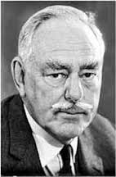
2. The Role of the USA
Having now divided the Korean peninsula, both superpowers began to withdraw their troops.
Soviet troops left the North in 1948 whilst US troops left by mid-1949. In Dean Acheson’s ‘perimeter’ speech of January 1950, the US declared that they wouldn’t commit troops in mainland Asia.
This withdrawal of troops left a power vacuum in Korea, in which hostilities between the two Koreas' could develop. The withdraw of US troops presented Kim Il Sung with an opportunity.

Slide 18
3. The Role of Kim Il Sung
Both Kim Il Sung and Synghman Rhee wanted to reunify Korea on their own terms. However neither side could unify Korea on their own.
Kim Il Sung persistently tried to persuade Stalin into supporting an attack on the South, in which he eventually agreed.
Stalin wasn’t to blame for the war although his support for Kim Il Sung was significant in the North’s decision-making.

Slide 19
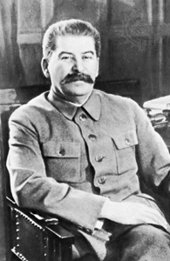
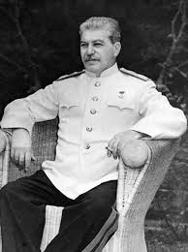
4. The Role of Stalin
Stalin eventually supported plans for a war at the beginning of 1950. This may have been because he was more hopeful of winning.
The Communist victory in China and the development of their first atomic bomb in 1949 may have persuaded Stalin to act.
The development of an anti-communist Japan by the USA also threatened Stalin’s control in the region.
A successful invasion of South Korea thus presented Stalin with a tempting opportunity to spread his influence.

Slide 20
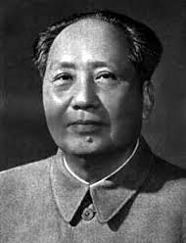
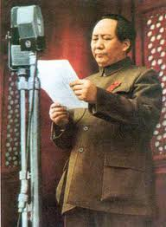
5. The Role of Mao Zedong
Kim Il Sung also had the support of China. Mao was initially sceptical about the success of the invasion.
However Kim persuaded Mao that Stalin was more enthusiastic then he actually was. Mao was also keen to get support from Stalin for his planned attack on Taiwan.
Mao therefore gave his approval to Kim for an attempted invasion of the South.

Slide 21
What were the effects of the Korean War?
Content – Economic, Political, Ideological, Social
Time – Long-term, Short-term, Immediate
Role – Trigger, Catalyst, Pre-condition, Multiplier
Importance – Necessary, Sufficient

Slide 22
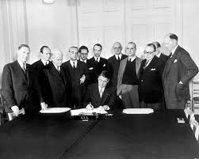
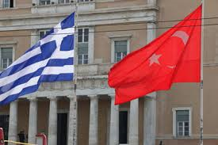
Effects on the USA
The Korean War heightened US fears of further Soviet aggression elsewhere, therefore the NSC-68 recommendations to triple the defence budget were approved.
US land forces in Europe were strengthened along with NATO which added Greece, Turkey and eventually West Germany as members.
Many of these plans had already been discussed before the War, however the War served as a catalyst for these policies.

Slide 23
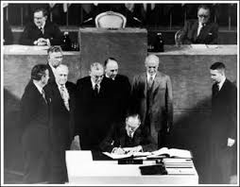
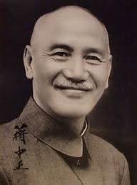
Effects on the USA
The USA signed the Treaty of San Francisco with Japan in 1952. This allowed the US to build military bases in Japan and the US began to rapidly rebuild the Japanese economy.
The US also began increasing its support for Chiang Kai-shek in Taiwan, whilst continuing to isolate China.
The South-East Asia Treaty Organisation (SEATO) was created in 1954 as an anti-communist containment bloc. Members included Thailand, Philippines, Pakistan, USA, UK, France, Australia and New Zealand.

Slide 24
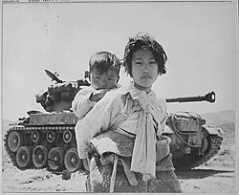
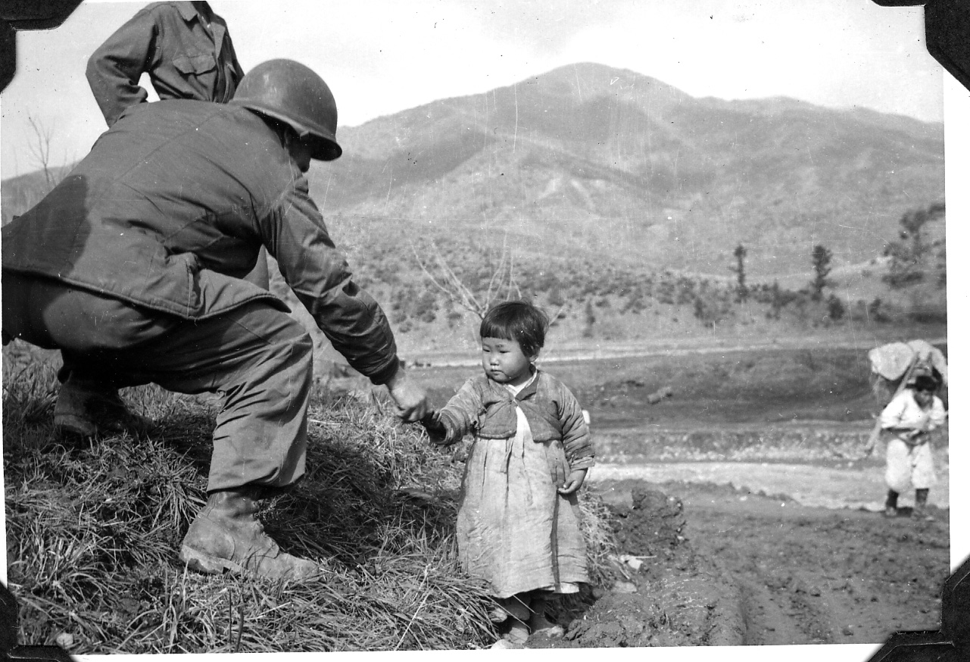
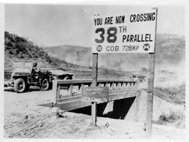
Effects on Korea
The war had cost the lives of over 300,000 civilians and property damage was huge. The peninsula became permanently divided with no hope of reunification.
The 38th Parallel became a new heavily defended frontier in the Cold War that exists even today.
North Korea remains under Communist rule whilst South Korea became a successful democratic and capitalist nation.

Slide 25
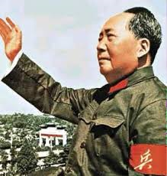
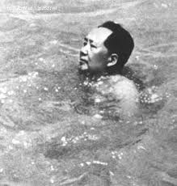
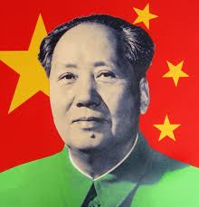
Effects on China
China’s reputation grew after the War, having successfully pushed back US forces. This increased Mao Zedong’s reputation and helped him to consolidate the Communist revolution in China.
Stalin’s reluctance to help China throughout the War would eventually contribute to the division between the two powers, with China taking a more independent stance from Moscow.
However Mao’s aim of uniting Taiwan with China became harder as the USA now committed itself to defending Taiwan.

Slide 26
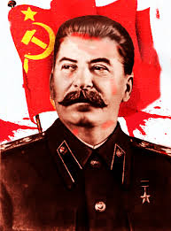
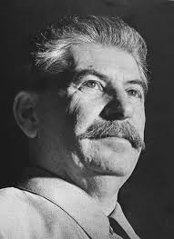
Effects on the USSR
The USSR was not directly involved in the Korean War however it did give tacit consent to North Korea.
In the long-term, the outcome of the War damaged Soviet interests. The USA’s decision to triple its military spending, rearm West German, maintain troops in Europe and contain Communism in Asia drew the USSR into a wider, global conflict.
This would stretch Soviet commitments throughout the world, harming their economy.

Slide 27
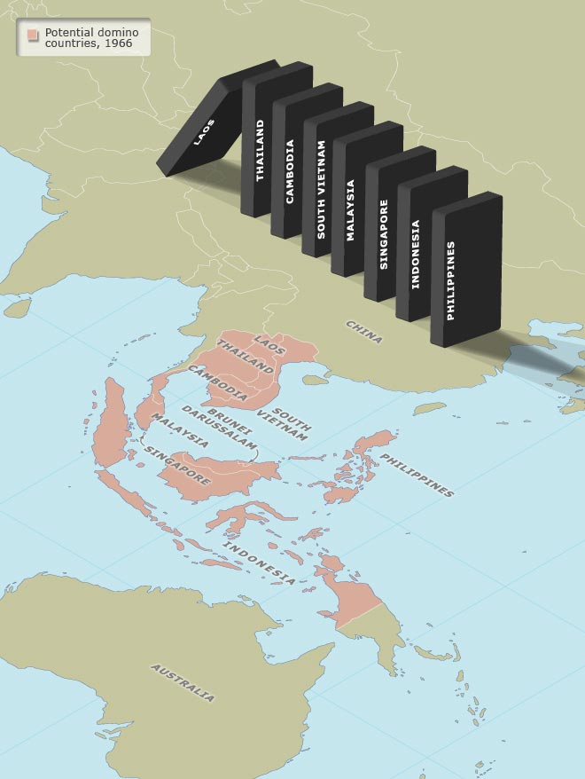
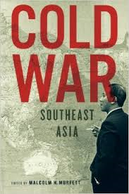
Effects on South-East Asia
The Korean War was an attempt by the USA to contain Communism in Asia. Asia was now a new battleground in the Cold War.
Many nationalist groups in countries like Vietnam, Cambodia, Malaysia and the Philippines all sought independence from Colonial powers. Some of these movements were Communist and increasingly relied in the USSR or China for support.
US policies increasingly confused these national communist groups as being allied with Moscow. This would eventually lead to the USA’s involvement in Vietnam.

Slide 28
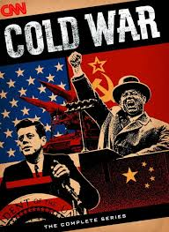
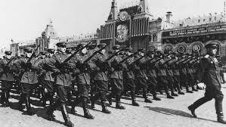
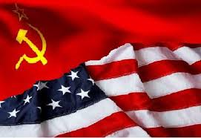
Effects on the Cold War
The Korean War effectively globalised the Cold War. It was no longer just a European conflict but a global conflict which would also affect other parts of the developing world.
It also led to increasing militarisation. Both sides increased their military budgets, with the USA’s military budget reaching 10% of GNP in the 1950s.
The USSR increased the size of the Red Army from 2.8 million troops to 5.8 million!

Slide 29
Paper 2 - Exam Question 1 (2007)
For what reasons, and with what results for East-West relations, did the superpowers become involved in the affairs of one of the following: Korea; Vietnam; the Middle East? (15 marks)
A two-part question requiring candidates to explain the motives behind involvement in either area of conflict and what result this had for East-West relations. It is not an invitation to detail or recount the course of the conflicts in either area.
For Korea, accept answers which use either the start of the Korean War in 1950, or the “liberation” from Japan in 1945 as a starting date. For Vietnam – accept starting date from either 1946, or from 1960–61. Middle East – could include the Arab-Israeli dispute characterized by a series of wars since 1948 and/or Iran/Iraq/Afghanistan.
Reasons could include: ideology; strategy; mutual fear of perceived rival expansion; prestige; proxy/surrogate conflict; economic resources etc.
Results could include: intensification of tensions; economic and political burdens placed upon superpower participants; arms/technological development; realisation of risk of direct confrontation leading to periods of peaceful co-existence/détente; increasing role of PRC in East-West confrontation etc.

Slide 30
1-3 L1 | Demands of question barely understood; poorly structured with minimal focus on the task; little knowledge is present; some factual examples identified but factually incorrect, irrelevant or vague; very little or no critical analysis; mostly generalisations or poorly substantiated assertions
4-6 L2/3 | Some understanding of question; attempts at structured approach but lacks clarity and coherence; knowledge is present but lacks accuracy and relevance; factual examples identified but are vague or lack relevance; some limited analysis but is mostly descriptive/narrative in nature, not analytical
7-9 L4/5 | Demands of question understood but only partially addressed; attempts at structured approach; knowledge is mostly accurate and relevant; factual examples are appropriate and relevant; some analysis or critical commentary but is not sustained throughout
10-12 L6/7 | Demands of question understood and addressed; focused and generally well-structured; knowledge is accurate and relevant; factual examples are used to support analysis/evaluation; critical analysis is present and mostly clear and coherent; some awareness of different perspectives; most points are substantiated and argued to a consistent conclusion
13-15 L7 | High degree of awareness of demands and implications of question; clearly focused and well-structured; knowledge is detailed, accurate and relevant; factual examples are used effectively to support analysis/evaluation; critical analysis is well-developed, clear and coherent; there is evaluation of different perspectives; all main points are substantiated and argued to a reasoned conclusion

