Slide 1
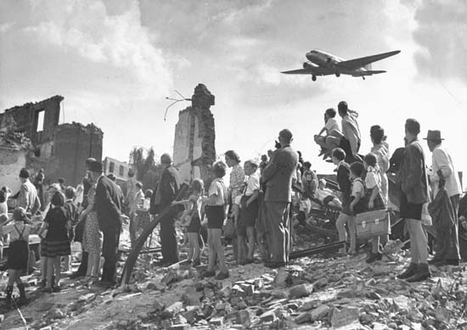
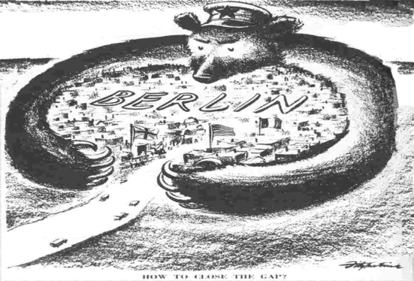
Did the Berlin Blockade ‘trigger’ the Cold War?
L/O – To identify the causes and effects of the Berlin Blockade on relations between the superpowers

Slide 2
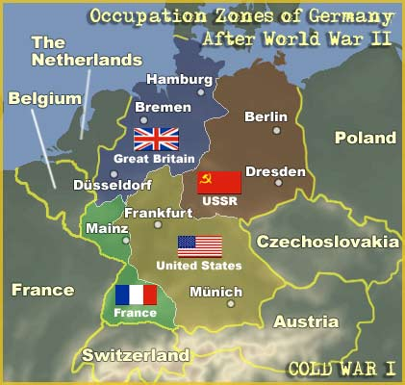
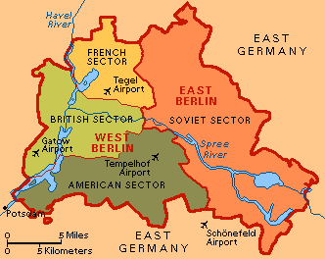
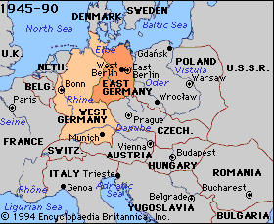
The Occupation of Germany
In 1945, Germany was invaded by Western Powers and Soviet forces. It was decided at Yalta and Potsdam to temporarily divide Germany into four zones, all administered by the Allied Control Council (ACC).
Berlin itself would be administered by the Allied Kommandantura, made up of four military governors.
This was a temporary arrangement. The intention was to keep Germany as one economy that would eventually become an independent state again. However by 1949, Germany had become permanently divided.

Slide 4
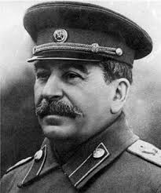
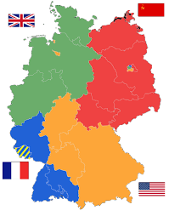
Long-Term Conflicts over Germany
1. Differing Aims of the Powers – Germany’s position in Europe and its economic potential made it an area of concern.
The USSR did not want a resurgent and threatening Germany. It also wanted US$20 billion in reparations.
France also feared a united Germany and was in no rush to see Germany prosper again.
However the USA and UK saw the rapid economic recovery of Germany as the best way to contain communism.

Slide 5
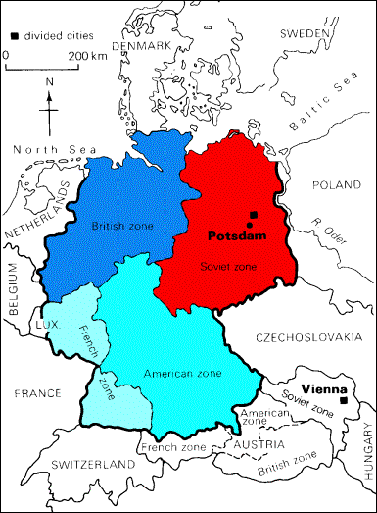
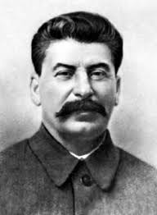
Long-Term Conflicts over Germany
2. Increasing Lack of Trust – As the Cold War developed, suspicions between the East and West intensified.
Both sides were concerned that a powerful Germany could once again be a threat if it joined with either side. Neither side wanted their opposing zones to recover before their own.
Stalin feared a pro-American and economically prosperous Germany. The West feared the influence of a Communist Germany.

Slide 6
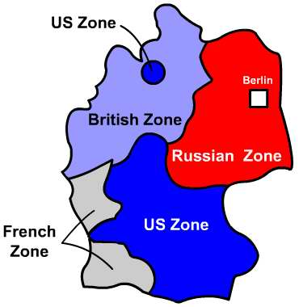
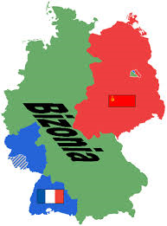
Specific Disagreements over Germany
Economic Disagreements – At Potsdam it was agreed that the USSR could take 25% of all industrial equipment from Western Zones. In return, the USSR had to supply food and raw materials.
However, the USSR failed to deliver enough food, therefore the UK and USA stopped supplying the Soviet zone.
The Soviets also wanted coal from Western Zones, however the Americans exported 25 million tons of coal to Western Europe instead.
On 1st January 1947, the British and American zones were merged into one called ‘Bizonia’. This angered Stalin who wanted to prevent the West from rebuilding Germany.

Slide 7
Specific Disagreements over Germany
Political Disagreements – As early as 1945, Stalin made moves to incorporate Germany into Moscow’s sphere of influence.
In April 1946, the Soviets forcibly merged all political parties in their zone to form the Socialist Unity Party (SED).
However the SED failed to win support in the Western Zones as many Germans feared Soviet influence. As a result, SED leaders began planning their own regime in the East.

Slide 8
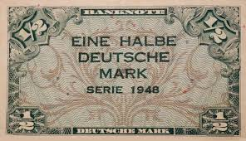
Specific Disagreements over Germany
Meanwhile, Western allies decided to consolidate their occupying zones.
At the London Conference of Foreign Ministers in 1948, France, Britain and the USA began drawing up a constitution for a new West German state. Soviet spies told Stalin everything.
They also agreed to introduce a new currency, the Deutschmark, in the Western Zones. Stalin viewed this as the first step in the establishment of a new Germany.
To stop this, Stalin decided to blockade Berlin in an attempt to force the West out.

Slide 9
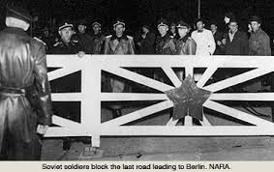
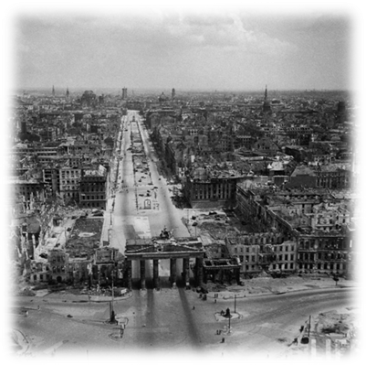
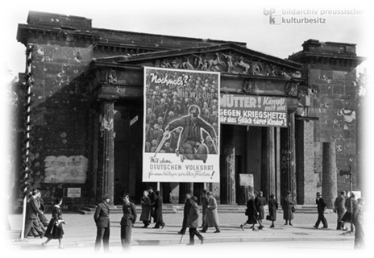
What happened?
In response to the introduction of the new currency, Stalin launched a total blockade of West Berlin on 23rd June 1948.
All road, railway and waterways linking West Berlin to the Western Zones of Germany were closed. Supplies of electricity were also cut. The USSR also left the Allied Control Council for Germany and the Berlin Kommandantura.
This left the West with a stark choice, they didn’t want to risk war with the USSR but they didn’t want to let West Berlin fall to the Communists.

Slide 10
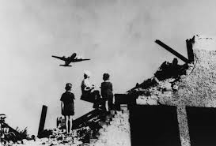
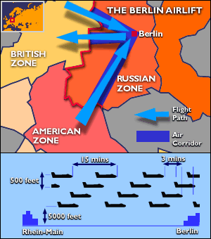
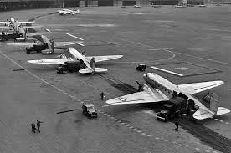
What happened?
To avoid war, the West decided to bypass the blockade entirely by airlifting supplies to West Berlin.
Over 320 days, the West flew 200,000 flights to Berlin, supplying over 1 ½ million tons of food and coal to 2.2 million West Berliners at a cost of $100 million. 1 plane landed every three minutes and had 7 minutes to unload.
It worked. By May 1949 Stalin realised his gamble had failed. He couldn’t force the West out of Berlin without using force.

Slide 11
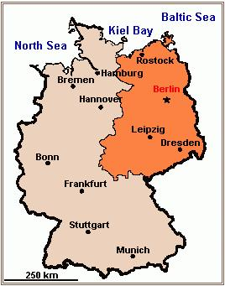
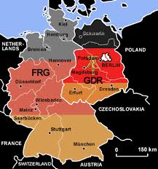
Results of the Blockade
The Berlin Blockade was the first major confrontation of the Cold War. During the Blockade, war appeared like a distinct possibility.
Agreement now seemed impossible. In the short-term, Germany became permanently divided.
The West created the Federal Republic of Germany (FRG) in May 1949. Konrad Adenauer became its first Chancellor. In October, the USSR created the German Democratic Republic (GDR).

Slide 12
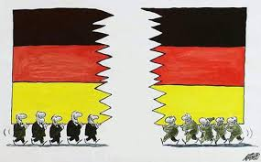
Results of the Blockade
Berlin remained a divided city under four-power control. This would cause tensions for another 12 years, resulting in the construction of the Berlin Wall in 1961.
More significantly, the Blockade reinforced Western suspicions of Stalin. The risk of war persuaded the USA that they need to commit military forces to Europe.
This resulted in the creation of the North Atlantic Treaty Organisation (NATO) in April 1949 which was a military alliance of the USA, UK, Canada, Norway, Denmark, Iceland, Italy, France, Holland, Luxembourg, Belgium and Portugal.

Slide 13
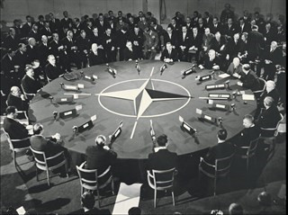
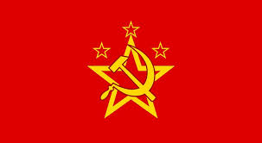
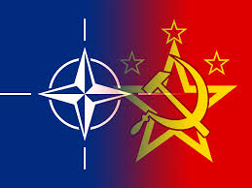
Results of the Blockade
In May 1954, West Germany was also admitted to NATO. This angered the USSR who feared a re-armed pro-Western Germany.
In response, the Warsaw Pact was created in 1955 to unite all the countries of Eastern Europe under the military command of the USSR.
The creation of both military alliances led to a build up of conventional forces across Europe.

Slide 14
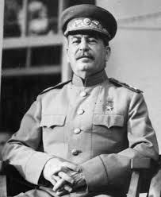
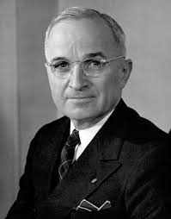
Conclusions
Before the Blockade, there was a clear economic and political divide in Europe. Now there was also a military divide – all elements of the Cold War had now fallen into place.
Germany now became officially divided and both states (GDR/FRG) refused to recognise the existence of each other. The division of Europe was now complete.
Stalin had backed down in the end. However in August 1949, the USSR tested its first Atomic Bomb. Would it back down next time?

