Slide 1
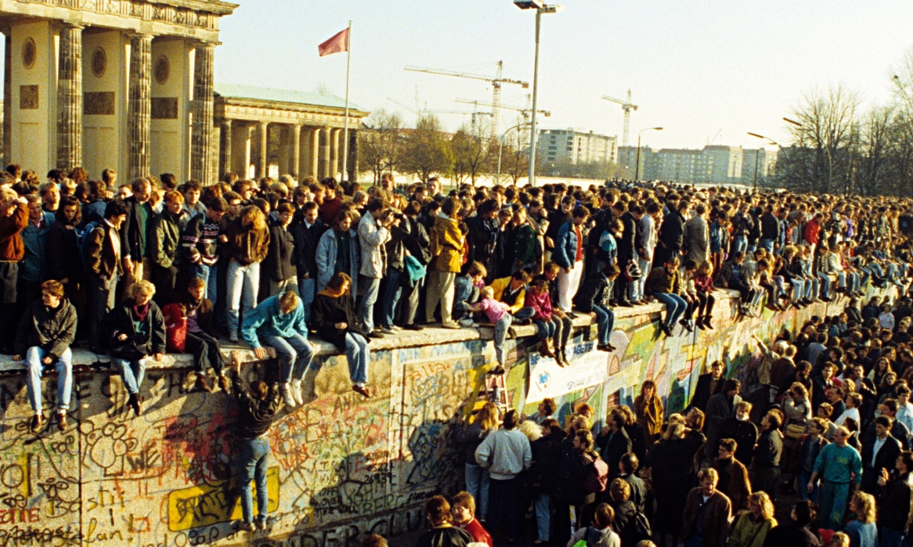
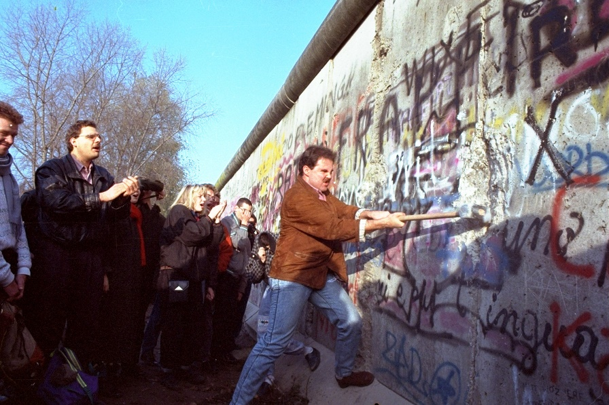
What caused the collapse of the USSR and end of the Cold War?
L/O – To identify and evaluate the long and short-term causes of the collapse of the USSR

Slide 2
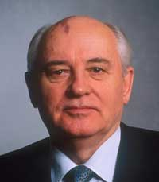
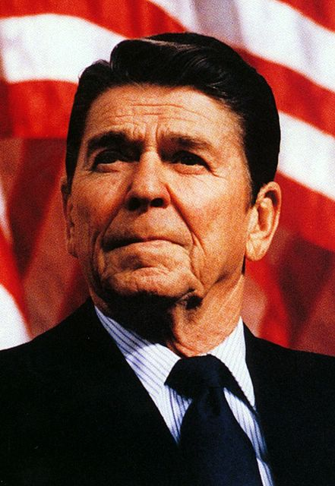
The ‘Sudden’ Collapse of the USSR
On Xmas Day in 1991, Mikhail Gorbachev resigned as President and the USSR ceased to exist. Thus ending the Cold War. No one in the West had predicted it!
The immediate collapse began in 1989 as communist governments fell all over Eastern Europe in a wave of popular protests. Even the Berlin Wall was torn down in November.
Many have attributed the causes of the collapse to the reforming policies of Mikhail Gorbachev. Others argue that it was the pressures of the arms race put on the USSR by US President Ronald Reagan.

Slide 3
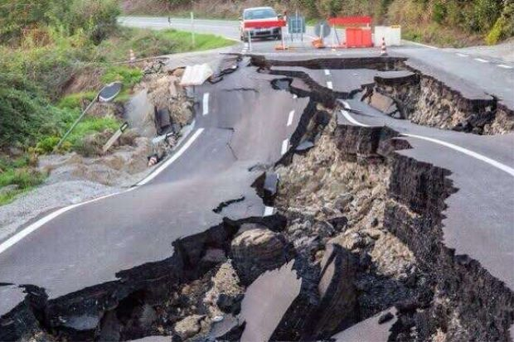
The ‘Sudden’ Collapse of the USSR
In history, historians try to identify the key causes of events. This requires us to consider both the long-term and short-term reasons.
Like an earthquake, we don’t often see the long-term underground geological pressures – all we see is the sudden shake on the surface!
We therefore need to consider the long-term social, political, economic, ideological and military pressures (SPERM!) and how they made a collapse in 1989 possible.

Slide 4
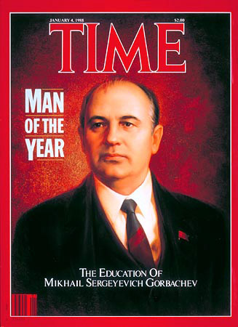
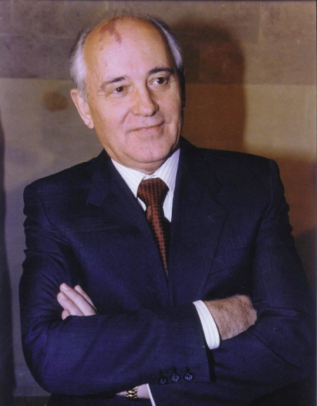
The Role of Leaders - Gorbachev
When Mikhail Gorbachev became leader of the USSR in 1985, he introduced two new reforming ideas – Glasnost and Perestroika.
Glasnost (openness) called for more democracy within the USSR. He believed the people should be able to scrutinise government in order to reform it.
Perestroika (restructuring) called for changes to the command-economy. Market forces were to be introduced and private business allowed. Military spending was reduced.

Slide 5
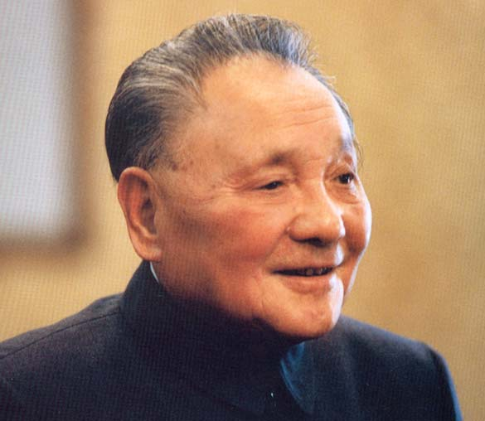
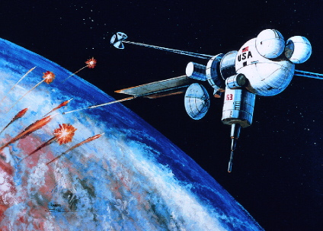
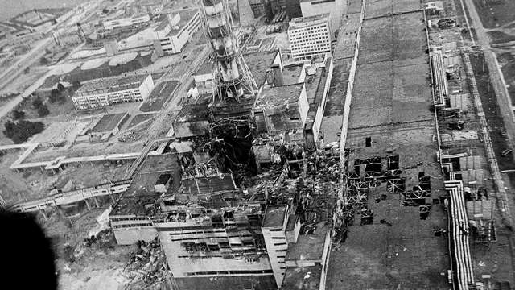
The Role of Leaders - Gorbachev
Similar to the reforms in China that had begun under Deng Xiaoping in 1978, Glasnost and Perestroika was an attempt to reform the Communist system, not abolish it!
Gorbachev also knew that the USSR couldn’t complete with the USA in the arms race. Reagan’s Strategic Defence Initiative (SDI) was too technologically advanced for the USSR.
The arms race had to be abandoned. The USSR simply couldn’t compete anymore. The Chernobyl disaster in April 1986 also highlighted to Gorbachev the dangers of nuclear weapons.

Slide 7
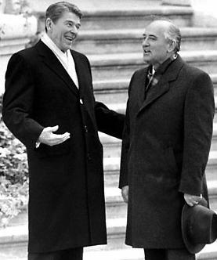
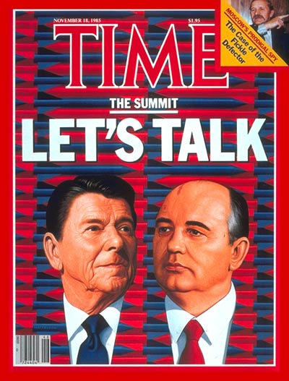
The Role of Leaders - Gorbachev
Gorbachev therefore knew that the arms race had to be ended if he was to reform the USSR. This led to a series of summits:
Geneva, Nov 1985 – Gorbachev and Reagan agreed ‘a nuclear war cannot be won and must not be fought’.
Reykjavik, Oct 1986 – Disagreements over SDI but discussed arms control.
Washington, Dec 1987 – INF Treaty signed. Abolished land-based nukes, inspections.
Moscow, May 1988 – Further arms reductions. Reagan no longer believes in an ‘evil empire’.

Slide 8
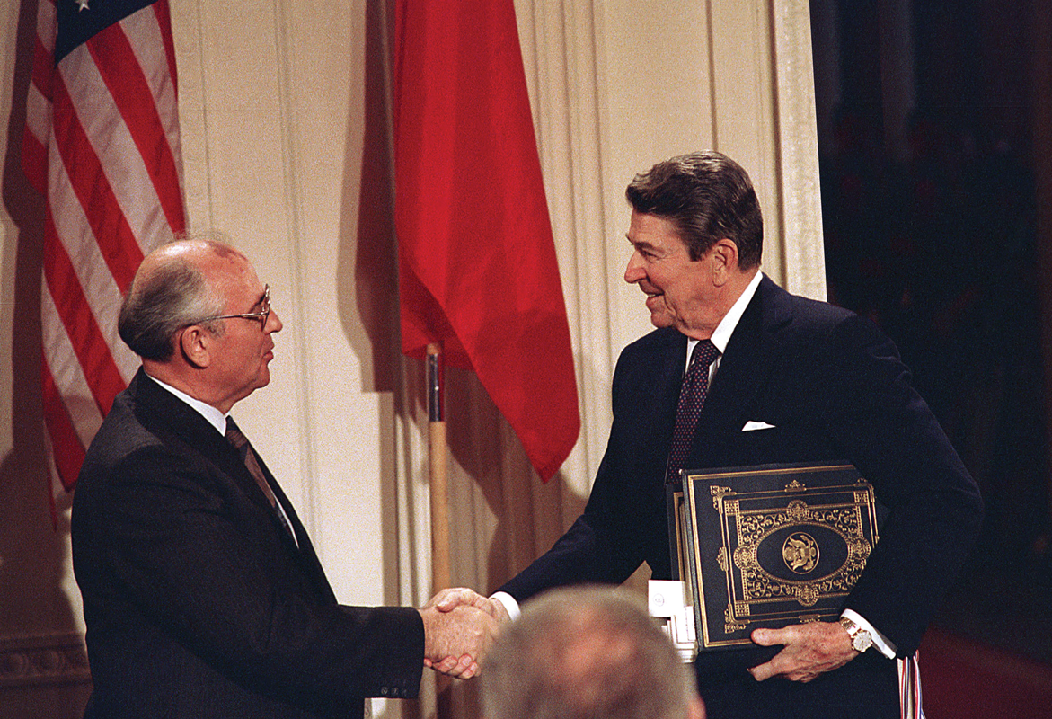

Slide 9
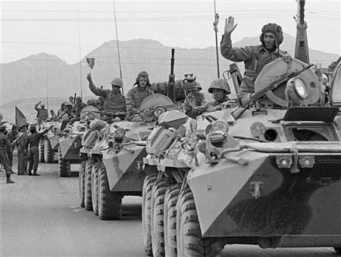
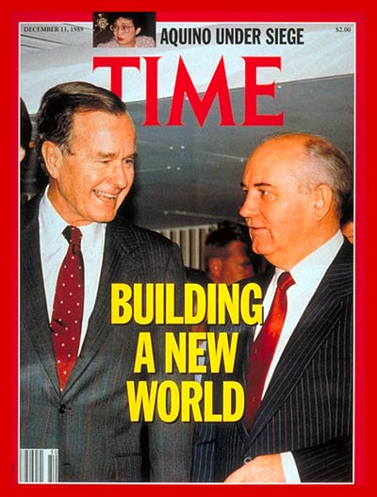
The Role of Leaders - Gorbachev
The success of the summit meetings were in large part successful due to the personal chemistry between Gorbachev and Reagan and the desire to reach a deal.
In 1988 Gorbachev improved relations even further by announcing the Soviet withdrawal from Afghanistan.
In the Malta Summit of 1989, new US President George HW Bush announced that the superpowers had ‘buried the Cold War at the bottom of the Mediterranean’.

Slide 10
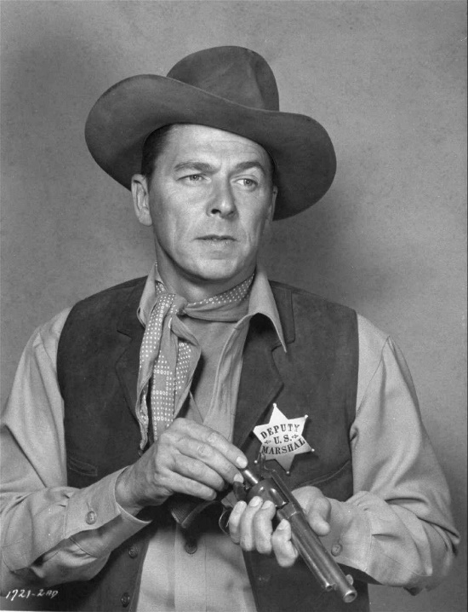
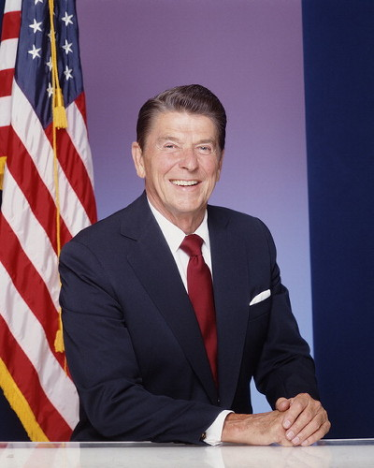
The Role of Leaders - Reagan
Many Western historians argue that despite Gorbachev’s role, it was the policies of Reagan that pressured the USSR into ending the Cold War.
The ‘New Cold War’ started by Reagan in 1982 increased USA military spending by 13% and introduced the SDI programme. This pushed the Soviet economy to breaking point.
These ‘Reagan Victory School’ historians are critical of the détente policies of Jimmy Carter in the 1970s. They argue that détente only helped to prolong the existence of the USSR.

Slide 11
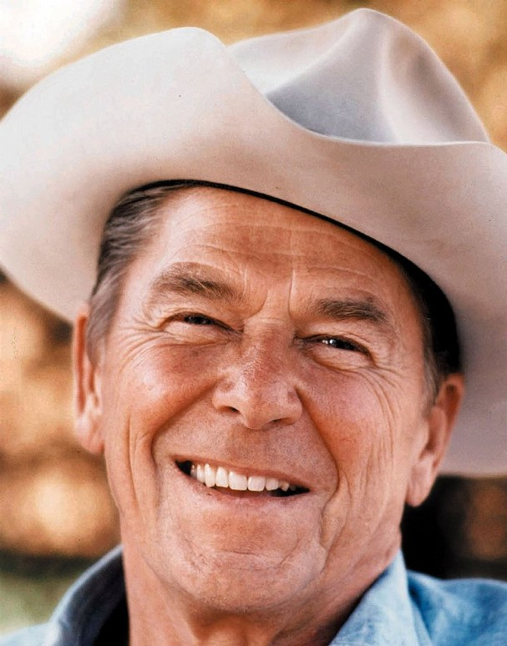
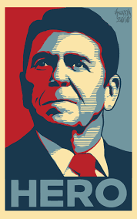
The Role of Leaders - Reagan
Many also credit Reagan with being willing to negotiate and compromise with the Soviet Union when it was clear that Gorbachev was willing to introduce drastic changes.
By being a hard-line republican who hated communism, Reagan had the political power to negotiate from a position of strength. Historian Robert J McMahon:
‘To his great credit, Reagan proved willing first to moderate, then to abandon, deeply held personal convictions about the malignant nature of Communism, thereby permitting a genuine rapprochement to occur’.

Slide 12
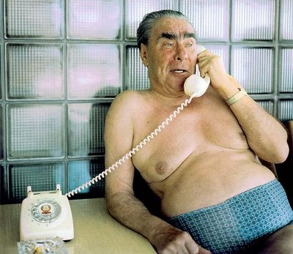
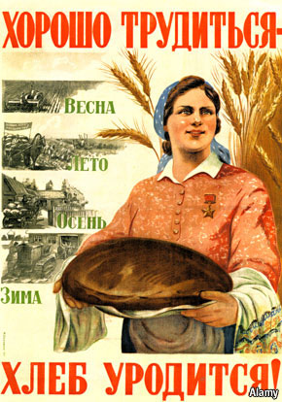
Long-term Causes: Economic Collapse
It could be argued that by 1982, the Soviet economy was near collapse – this prompted Gorbachev to introduce reforms and end the arms race in the first place.
Under Brezhnev, the USSR achieved nuclear parity with the USA but at a cost of spending 25% of GDP. The USA was only spending 4-6%!
The USSR also had costly foreign commitments. The war in Afghanistan was draining resources. The USSR also gave $4 billion a year to Cuba, $6 billion to Vietnam. $3 billion was given to E. Europe.

Slide 14
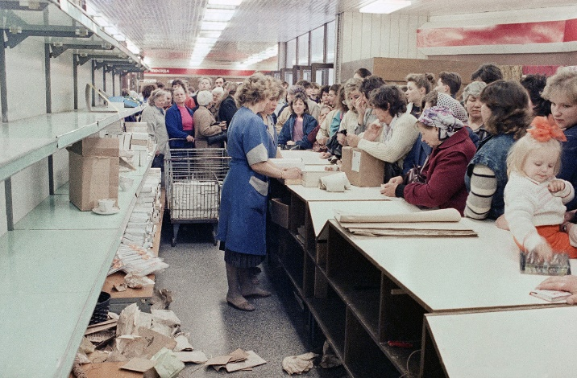
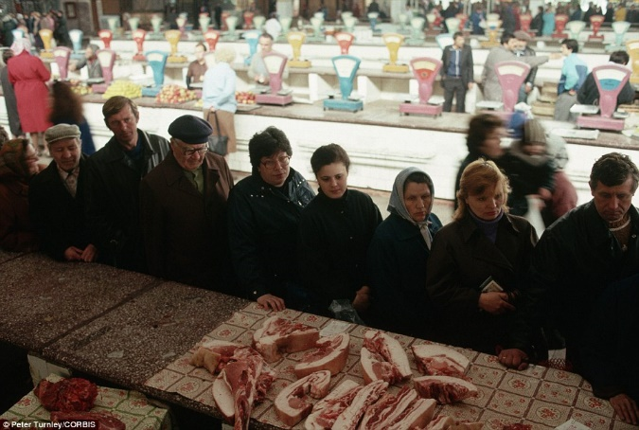
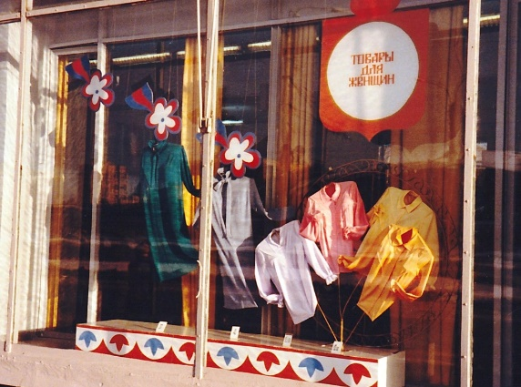
Long-term Causes: Economic Collapse
It was also clear that the Stalinist-era ‘command economy’ was failing. Very little money was put into producing consumer goods and promoting domestic demand.
No incentives to work harder or be more efficient. Corruption was rampant. Annual growth dropped from 5.2% in 1967 to 2% in 1980!
The Soviet economy was therefore imploding under the strains of military competition with the USA.

Slide 15
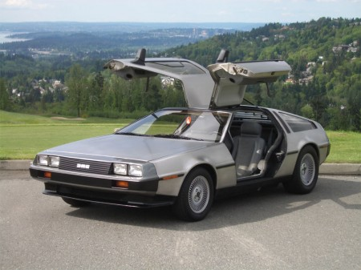

Slide 16
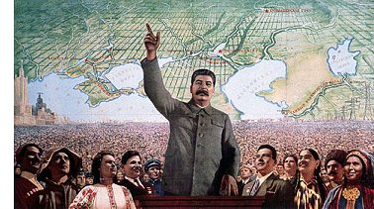
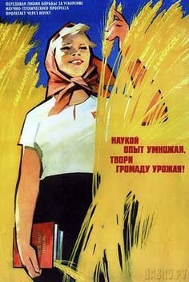
Long-term Causes: Ideological Collapse
The USSR was a regime built by Stalin with Communist ideology at its core. Its people were indoctrinated with the belief that they were building a better world and their system was better.
Yet by the 1980s, all the promises of the system had failed to become true. World revolution had not occurred, crime had risen, nationalism and religion had not disappeared.
The cohesive ‘faith’ that Soviet people had in the system was slowly eroded. This provided Gorbachev with the pressure for reform, even from people in leadership:

Slide 17
General Dmitriy Volkogonov:
‘I was an orthodox Marxist, an officer who knew his duty. I was not part of some liberal current. All my changes came from within, off on my own. I had access to all kinds of literature. .. I was a Stalinist. I contributed to the strengthening of the system that I am now trying to dismantle. But latently, I had my ideas. I began asking myself questions about Lenin, how, if he was such a genius, none of his predictions came true. The proletarian dictatorship never came to be, the principle of class struggle was discredited, communism was not built in fifteen years as he had promised. None of Lenin's major predictions ever came true! I confess it: I used my position, I began gathering information even though I didn't know yet what I would do with it.’
(Remnick, 1992, p. 15)

Slide 18
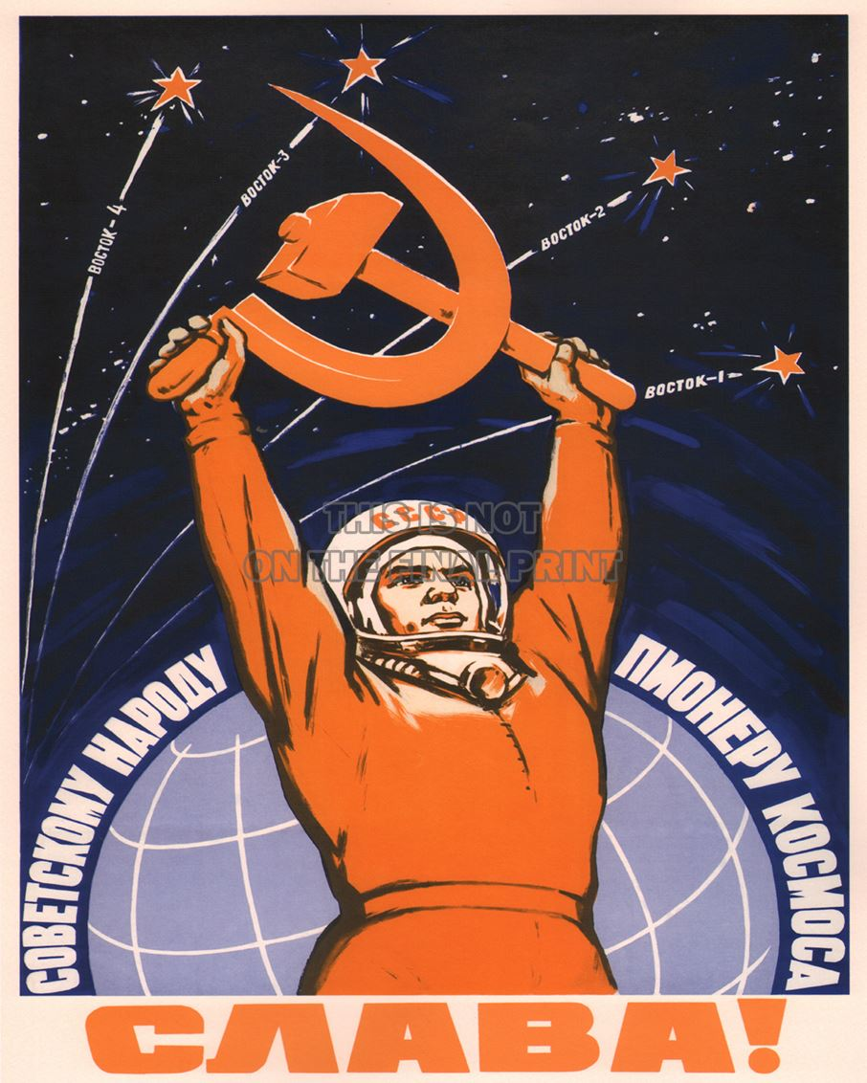
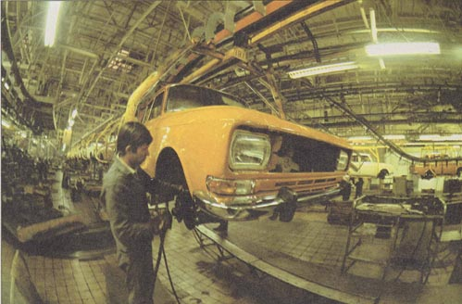
Long-term Causes: Social Collapse
As the economy collapsed, members of society also lost faith in the system. Soviet citizens growing up in the 1970s/80s faced a lack of career opportunities.
Ambitious young people had received a free education and were indoctrinated with high expectations in the Soviet system. Without enough jobs, many in society lost optimism and faith in the system.
Alcoholism and anti-social behaviour became rampant throughout the Soviet bloc.

Slide 19
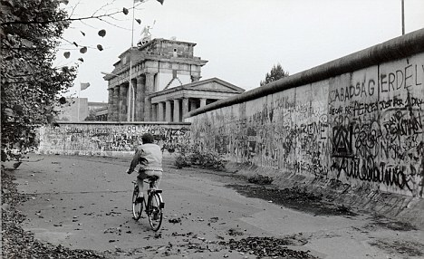
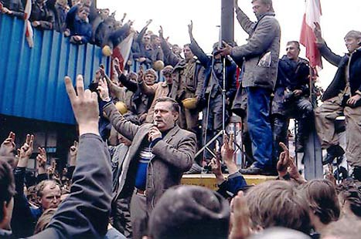
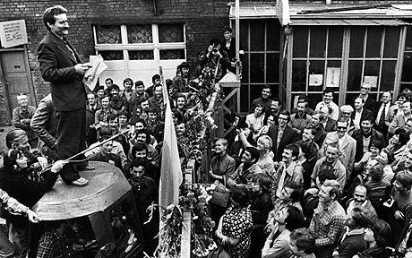
Long-term Causes: Nationalist Feeling
Due to the combination of economic collapse and ideological/social decline, nationalist movements grew across Eastern Europe in the 1980s.
Many in places like East Germany, Czechoslovakia and Poland grew disillusioned with the Communist Party. It seemed to have no interest in reform and was repressive.
Many had access to radio and TV from the West. They could see the difference! Glasnost and Perestroika also seemed to allow people to criticise their leaders!

Slide 20
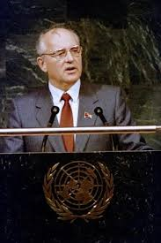
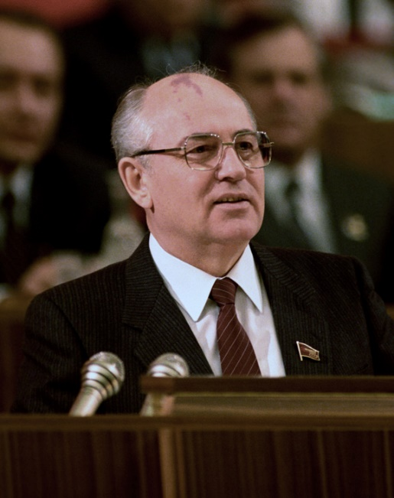
Long-term Causes: Nationalist Feeling
In December 1988, Gorbachev gave a speech to the UN announcing that the USSR would cut its troop commitments to the Warsaw Pact by ½ million men.
He argued that, ‘force and the threat of force cannot be and should not be an instrument of foreign policy… Freedom of choice is… a universal principle and it should know no exceptions’.
This was a complete overturn of the Brezhnev Doctrine – using force to rule Eastern Europe. He seemed to be saying that he wouldn’t stop people in Eastern Europe from choosing their own rulers!

Slide 21
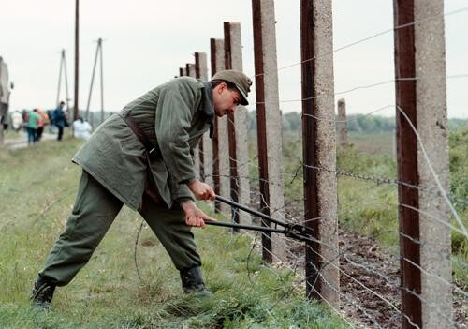
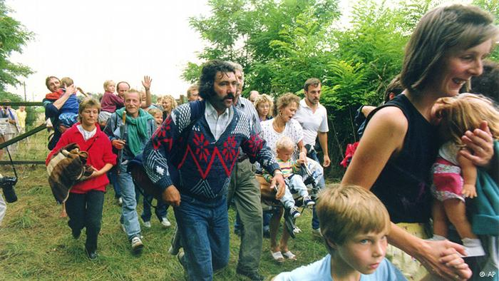
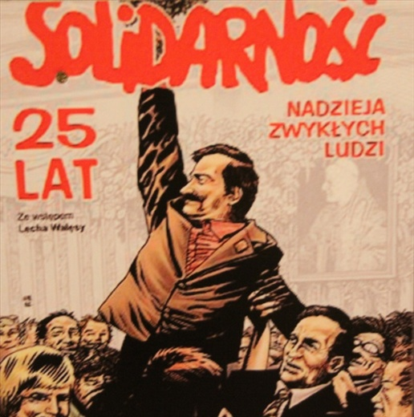
The Events of 1989
In May 1989, the Hungarian government stopped patrolling its Austrian border. Tens of thousands of people from East Germany simply went on holiday to Hungary and never came back!
At the same time, in Poland, the ‘Solidarity’ union movement which was legalised in 1988, won the first free elections in Poland. Poland became the first country not to be ruled by communists. Gorbachev refused to use force to support the communists!

Slide 22
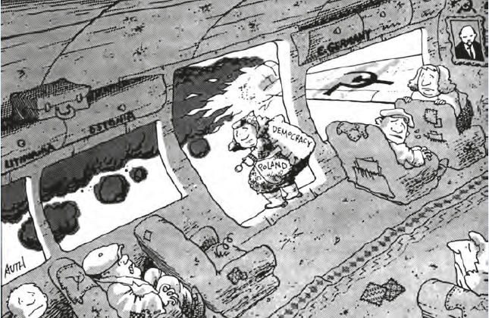

Slide 23
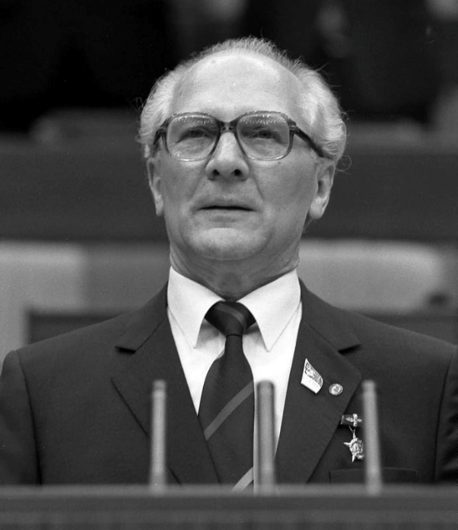
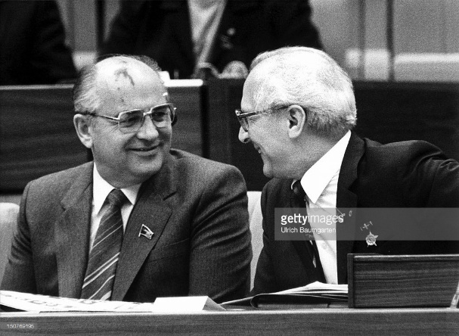
The Events of 1989
By October, people across East Germany were either fleeing to Austria or were begin to publically protest against its government. Its leader, Erich Honecker, wanted to use force to put down the protests.
Gorbachev then visited Honecker and told him that the USSR would not intervene if the people revolted! In a panic, the government announced on 9th November an easing of travel restrictions.
In the confusion over the order, people descended on the Berlin Wall and the guards let them through. People on both sides then started dismantling the Wall!

Slide 24
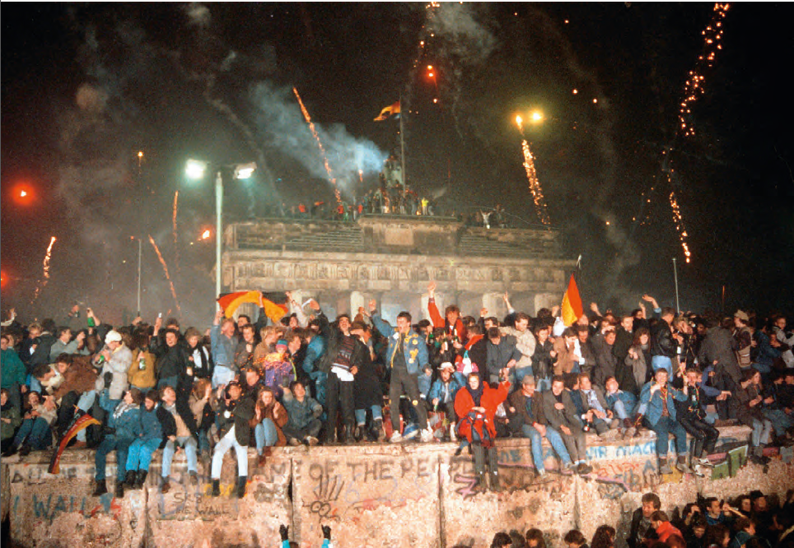

Slide 25
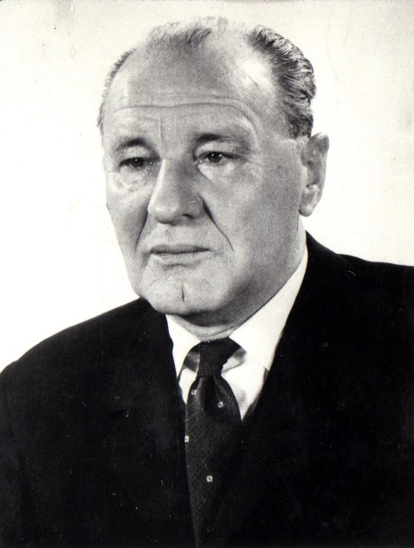
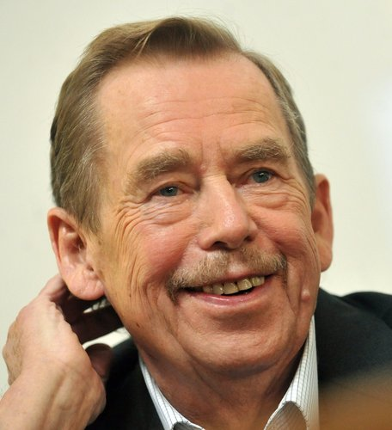
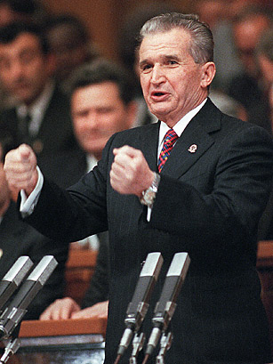
The Events of 1989
In October, Hungary’s hardliner leader, Janos Kadar, was sacked by reforming communists. Free elections were held in 1990.
In Czechoslovakia, the ‘Velvet Revolution’ took place. Mass demonstrations led to pressure for free elections. Vaclav Havel was elected President.
In Romania, it’s repressive President Nicolai Ceausescu tried to use force to put down protests. However the army turned on him. He tried to flee but was arrested and executed by the army of Xmas Day 1989.

Slide 26
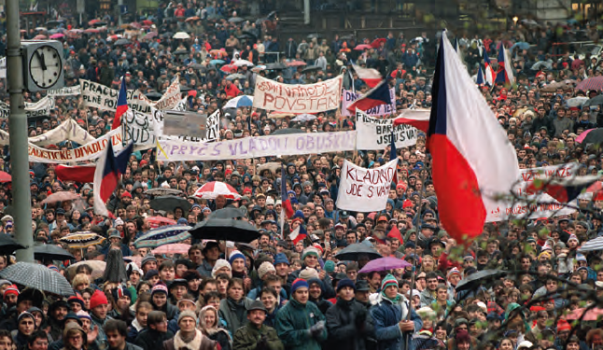

Slide 27
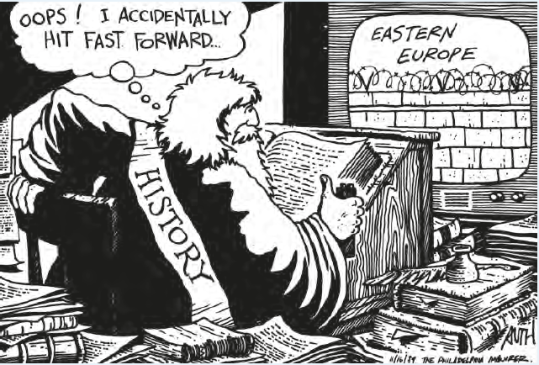

Slide 28
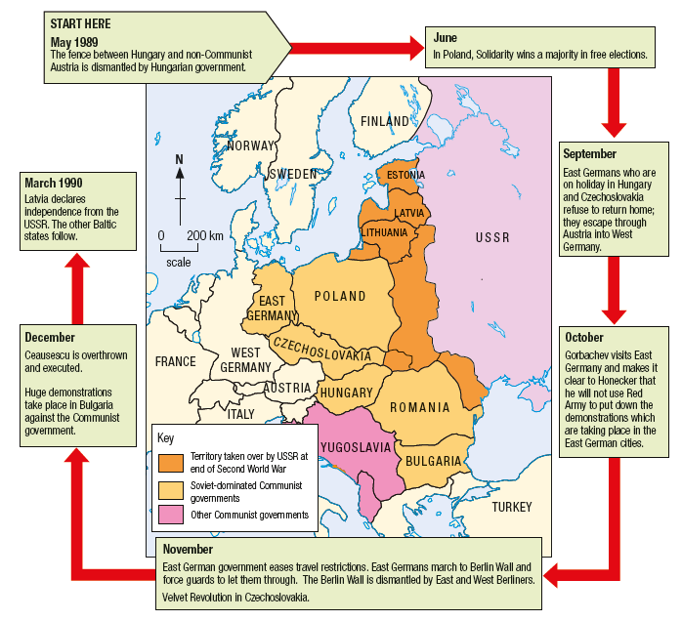

Slide 29
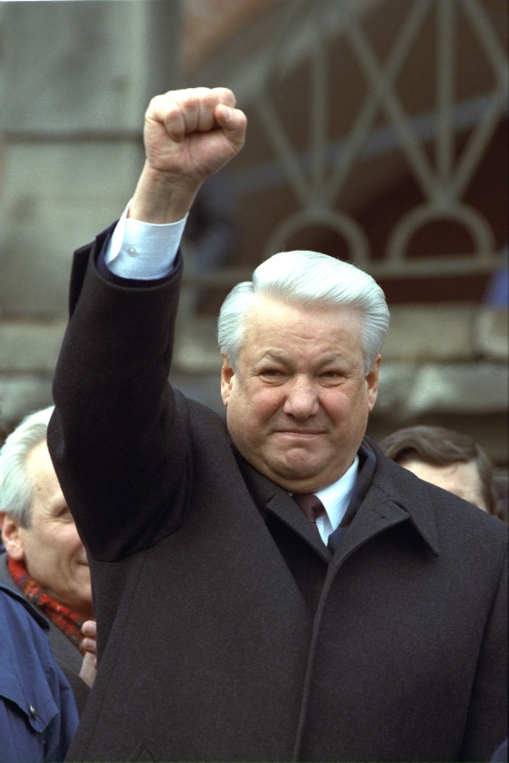
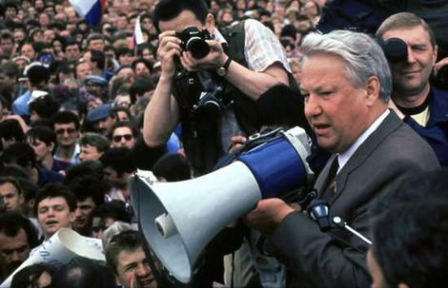
The Collapse of the USSR
The collapse of the communist regimes in Eastern Europe also encouraged calls for independence within the republics of the USSR.
In 1991, Estonia, Latvia and Lithuania all declared independence from Russia. Gorbachev became deeply unpopular due to his inability to improve the economy.
In August 1991, hard-line communists attempted a coup. This was defeated by the President of Russia, Boris Yeltsin who confronted the soldiers.

Slide 30
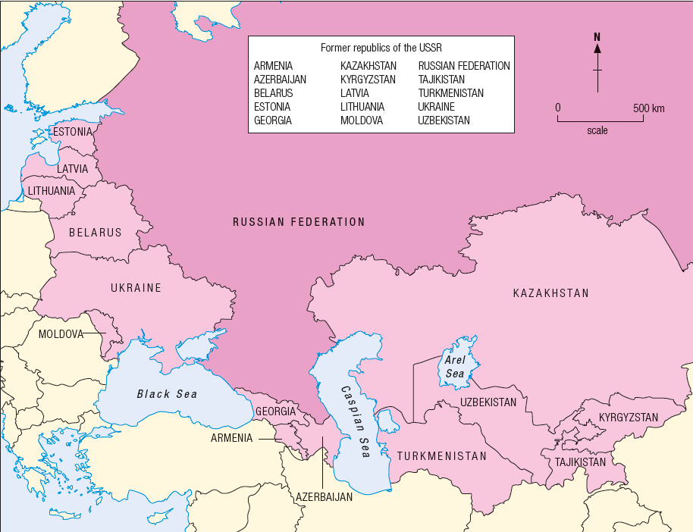

Slide 31
The Collapse of the USSR
Yeltsin restored Gorbachev who remained as President of the USSR. However he was put under pressure by Yeltsin to resign. On 25th December 1991, Gorbachev resigned as President.
The USSR was formally dissolved, being replaced by the Commonwealth of Independent States (CIS). Russia became the Russian Federation with Boris Yeltsin as its first President.

Slide 32
Military Failures
Economic Stagnation
Ideological & Social Malaise in Soviet Bloc
Role of Gorbachev
Role of Reagan
Afghanistan 1979-89, Costs, ‘Vietnam Effect’,
Events of 1989
Nationalist Movements
Summit Meetings
Glasnost, Perestroika, Democratisation, 1988 UN Speech, Refusal to Use Force, Visit to Honecker 89
Zero Option, SDI, Containment, Evil Empire, Increased Defence Spending, Stealth Bomber, Trident
Geneva 85, Reykjavik 86, Washington 87, Moscow 88, Malta 89 – INF Treaty
Little growth, No consumer goods, lack of jobs, absenteeism, inefficient, imports food, low oil prices
Self-doubt in leaders, failure to beat capitalism, Alcoholism, Anti-Social behavior, Criticism
Solidarity in Poland, Influence of Catholic Church, New Forum in East Germany, Civic Forum in Czecho.
Hungary removes border in May, Solidarity wins Elections in June, Berlin Wall/Velvet Rev. in Nov

