Slide 1
Authoritarian states
Nazi Germany

Slide 2
Collapse of empires

Slide 3
Collapse of German empire
Following WWI
WWI Armistice 11/11/18
Germany required to submit to Treaty of Versailles – June 1919
Loss of territory
Forbid anschluss (alliance with Austria)
War Guilt Clause
Demilitarization
War Reparations (50 billion marks)

Slide 4
Territorial Loss Germany
Alsace-Lorraine to France
Eupen and Malmedy to Belgium
Saar region (industrial) administered by League of Nations
Northern Schleswig to Denmark
Rhineland demilitarized
West Prussia and Silesia to newly established Poland
Hultschin to Czechoslovakia
Danzig free city under League of Nations protection
Loss of ALL colonies
13% of European territory
1/10 of its population (6.5 – 7 million people)

Slide 5
https://www.ushmm.org/outreach/en/media_nm.php?MediaId=1620

Slide 6
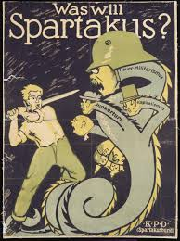
Weimar Republic
Democratic governing system that replaced Kaiser Wilhelm – abdicated 11/9/18
German Revolution
Suffrage granted to everyone over 20 (women too!)
Voted every 7 years for President – oversees Reichstag
Could call elections for Reichstag as he deemed necessary
Appoints Chancellor – ran government and proposed laws
Voted every 4 years for Reichstag representatives (legislative)
Proportional representation - % national vote = % seats in Reichstag
Laws must be passed by majority
Coalition governments form

Slide 7
Weimar republic
Numerous revolutionary coup attempts
Spartacus League
Socialist revolutionaries Dec. 1918
Attempt to destabilize Weimar Republic
Leaders arrested and killed in prison
1920 Revolution Dr. Wolfgang Kapp
Berlin
Fails after a general strike
1923 Beer Hall Putsch
Hitler and SA attempted revolution in Munich

Slide 8
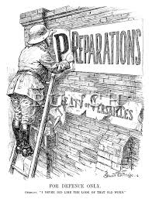
Economic Hardships
Constant revolutions and uprising lead to Germany missing a payment on reparations – could be paid in raw materials
French occupation of Ruhr an industrial heartland
Weimar Republic prints money to pay off reparations → Hyperinflation!
Loaf of Bread – Jan. 1923 = 163 marks → Nov. 1923 = 75 billion marks
1924 Dawes Plan –
French leave Ruhr
Staggered reparation repayment,
800 million mark loan from US
Oct. 1929 – Wall Street collapse, US recalls loans…

Slide 9
Nazis
NSDAP – National Socialist German Workers’ Party
Founded 1919 Anton Drexler as German Workers’ Party
Adolf Hitler would become chairman 1921

Slide 10
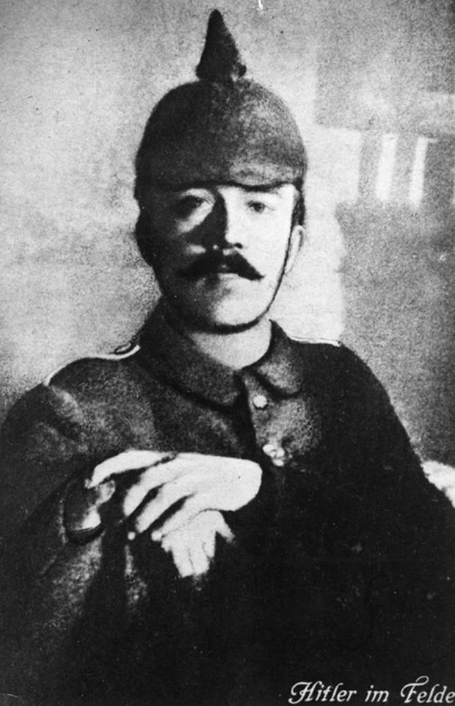
Adolf Hitler
1889 – born Branau, Austria
1907/1908 – failed art student
1914 – Western front, dispatch runner, eventual corporal
1918 – hospital recovering from poison gas attack – armistice
1919 – enlightenment project spying on political movements for army – first encounter with German Worker’s Party
1920 – helps write party platform, name changes to NAZI
1921 – leader of party

Slide 11
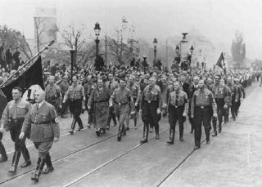
Nazis development
1921 – SA (sturmabteilung) created → becomes paramilitary group (will be replaced by SS (Schutzstaffel); Voelkischer beobachter (People’s Observer) Nazi newspaper
1923 – 55,000 members (German electorate of 38 million)
Nov. 1923 – Beer Hall Putsch – Nazi led attempted coup “March on Munich”
March on Rome – Mussolini comes to power in Italy leading to Fascist control of gov’t Oct. 1922
Late 1920’s see participation in Reichstag and development of SS

Slide 12
Rise to power
1929 forces changes in world markets
President Hindenburg invokes Article 48 – allowing President to bypass Reichstag in times of state emergency
Rising fervor among German people
Turning to groups to fix economy
Nazis begin gaining seats – 230 in July 1932, largest in Reichstag (608 total seats)
Promises of jobs, middle class values, and a restoration of national strength for Germans
Communist and Jews enemies of German people
Unify German people
Dismantle Treaty of Versailles
Notes:
Collapse of world markets – Young Plan (replaced Dawes) cannot be met, reparations payments not coming through. 5 Chancellor elected in 3 years. Hitler runs for president against von Hindenburg.

Slide 13
Political Power Players
Paul von Hindenburg – President 1925 – 1934; field marshal and commander in German military during WWI.
Franz von Papen – Chancellor of Germany June 1932-Nov 1932; Vice Chancellor 1933-1934; would be voted out of office by NSDAP and Communist party.
Kurt von Schleicher – Chancellor of Germany Dec 1932-Jan 1933; instrumental in von Papen’s rise to Chancellor.
Adolf Hitler – Chancellor of Germany Jan 1933-April 1945; leader of NSDAP
Herman Göring – NSDAP military leaders, President of Reichstag July 1932; Commander of Gestapo
Heinrich Himmler – Reichsfuhrer of the SS (Schutzstaffel), head of Gestapo and Waffenn-SS, organizer of Holocaust
Ernst Röhm – leader of the S.A.; becomes increasingly demanding that the S.A. replace the German army – Killed during Night of Long Knives

Slide 14
German Constitutional Articles
Article 25 – President may dissolve Reichstag
Article 48 – President may sign emergency bills into law without Reichstag consent. Simple majority within 6 days would dissolve said law.
Article 53 – President appoints the Chancellor
Kurt von Schleicher and Franz von Papen would support this “presidential government” over parliamentary government beginning in 1926
Essentially begins the descent into authoritarianism
Brϋning (current chancellor) urged by von Papen and von Schleicher to support this idea

Slide 15
Politics
Weimar Republic Elections
1919 Federal Elections
1920 Federal Elections
May, 1924 (dissolved March 13 over disagreements related to emergency decrees)
December, 1924 (dissolved Oct. 20 over inaction related to Dawes Plan)
1928 Federal Elections
1930 Federal Elections
July, 1932 (Dissolved following replacing of , Nazis gain large number of seats, 37% of total)
November 8, 1932 (Dissolved following no confidence vote in von Papen government, Nazis drop to 32%)

Slide 16
Politics
1932 Nazis win 37% of votes – largest in Reichstag
Hitler demands to be Chancellor
von Hindenburg (President) denies request
von Schleicher discusses Presidential government with Hitler
Agreement – Brϋning government brought down
Had been ruling via emergency decrees after a failure of Reichstag to implement his austerity measures
Lift ban on SA and SS
Dissolve Reichstag for 1932 Summer elections
von Papen appointed Chancellor
Uses Article 48 – obtains decree from Hindenburg dissolving Reichstag → move to dictatorship
Sept. 1932 Reichstag meeting elects Hermann Göring as speaker
Communist party brings vote of no confidence against von Papen
Hitler tells Göring, vote WITH the Communists
Papen government disbanded 512 votes to 42.

Slide 17
politics
Nov. 1932 elections
Nazis lose minimal seats
Hitler still demands presidential government led by himself
Papen resigns Nov. 17, 1932
Schleicher appointed Chancellor
Hopes to cause division within Nazi party to force Hitler to support his gov’t
Papen convinces Hindenburg to put Hitler as Chancellor
Government of National Concentration
Coalition gov’t of NSDAP and Nationalists, with Papen as Vice-Chancellor
Vote of no confidence in Schleicher’s gov’t to occur Jan. 31
Schleicher was not supporting landed Junker class through protectionism
Schleicher resigns Jan. 28
Hitler becomes chancellor Jan. 30, 1933
https://en.wikipedia.org/wiki/Paul_von_Hindenburg

Slide 18
Politics
Reichstag Fire – Feb. 27, 1933.
Dutch Communist accused of setting fire to the Reichstag
Hitler seeks emergency decree
For the Protection of People and State – Reichstag Fire Decree Feb. 28, 1933
Forces Communists from Reichstag
Leads Nazis to small majority with DNVP (Nationalist Party)
Moves state power to that of the Reich – Reich Commissars sent to take over states with force and repression

Slide 19
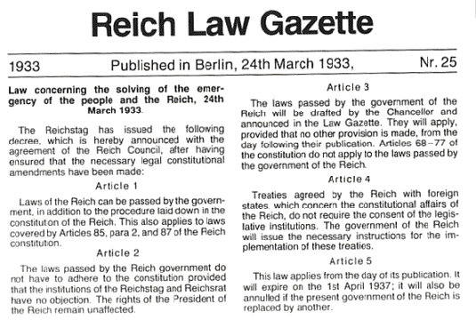
Enabling Act 1933
Enabling Act March 24 1933
Hitler allowed to issue decrees without oversight from Reichstag or President
Formally: Law to Remedy the Distress of People and Reich
Required 2/3 vote as an amendment to Constitution
Gained from Centre Party and Right-wing parties
Votes held behind closed door with SA bodyguards
After passage, Hitler begins Gleichschaltung – Nazification of German institutions (eliminates Reichsrat (representatives of states))

Slide 20
Verordnung des Reichspräsidenten zum Schutz von Volk und Staat |  | Order of the Reich President for the Protection of People and State
Auf Grund des Artikels 48 Abs. 2 der Reichsverfassung wird zur Abwehr kommunistischer staatsgefährdender Gewaltakte folgendes verordnet: |  | On the basis of Article 48 paragraph 2 of the Constitution of the German Reich, the following is ordered in defense against Communist state-endangering acts of violence:
§ 1. | Die Artikel 114, 115, 117, 118, 123, 124 und 153 der Verfassung des Deutschen Reichs werden bis auf weiteres außer Kraft gesetzt. Es sind daher Beschränkungen der persönlichen Freiheit, des Rechts der freien Meinungsäußerung, einschließlich der Pressefreiheit, des Vereins- und Versammlungsrechts, Eingriffe in das Brief-, Post-, Telegraphen- und Fernsprechgeheimnis, Anordnungen von Haussuchungen und von Beschlagnahmen sowie Beschränkungen des Eigentums auch außerhalb der sonst hierfür bestimmten gesetzlichen Grenzen zulässig. | § 1. | Articles 114, 115, 117, 118, 123, 124 and 153 of the Constitution of the German Reich are suspended until further notice. It is therefore permissible to restrict the rights of personal freedom [habeas corpus], freedom of (opinion) expression, including the freedom of the press, the freedom to organize and assemble, the privacy of postal, telegraphic and telephonic communications. Warrants for House searches, orders for confiscations as well as restrictions on property, are also permissible beyond the legal limits otherwise prescribed.

Slide 21
Establishing the one party state
March – July 1933
Communists, Socialists banned/arrested
Trade Unions abolished
Right wing coalition parties disband
Catholic Centre Party disbands after Concordat with Pope July 1933 – state would not interfere with Church and vice versa
July 14 1933 – Law Against the Establishment of Parties
Gestapo
State secret police enforcing policies
Notes:
Support of Concordat – moral authority will win the day in Germany; Protestants and Jews will be supported by the moral majority 1/3 of individuals in Germany is Catholic; Pope must secure itself before reaching hands out to aid others.
Dissent of Concordat – again the decision to take political inaction drives Church to wait for higher morality, hoping the bad political institution will die out.
Violations of the Concordat occur fairly immediately – closing of Catholic educational institutions – Catholic Youth League, etc. seeking a return to Nordic and Germanic paganism; Pope considers removing Concordat, but fears retaliation against Catholics.

Slide 22
Consolidation
Law for the Restoration of the Professional Civil Services – April 1933
Jews and non-Aryans must resign positions in administration, courts, universities, and schools
Law to Ensure the Unity of Party and State – Dec. 1933
Secures NSDAP monopoly
Overlap in authority between branches or local authorities
Notes:
Leaning on older political structures resulted in division within the Nazi party
Hess attempts to create a unified governing body, but is unable to make justifiable gains

Slide 23
Consolidation
Night of the Long Knives
SA leader Röhm wished for a second revolution
June 30, 1934
SA leaders (near 200) shot
Hitler ‘acted on behalf of the German people’ → cult of hero
Hindenburg dies August 1934
Army swears allegiance to Hitler

Slide 24
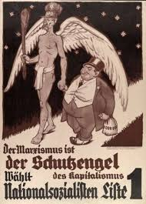
Hitler’s Ideologies
Mein Kampf – My Struggle
Germany must fight Communism
Marxism was the invention of Jews bent on world domination
National Socialism could fight communism – democracy was a stage towards communism
Prepare for war to gain Lebensraum in Polish corridor – racial unity, eliminate Jews, authoritarian gov’t, no dissent or diversity
Notes:
Less and less socialism within the Nazi political realm
Little state aid to the farmer – blood and soil
Women first discouraged from working, then sent to work during WWII (lack of males)

Slide 25
Ideology and State
Volksgemeinschaft – state before all other loyalties, people bound together by blood
Social Darwinism – loose association with Theory of Evolution, strongest will survive → strongest being Aryans
Lebensraum – Organic State Theory, states must grow to survive, like all living creatures → German state must expand to acquire living space for Germans
Herrenvolk – German Aryans as master race
Anti-Democracy – gives importance to weaker races
Führerprinzip – leader’s will is the source of political authority → cult of leader
Anti-feminism- women’s role is to bear more Aryans
Anti-Marxism – internationalism weakens nations
Anti-Semitism – Jews are the lowest race in social heirarchy
Blut and Boden (Blood and Soil) – blood of the community is in the soil – a belief that peasants and landowners live in organic harmony

Slide 26
Propaganda
Goebbels
Ministry for Popular Enlightenment and Propaganda
By 1939 – Nazis owned 2/3 of newspapers
Reich Broadcasting Corporation 1933 – all radio
Film conformed to Nazi ideals – Triumph of the Will (1935) shows the Nuremberg Rallies of 1934 (full video on YouTube)

Slide 27
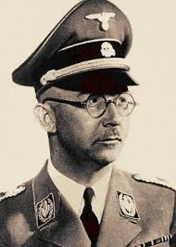
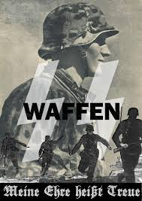
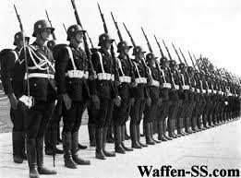
Army
SS – security, surveillance, enforcing Nazi ideology, paramilitary group that replaces the SA under Himmler’s direction
Waffen-SS – 1938, established to be functioning members of the army
SS-Totenkopfverbände (Death’s Head) expanded as reserve military force, eventually oversee concentration camps
Army supports reverse of disarmament and expansion to old empire
Army dissents on war with Russia and need for Lebensraum
Those opposed were dismissed or reassigned
1936 Rhineland remilitarized, Anschluss w/ Austria
1938 entry into Czechoslovakia

Slide 28
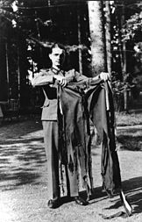
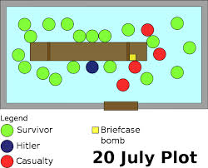
Opposition
Simple – reading banned material, listening to banned music
Rot Kapelle (Red Orchestra) – anti-Nazi resistance in Berlin, Soviet espionage rings in German occupied Europe and Switzerland
Schwarze Kapelle (Black Orchestra) – July 20 Plot – assassinate Hitler at Wolf’s Lair, remove SS and Gestapo authority, end War and keep gains from Hitler’s invasions – military leaders

