Slide 1
Communist China – Mao – Consolidation of Power

Slide 2
Two Chinas
1949
PRC Mainland
Republic of China (Taiwan)
UN Resolution 2758 - 1971
US rapprochement 1972 – Nixon

Slide 3
Communist China Goals
Single-party state led by Mao
1) Resources directed toward political, social, and economic growth
2) Medical supplies and hospitals made available
3) Schools built
4) Regulation of all media (press, speech, films, etc.)

Slide 4
Land Reforms
90% of areas in China
300 million farmers granted 47 million hectares of land (1 hectare = 10000 square meters of land)

Slide 5
Hectare

Slide 6
Domestic Economic Policy: First Five Year Plan
1953-1957
Annual increase rate of income 8.9%
Basic industry established to produce airplanes, cars, industrial equipment, and mining equipment

Slide 7
2nd 5 Year Plan
1958-1963
Known as The Great Leap Forward
Agriculture and Industry work hand in hand
Reformation of society into communes (5000 people)
Everything collectivized – food, former possessions, even caring for children (schools and nurseries provided)
“Houses of happiness” for the elderly

Slide 8
Communes
12 families = work team
12 work teams = brigade
Party members oversaw production and tasks
1958 – 700 million people in 26,578 communes
Fields included loud speakers to promote hard work
Propaganda posters throughout the commune

Slide 9
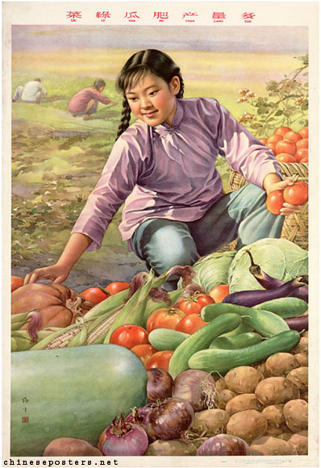
Production during GLF
Back-yard furnaces encouraged
60,000 constructed
Adding 11 million metric tons to China’s steel production
By ’58 steel, grain, timber, cement, and cotton also saw increases in production, but things would change

Slide 10
Realities of Great Leap
Party officials began expecting unrealistic goals
Steel produced in backyard furnaces was weak and brittle
Many individuals stopped agricultural production to focus on steel, 1958 harvest was claimed at 260 million tons – this was not true
Good weather in ’58 was followed by floods in some areas, droughts in others leading to 170 million ton harvest

Slide 11
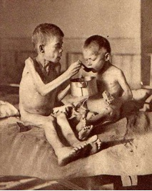
Famine
’60 followed with 144 million tons
9 million people are thought to have starved to death
Gov’t begins rationing in 1959 – 1962
Coal, used in furnaces, now derailed China’s rail industry
Mao admits failure, asks for reflection from party

Slide 12
The Great Leap Forward has basically proved the correctness of the General Line for building socialism…But as we can see now, an excessive number of capital construction projects were hastily started in 1958. With part of the fund being dispersed, completion of some essential projects had to be postponed. This is a shortcoming…Because we did not have a deep enough understanding, we came to be aware of it too late. So we continued with our Great Leap Forward in 1959 instead of putting on the brakes…As a result, imbalances were not corrected in time and new temporary difficulties cropped up…”
Extracts from Peng Dehuai’s “Letter of Opinion” July 1959. quoted in Ebrey, P. (ed.) 1981. Chinese Civilization: A Source Book. New York, USA. The Free Press. pp. 436-39
Peng Dehuai was Defense Minister from 54-59. Replaced by Lin Biao after the 8th Communist Conference and delivery of this speech.

Slide 13
Decline of Mao
1960 – Three “rightists, revisionists, capitalist roaders” control day-to-day operations
Liu Shaoqi, Zhou Enlai, Deng Xiaoping (L to R)
Private ownership returned, commune size reduced, and spare food could be sold

Slide 14
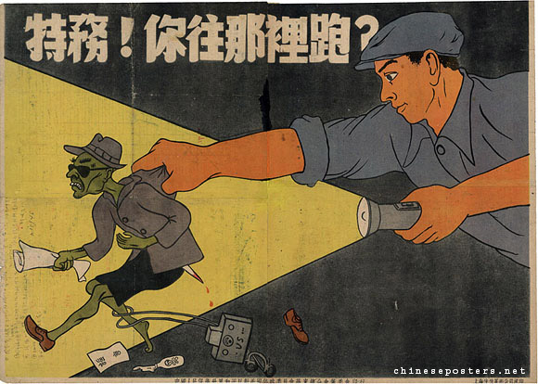
Political Efforts/Legal Efforts
Campaign to Suppress Counterrevolutionaries – 1950-53
First political campaign
Suppress residual opposition (KMT, intellectuals, businesspeople)
700,000 – 2 million estimated deaths

Slide 15
Political Efforts/Legal Efforts
3 Antis Campaigns
1951 – Directed at CCP, former KMT, & bureaucrats not part of CCP
Corruption, Waste, Bureaucracy
Denunciations, work camps, executions
5 Antis Campaigns
1952 – Target Capitalist class
Bribery, theft of state property, tax evasion, cheating on gov contracts, stealing of state information.
Trained surveillance, state encouraged letters of suspicion

Slide 16
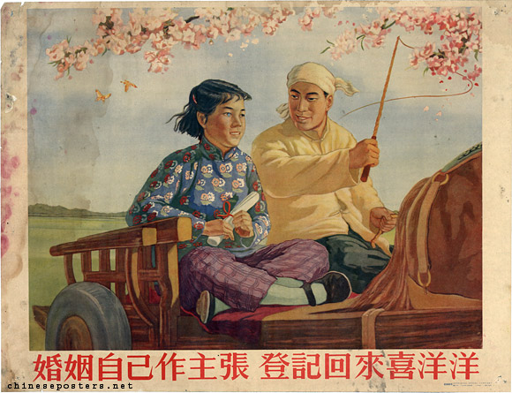
Political Efforts/Legal Efforts
New Marriage Law
1950-55
Civil registry (state)
Age of marriage 20 (m), 18 (f)
Both parties must consent

Slide 17
Political: Hundred Flowers Campaign
1956-1957
Double Hundred slogan
“The policy of letting a hundred flowers bloom and a hundred schools of thought contend is designed to promote the flourishing of the arts and the progress of science.”
Intellectuals and artists speak up
Question Mao’s unassailable position

Slide 18
Political Efforts/Legal Efforts
Anti-Rightist Movement
1957-59
Response to Hundred Flowers Campaign
Purge rightists and critics of CCP
Persecution of 400,000-700,000

Slide 19
Political: Return of Mao – Cultural Revolution
1966-1976
Attempt by Mao to reinstate himself into power
Lin Biao 1965 speech – return to basic principles of revolution, criticize “liberals” and those associated with Khrushchev

Slide 20
Cultural Revolution
Mao believes there is a new privileged class developing
Encourages Red Guard (youth groups) to oppose those not going in the correct direction, including Liu Shaoqi – this direction was a classless society

Slide 21
Cultural Revolution
4 olds – habits, customs, culture, ideas
Some Red Guard members begin fighting one another as they believe they knew how best to make China progress
Zhou Enlai (Premier 1949-76) requests a return to normality.

Slide 22
End to Cultural Revolution?
Historians see the removal of Liu Shaoqi in Oct. 1968 as the end of the cultural revolution
However, Mao and the Gang of Four continue rule until Mao’s death in 1976
Jiang Qing (Madame Mao, culture/arts), Wang Hongwen (vice-chairman CCP), Zhang Chunqiao (Politburo member), Yao Wenyuan (Politburo member) maintain power through control of media and propaganda

Slide 23
End of Gang of Four
Moderate and pragmatic politician Zhou Enlai brings Deng back into political fold after subsiding Cultural Revolution
Also secretly meets with Henry Kissinger to bring Nixon to China
Zhou dies Jan. 8, 1976 – public outpouring of sadness
Gang of Four – Tiananmen Incident – wreaths removed, mourners told to leave

Slide 24
Rise of Deng Xiaoping
After being brought back into political life, and following Zhou’s death, Deng gains political power
Gang of Four – all put on trial and found guilty of crimes, including treason
1979 Deng institutes policies of reform and opening to the outside world

Slide 25
Foreign Policy: Mao and Relationship With Soviets
Sino-Soviet Pact 1950 (Treaty of Friendship, Alliance, and Mutual Assistance) Feb. 14, 1950
Soviets officially recognize PRC and renounce Republic of China
Soviets send $300 million loan to PRC

Slide 26
Korean War
North – Communist
South – Democratic
AKA Fatherland Liberation War June 25, 1950 – July 27, 1953
38th parallel
China promoting the expansion of Communist revolution in its periphery and sphere of influence
US sees China as “integral battleground” in fight against Communism
Stalin wishes to avoid direct confrontation with US, the bomb came to Soviets Aug. 29, 1949

Slide 27
Korean War
Stalin gives permission to Kim to invade S. Korea given that Mao would supply reinforcements
Soviets supplied tanks, artillery, and aircraft
US and UN allies respond (Soviets boycott UN’s recognition of Chiang’s Taiwanese gov’t)
Korea left split in a similar way post WWII (US allies in South, Communists in North)
2.5 km demilitarized zone DMZ between the two near the original 38th parallel split

Slide 28
UN and US relations
PRC Officially seated in UN Oct. 25, 1971 – US begins using China for resolving Vietnam issue, leverage against the Soviets, and for new markets (largest market in the world)
Ping-pong diplomacy – US ping pong team invited to China in April 1971 – Chou Enlai receives them April 14. US lifts 20 year embargo on Chinese trade – represents the back and forth nature of “openness to new relationship”

Slide 29
Kissinger’s moves with Communism
National Security Advisor and Secretary of State under Nixon and Ford 69-77
Realpolitik – pragmatism in face of overarching theoretical differences
Détente with Soviets – SALT I Anti-Ballistic Missile Treaties
Paris Peace Accords to end Vietnam
Opens Chinese relationship

Slide 30
Nixon’s Visit to China
1972 – China comes to diplomatic consensus: “in the interest of all nations that the US and China normalize relations.”
Known as the Shanghai Communique
China nor US would seek hegemony in Asia-Pacific
Expansion of economic and cultural contacts (but without formalities in place)
One-China Policy – recognize PRC
1979 formalized through Joint Communique on the Establishment of Diplomatic Relations

Slide 31
Sino-Soviet Split
Generally 1960-89
Khrushchev’s policy changes:
Secret Speech Feb. 25, 1956 – destalinization; China believes Stalin’s successes as leader outweigh failures
Warfare: Nuclear destruction and war are to be avoided – China turn world war into revolutionary war
Peaceful Coexistence: mutual interests of both – China sees this as capitulation
Peaceful Transition – movement to Socialism/Communism can be achieved through peaceful means – China: must be revolutionary

Slide 32
Direct Confrontation with Soviets
Ussuri river Clash 1969
March 1969 Eastern border Soviets lose 59 men in clashes with PLA.
Soviets respond with T-62 tanks to attack PLA patrols – the Chinese steal one
August 69 – Western border Chinese lose 28 men
Soviets then ask “what the US response would be if they attacked the Chinese nuclear installations.”

