Slide 1
Mao & China

Slide 2
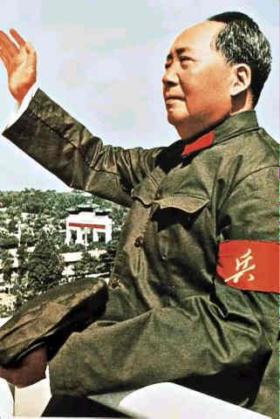
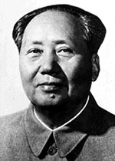

Slide 3
Referred to as Chairman Mao
Chinese communist revolutionary
guerrilla warfare strategist
author
political theorist
and leader of the Chinese Revolution.
He was the architect of the People's Republic of China (PRC) from its establishment in 1949, and held authoritarian control over the nation until his death in 1976.
His theoretical contribution to Marxism-Leninism, along with his military strategies and brand of political policies, are now collectively known as Maoism.

Slide 4
Emergence of an Authoritarian Regime in China
Part 1

Slide 5
How did political conditions in China in the early 20th century contribute to the emergence of a Communist State?
100 years of humiliation by foreigners following defeats in Opium Wars and against Japanese;
1911- revolutionary uprising in China under Sun Yat Sen – led to proclamation of Chinese Republic – the Qing Dynasty (since 1644) collapsed
Sun Yat Sun – ends up being the president of the national assembly; republic established Jan. 1st 1912 – sun resigned and handed presidency over to Yuan Shikai (military leader) – who tried to crown himself emperor

Slide 6
1912 – Guomindang (GMD) party was formed; Sun was its leader
Upon Yuan’s death, many subordinates seized control of their own provinces – and ruled as warlords.
End of WWI – disappointment that former German colonies in China were given to Japan
1925 – Jiang Jieshi (Chang Kai-shek) took over leadership of GMD and in 1926 he undertook campaign against the warlords
Mao Zedong – young communist – supported this move, as did many others
Jiang, however, regarded communists a threat after a successful campaign in Shanghai, turned his army to fight against communists – after which western powers provided help to GMD – to keep communism out of China
1928 Jiang took over Beijing and established central government in Nanjing

Slide 7
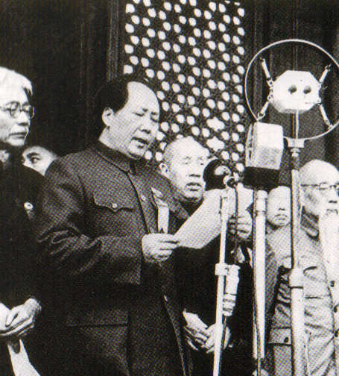
Mao’s Early Life
Born in 1893 in Shaoshan, China
His father was a poor peasant who was able to become a landowner and businessman
Received a basic education and learned a lot about political and economic problems in China (e.g. widespread famines)
Notes:
7

Slide 8
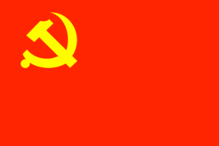
How did Mao Zedong achieve leadership of the Chinese Communist Party?
Moved to Beijing in 1918 and worked for a Marxist thinker;
Came to believe that all power grows out of the barrel of a gun and that violence was the only way to achieve change in China
Quickly became a strong believer in Communism and edited radical magazines, organized trade unions, and started schools of his own.
Russians encouraged the formation of Chinese Communist Party (CCP) in 1921
CCP led by Chen Duxiu and Li Dazhao but Mao one of the first 12 delegates who attended the first national Congress of the party in July 1921
CCP joined GMD to fight off “imperialists”/ in 1924 Mao elected to Central Committee of CCP and GMD
Jiang broke off alliance in 1927, Mao developed his own brand of Communism in rural areas
Notes:
8

Slide 9
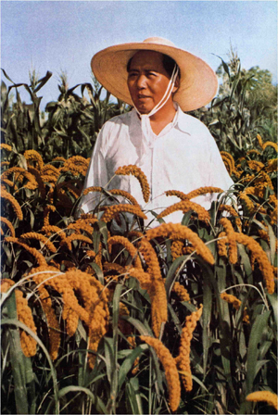
Mao’s Focus on the Peasants
Mao went back to his hometown and had very little communication with the Party
He studied the peasants and learned about their financial situation and the ways they were being abused by the landowning class
His new knowledge of the peasants allowed him to rise again as a leader in the Party, where he advocated that peasants should lead the revolution
Attempts (unsuccessfully) peasant revolt in Hunan in 1927; after which he led his followers into the mountains and formed the Red Army
Notes:
9

Slide 10
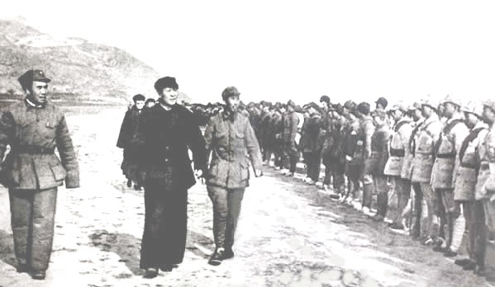
Red Army
Well disciplined; Mao endured hardships with soldiers; soldiers treated as equals and helpful to peasants ; By 1928 – 28,000 men
Poorly equipped; bamboo spikes – developed guerilla tactics and worked closely with locals
1929 – Mao moved to more fertile area of Ruijin; established base and set up Jianxi Soviet – “Chinese Soviet Republic”, population 1 mio
Mao became CCP secretary and ordered land redistribution – used violence – poor peasants encouraged to kill rich peasants and landlords , those who disagreed with Mao were purged
1930 – revolt by army staged at Futian – Mao ordered 2,000 Red Army soldiers shot

Slide 11
The Long March
Jiang failed to defeat the Red Army, however surrounded the communist stronghold forcing Mao to move
Oct 1934 – began the Long March
Oct. 1935 – arrived at Shaanxi, around 5,000 of 100,000 original marchers survived the 13,000 km ordeal
Settled in the Ya’an Soviet
Mao organizes milder approach to land redistribution, no killings
Campaign to improve literacy and stamp out corruption
Mao wrote a number of political and philosophical works, which helped him impose his personal authority
“rectification campaigns” 1942 – removed suspected disloyalty
Self-Criticism sessions, where everyone was asked to talk about their doubts and suspicions
No outside press and radio communication was permitted / no letter sent in or out

Slide 12
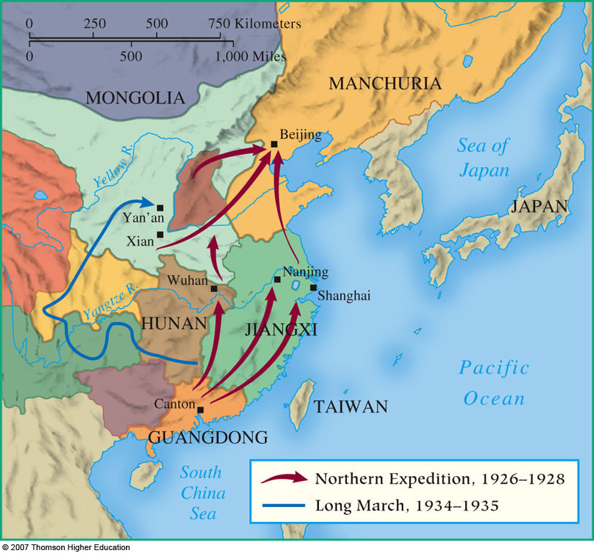
The Long March

Slide 13
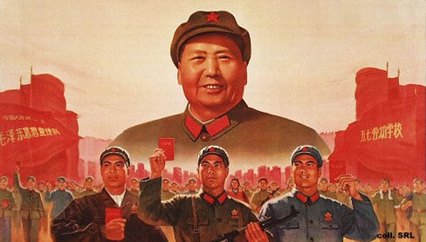
How did the aims and ideology of the Chinese Community Party develop under Mao?
“Mao Zedong Thought” – product of peasant background;
Believed in masses as source of energy and transformation
Mao remained detached from the mainstream communist group
CCP concentrated in cities/ Mao saw numerically strong peasants as the leaders of revolution

Slide 14
Mao Zedong Thought (You can print this)
 | Orthodox Marxist Beliefs
Marxist Revolution | Progress through class struggle; overthrow bourgeoisie, dictatorship of proletariat , collective ownership of means of production, promote worldwide revolution
 | Chinese elements of Marxist Beliefs
The importance of peasants | Peasant masses could overthrow capitalism and establish socialist soviet
A two-stage revolution | In the first stage, private ownership could continue; Second: collectivization and nationalization of property; remove remaining elements of bourgeoisie
Mass mobilization and voluntaryism | Party should learn from the people; proper guidance would ensure people support campaigns voluntarily, and work in best interest of all
Continuous revolution | Revolution should not cease after party achieved power; constant process of renewal to avoid complacency and corruption
Self-criticism and rectification | Officials should undergo regular criticism to prevent them from becoming elitist/ regular purges of the party would ensure purity; self-criticism of individuals to rectify false thoughts
Ruthless determination | Will power and determination sufficient to bring about change; violence was necessary element of revolution
The primacy of Mao Zedong Thought | Mao Zedong was always right and people could find the solution to any problems if they studied his thought sufficiently.

Slide 15
How did the Second-Sino Japanese War and Chinese Civil War increase communist support and bring about political change in China?
1937 – full scale attack on China by Japan – Jiang approached CCP to from the Second United Front/ leads to expansion of Communist Army
1941 – Jiang broke agreement and again attacked Communist forces in the south (seen as unprincipled by communists)- GMD received help from USA and GB, therefore CCP advertised itself as the only true Chinese patriot
At the end of WWII – 1945 – Allies recognized legitimacy of Jiang’s government in China (event though it only controlled a faction of China’s territory; Gave China a seat on the UN Security Council
US continued to supply GMD, helped retake areas from Red Army

Slide 16
Jieshi & Mao

Slide 17
How did the Second-Sino Japanese War and Chinese Civil War increase communist support and bring about political change in China?
Nationalists tried to reclaim Manchuria in 1946- full scale civil war broke out
It was the civil war of 1946-49 that against all odds secured Mao as a ruler of China
1946, Mao reorganized communist forces in a single army People’s Liberation Army (PLA)
During the fierce 4 year struggle PLA defeated Jiang’s forces despite Jian’s US aid and the fickleness of Soviet Union under Stalin, who to the end engaged in negotiations with Jiang.

Slide 18
Strengths and weaknesses of the GMD and CCP/PLA in the civil war 1946-49 (You can print)
Issue | GMD | CCP/PLA
Troops | Larger, better equipped; had air force Exp. In conventional war; troops low morale | Fewer troops, poorly equipped, but in 1948 equal size to GMD, soldiers trained, guerilla warfare, good morale and discipline
Territory | Controlled most territory and population, cities, railway, and waterways at outbreak | 19 base areas, but from 1948 took cities, key railway junctions, controlled N. China, and parts of S and W by 1949
Foreign Powers | Recognized by foreign powers (USSR too), helped by USA ($3 bill and equipment), Russians signed alliance | Soviets provided early training and support, relationship with USSR eroded b/c Stalin
Popular Support | Used force against peasants, noted for corruption, inefficiency, inflation; poor reputation, relies on wealthy | Supported by peasants, good reputation, restrained troops, controlled prices, used propaganda to win support, dealt harshly with opposition
Leadership | Jiang- experienced, hard-working, confident, ruthless, stubborn, not good in delegation, poor judgment of character – corrupt advisors | Mao – personality cult – inspired confidence, delegated well, not good with dealing with foreign powers.
Military Factors | Early advantages; Ya’an taken in 1947; sent best troops to Manchuria (lost in 1948) | Guerilla warfare, from 1948 conventional; retook Ya’an in 1948

Slide 19
October 1st 1949 – Mao Zedong gave a triumphant victory speech in Beijing – crowds cheered, watched procession of the Red Army and other party members
Jiang with remaining army fled to Taiwan, and declared that to be the legitimate Chinese government
Jiang ruled Taiwan as Republic of China (ROC) and until 1971 it was recognized as the only legitimate government of China – including the United Nations
Parts 1 – 4
https://www.youtube.com/watch?v=02SHeHR3zOg

Slide 20
Mao – Part 2 Consolidating and Maintaining Power

Slide 21
How did Mao consolidate his power to create an authoritarian regime between 1949 and 1954?

Slide 22
Government:
Chinese People’s Political Consultative Conference met in Sept. 1949
Bringing together non-communist parties and other groups that had opposed the GMD -> dominance of communists was w/o question
5 “black” categories were identified
Reactionary elements
Feudal elements
Lackeys of imperialism
Bureaucratic capitalists
Enemies of the people
Considered non-people/ had no political rights, but subject to state law (most landlords, big business owners, ex-GMD)
Bourgeoisie given rights – their expertise needed
Country divided into six regions-each under control by the military, most officials (2mio) that served under GMD were retained; but as CCP members and competence increased, the non communists were removed

Slide 23
“The Black Categories”

Slide 24
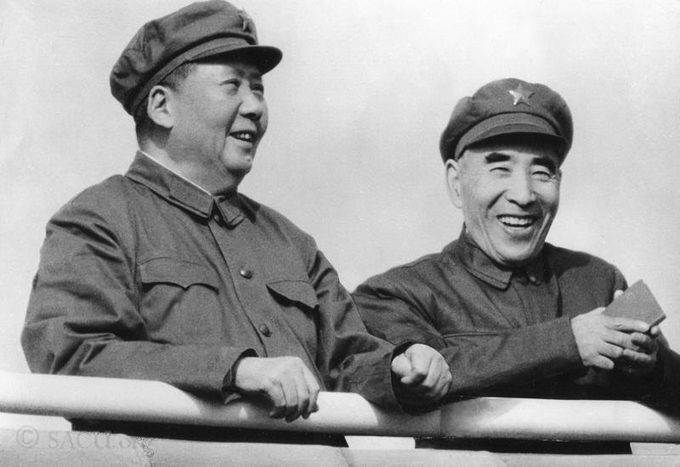
1954- a formal constitution established China as a single-party state
Mao became the head of government -> beneath him two vice chairmen and a council of ministers headed by a Prime Minister Zhou Enlai - was PM from 1949 until 1976 (death)
Mao’s consolidation of power was built on a series of mass mobilization campaigns during which propaganda, self-criticism, rectification and purges were used to stamp out any opposition

Slide 25
1950-52: 4 mass mobilization campaign
The Resist America and Aid Korea Campaign 1950
rallies held to increase Chinese suspicion of foreigners (West)/ US people singled out b/c involvement in Korea- many arrested, Churches closed, priests and nuns expelled; by the end of 1950, closed to all foreigners except Russians
2) The Suppression of Counter-Revolutionaries Campaign 1950-1951
Focused on those with links to GMD, criminal gangs and religious sects included denunciations and public executions
3) The Three Antis Campaign 1951
Campaign against corruption, waste and obstruction, directed at communists and non-communists – humiliation and group pressure used against managers, state officials, and police
4) The Five Antis Campaign 1952
Campaign against bribery, tax evasion, theft of state property, economic espionage, cheating in government contracts -> investigation of employers’ business affairs, forcing employers to provide self-criticisms and undergo thought reform.
Accused faced fines, property confiscation and periods in labor camps; Few were executed, although 2-3 mil committed suicide b/c of shame and humiliation

Slide 26
What part did personality and propaganda play in the consolidation and maintenance of power?

Slide 27
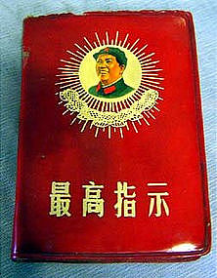
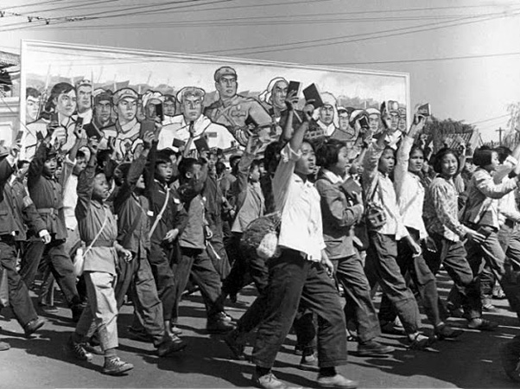
Personality:
Mao-ideology committed; desire to make China a powerful, self-sufficient and influential
Proved to be inspirational in struggle for power, and achieved a cult status once in power
Soldiers, workers, and peasants expected to know his quotes; his pictures all over the place and to study Mao’s Little Red Book
Portrayed as savior of the nation, the voice of truth, the source of all wisdom and benefactor for the people
People persuaded that careful study of Mao’s thought would solve all problems
Debatable- whether Mao was a “visionary reformer” or whether he was driven by ambition that overrode all moral scripts

Slide 28
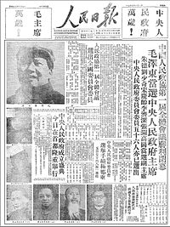
Propaganda
Central to communist rule in China
Controlled by CCP’s Central Propaganda Dept.-commands mass indoctrination
Aim-”thought reform”- so people would support mass campaigns (Great Leap Forward, etc.)
PLA (largest army in the world) also helped indoctrinate and reinforce political messages
Propaganda used to spread ideology, encourage activism, and model
Cult of Mao and ideological messages were spread through posters, the media, the educational system and arts
Nationwide system of loud speakers reached into every village, reading news papers was regarded as political obligation (“People’s Daily”); Controversial news were censored

Slide 29
What were the main characteristics of Mao’s political control between 1954 and 1976?
Political control based on CCP, they made all political decisions
Party administration, under Mao, similar to structure of a state
Most ministers, provincial officers, and leadership positions were members of CCP, but if not they were assisted by a communist adviser
1954 Constitution provided framework for development of legal system (Modeled to USSR) each citizen was granted right to a public trial and defense -> but not practiced until Mao’s death
During Mao’s time party committees replaced courts, party leadership held absolute power in legal matters, and many judicial functions were passed to local party cadres and by 1960 the court system existed only for “show trials” during the Cultural Revolution
Mao always felt that his position was insecure, constantly concerned that officials were plotting against him -> continued to look for ways to consolidate power

Slide 31
The Hundred Flowers Campaign
1956- lifted censorship restrictions and encouraged open criticism of the way the party had been working
Participation slow at first-but in 1957 Mao told people they could vent criticism as long as constructive rather than destructive
May/June 1957- central gov. received deluge of letters, people complained about corruption, low living standards, censorship, and privileged life of CCP cadre -> Mao decided that this criticism was not constructive, called off the campaign, and reenacted censorship
The Anti-Rightist Campaign, July 1957
Crackdown that followed the Hundred Flowers Campaigns, which ended any criticism by intellectuals
Around half a million were branded as “rightist” and subjected to persecution (Labor camps, imprisonment, public shootings)
Many committed suicide

Slide 33
The Hundred Flowers Campaign

Slide 34
Mao’s disappearance from Public Life
1959 after Great Leap Forward failed, Mao gave up his position as PRC Chairman/ he claimed time away from public allowed him to think and plan rather then worry
But likely remained powerful influence (according to historian Philip Short) including the purge of Peng Dehuai in 1957
From 1962 Mao became obsessed w/ fear that the CCP was turning to “capitalist road” – clue to more moderate policies pursued by Deng Xiaoping and Liu Shaoai in response, he launched the Cultural Revolution in 1966
Political Control during the Cultural Revolution
Dramatic purge of Mao’s rivals
Mao mobilized the Red Guards (radical students) and ordered them to attack the “four olds” (thought, culture, practices and customs) and remove “bad elements” among the party, teachers, intellectuals and former bourgeoisie
Police instructed not to intervene
Public denunciations, “confession sessions”, tens of thousands died in prison

Slide 35
Cultural Revolution: Destroying the “four olds” – Old customs, old ideas, old culture, old habits

Slide 36
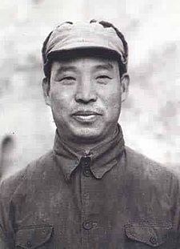
Mao removed many of his opponents from the party and reclaimed absolute control; his “cult” rose to new extreme his thoughts were written into the Constitution of 1969
May 1966- he purged Group of Five (committee established in 1965 to initiate Cultural Rev., led by Peng Zhen) / replaced them w/ Central Cult. Rev. group which he staffed w/ his supporters, including his wife
In Dec 1968- Mao ordered Red Guards to leave cities and go to countryside
Mao was still concerned about rivals in the party
He confirmed Lin Bau as his successor, but he died in Sept. 1971 in a “sudden” air plane crash after opposing Mao in his decision to seek cooperation w/the USA -> Deng Xiaoping spoke in favor of this and allowed back up on Vice Premier in 1973

Slide 37
Lin Bau with Mao

Slide 38
What was the nature and extent of opposition to Mao’s Communist rule and how was it dealt with?
Mao cultivated an atmosphere of vigilance, fear, and uncertainty within China
Little opposition to Mao, but some to Maoist thinking
“rightist” used to refer to those w/ bourgeois , intellectual or foreign connections, and those became victims of persecution
Central investigation departments within CCP from 1949, a military intelligence wing of the PLA and during Cultural Revolution the Central Case Examination group was set up
From 1951- dossier was created for every suspect Chinese person
Citizens encouraged to report on others
Repressive methods: group criticism sessions (self-criticism) also larger mass meetings when individuals publicly admitted crimes or denounced colleagues and neighbors (in 1950; 3,000 such meetings in Shanghai)
Admissions of guilt led to “rectifications” ranging from ritual humiliation, fines, loss of job, property, or housing, forced labor, or prison; many committed suicide

Slide 39
Mao speaking during rectification movement

Slide 40
Historiography on Struggle Sessions
Chang and Halliday- struggle sessions differentiated Mao’s China from Stalin's USSR and Hitler’s Germany
Others carried out purges through elite secret police force, Mao enforced ritualized public humiliation
Meetings- potent force of control/ victims tormented by their own associates
Labor Camps
Laogai- “reeducation through labor”- similar to Russian Gulags -> forced labor, back breaking projects
10 mio held per year; by 1976 more than 10,000 camps in China
Built in inhospitable regions, cold winters; food rations were dependent on confessions; refusal-solitary confinement, beating and sleep deprivation/ threats made to families
Many prisoners died of hunger, ill-treatment or suicide
Camps- helped terrify others into obedience
If prisoner executed, family sent bullet and bill for the cost
Families of prisoners shunned- guilty by association

Slide 41
Laogai

Slide 42
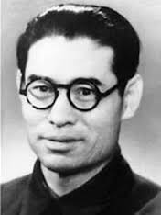
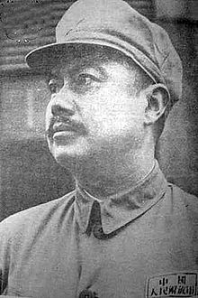
Repression
“Continuous Revolution”- some loyal in early years could become victims of repression and purges
1954 Gao Gang- w/ Mao from the beginning; but in 1954 him and colleague Rao Shushi were accused of “underground activities” -> Gao committed suicide rather than face disgrace, Rao was arrested and imprisoned until his death in 1974
First of many purges
CCP never had a highly centralized security system like KGB -> due to Mao’s reliance on individuals exposing those who seemed to not obey the regime.

Slide 43
What was the impact of international affairs and foreign policy on Mao’s consolidation and maintenance of power?
1949- Mao interested in establishing own brand of communism, rather than exporting it else where
China too poor and too isolated to lead an international revolution
He wanted China to be recognized as “great power” and committed to modernizing China
While his dealings with foreign powers may have been less important in his consolidation and maintenance of power than for ex. Hitler, Mao’s independent stance in int. affairs reinforced his authority

Slide 44
Relations w/ the USSR
Treaty w/ Moscow 1950- provided economic and military aid- but relationship between the two was rocky -> different views of communism and shared border issues
People accepted what they were told
After Khrushchev denounced Stalin in 1956- Mao took as attack on single-minded leadership
Soviets refused to back Mao for provocative Taiwan attack in 1958 (which was called off), and they condemned Mao's Great Leap Forward
In 1960’s- lots of Sino-Soviet propaganda was regarding “correct path to socialism”
Mao won great public acclaim when China detonated its first atomic bomb in 1964

Slide 45
Mao and Khrushchev

Slide 46
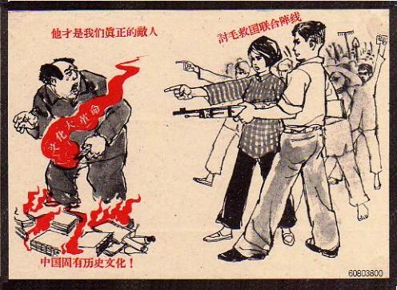
Relations with the USA
Bitter anti-USA rhetoric until 1970s (due to GMD and Taiwan support, opposition to communism)
Anti-US propaganda - kids chanted death to American imperialism
reached a peak during Vietnam war/China support N. Vietnam under Ho Chi- Minh
Anti-American rhetoric helped Mao in his maintenance of power, he was forced to reverse some of it in 1970’s
1971- US accepted PRC’s right to representation in the UN (in preference to Taiwan)
“ping-pong diplomacy” series of table tennis tournaments provided forum for talks- culminated in Nixon’s visit to China in 1972 -> this too was portrayed as Maoist triumph

Slide 47
Mao’s Policies and their Impact
Part 3

Slide 48
What factors influenced domestic and social policy?
Belief in transforming China by implementing his unique version of communism:
Emphasis on peasants, mass mobilization, self- criticism, and continuous revolution
Anything could be achieved by ruthless determination
Overall – policies hindered proper industrial management, deprived China of trained professionals to direct social and economic programs, wasted natural and human resources, and brought a famine
Mao determined policy; others in government were permitted say only when things went wrong – Mao would find a scapegoat (“bourgeois elements”, “capitalist roaders” or “backsliders”- derogatory terms given to middle class

Slide 49
What factors influenced domestic and social policy?
Mao’s policies – driven by his commitments to “continuing revolution”
“remold souls of people”
Ruthlessness and violence – integral part of cleansing
When “stability threatened” , Mao lunched new campaigns
Anti-intellectual attitude/ only masses were capable of carrying the revolution forward
Education –contained mandatory labor/ hindered academic achievement
Intellectuals despised, anyone suspected of thinking for themselves was subjected to “struggle session”

Slide 50
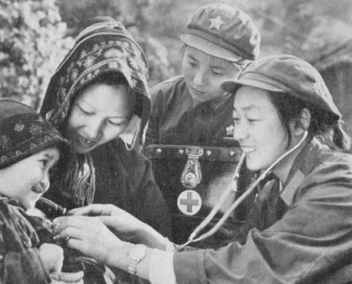
How far did Mao raise living standards in China?
Years after establishment of PRC – impressive raise in standard of living
inflation curbed, crime reduced, gained job security and stable income
Workers in urban areas had to belong to Danwei (work unit) – those controlled food supplies, allocation of housing, and permits to travel, marriage; etc.
Teams educated rural residents on healthy living – decline in death rates
Doctors and nurses trained – but they considered “bourgeois intellectuals”; replaced by “barefoot doctors”, who underwent short training of 6 months and worked among the peasants providing basic treatment

Slide 51
How successful was Mao’s economic policy?
Economic policy government by
collective ownerships of the means of production
Desire to make China a great power; to surpass USSR, achieve self-sufficiency
Land Reform, June 1950
Peasant led
Encouraged peasants to turn against their landlords (execution or trial), after which they lost their civil rights, land, animals and household goods/ distributed among the poor
Up to 2 million killed
Following redistribution - average farms too small for efficient farming- cooperative farming encouraged
Profits distributed according to land, tools, animals donated and work done
By 1952, grain production 10% higher than in 1936
From 1954 – encouragement to create higher level agricultural produces cooperatives (APC), policy failed due to poor harvest, and riots that followed
1955 tried APC policy again; large farms no more privately owned, by the end of 1956 most villages had formed collectives, and by 1957 90% of peasants families were incorporated into APCs
State became sole purchaser of grain from 1953 on; required to sell fixed quotas

Slide 52
Collectivization and the Great Leap Forward, 1958
After touring China, Mao decided to combine APCs into larger communes (large agricultural units, equipped with nurseries, old people’s homes, health clinics, hospitals, schools, cinemas, canteens)
Launched in 1958, part of Great Leap Forward
Set up 70,000 communes
Communal farming failed to work – lack of knowledge to farm on communal scale (most Chinese were small farmers)

Slide 53
How did Mao apply communism to industry?
In 1953 20 % of heavy industry and 60% of light industry privately owned
China appealed for help to USSR/ in 1950 11,000 Soviet experts arrived to China, and many Chinese received training in USSR
Between 1949 and 1952 value of industrial output doubled, and 300 modern factories were planned

Slide 54
The First Five Year Plan, 1953-57
Launched in 1953
Purpose: speed up China’s industrial growth
By 1955 all business nationalized/ owners as managers, received annual share of profits
Heavy industry prioritized at the expense of consumer industries
New development plans for Manchuria and NW China/ small towns – infrastructure built
Result: heavy industrial output nearly tripled; light industry increased by 70% (figures cannot necessarily be trusted); China produced own cars, tractors, aero planes, ships, etc.

Slide 55
Industrialization and the Great Leap Forward, 1958
Goal: to combine agricultural and industrial growth – so China could become a new world superpower that would challenge the US and overtake GB in 15 y
Mao’s reasoning for Great Leap Forward:
Reassert China’s independence from USSR
Chinese people should take responsibility for their future (success comes from determination)
He was 64 and in a hurry
He was worried that CCP was becoming too bureaucratic
Result: increase of number in State Owned Enterprises; managers no more receiving a share of the profit; surplus went to the state
Enterprises organized like communes
Rural communes expected to contribute to industrial growth – peasants told they’d get rich quickly if they concentrate on iron and steel production
Led to peasants abandoning other work to build brick furnaces in their yards and started smoldering crude steel / around 600,000 furnaces established

Slide 56
Furnaces

Slide 57
Did Mao succeed in making China a great economic power?
Unprecedented economic growth after 1949; infrastructure was developed too
However, Great Leap Forward was little less than disastrous:
Steel production increased, but less than 1% of what was produced was useful, the rest was poor quality
Khrushchev said “dangerous experiment”/Russian experts left China/ loans stopped
Factories left half-built or closed as capital disappeared
Peasants abandoned farming to work on furnaces
1960 – catastrophic famine (drought), 20-50 million people died between 1959 and 1961 – “Three Bitter Years”
PLA called in to suppress rebellion; grain from Australia imported
China abandoned Great Leap Forward, and returned to highly centralized economic planning; 1961 communes reorganized, and reduced in size and small private plots of land reappeared
It took 5 years to just recover from the damage done to agriculture
Overall industrial production declined in 1960
Only after 1976 did China really begin to develop its potential as an economic powerhouse

Slide 59
What was the relationship between the communists and the religion within China?
Religion see as “capitalist invention”, used to control lower classes
Mao – hostile towards organized religion; “poison”
Closure of churches, temples, shrines and monasteries; foreign priests and missionaries were expelled, and Chinese ones were forbidden to wear distinctive dress
Ancestor worship condemned; rituals banned
However, religious establishments could become “patriotic churches” operating under government control, had to support the regime
During the Cultural Revolution – churches regarded as “four olds”
1966 – Buddhist monuments and objects destroyed, no public worships or ceremonies allowed – worst in Tibet
Confucianism – accused of representing the worst of China’s past
In more remote areas private belief remained strong; in Tibet faith inspired continued resistance to occupation.

Slide 60
Attack on cathedral, 1966

Slide 61
How did the CCP view the role of education and try to ensure the support of youth?
Education:
1949- 1 in 10 could read; most could not write, and only 20% of children went to primary school; 1 % to secondary
Females– almost none past primary
CCP determined to increase literacy rates and expand educational provisions – this was in conflict with Mao’s disdain for intellectualism
Free schools opened – for all kids, except for those in “black categories”
Kids became “little teachers”, helped peasants to learn how to read and write
Chinese characters simplified for quick learning (to 2238 Characters)

Slide 62
How did the CCP view the role of education and try to ensure the support of youth?
Secondary schooling expanded/ initially assisted by USSR
Foreign languages studied only in Maoist translation of literature
Emphasis on practical work experience/ in fields or factories
“key schools” – priority of staffing and funding – attended by children of the party cadres
Results appeared impressive:
Literacy rates 50% in 1960, 66% in 1964, 70% in 1976
By 1957, most children had some primary education; number in secondary tripled
By 1976, 96% of all kids were in school
However:
Education neither compulsory, nor free, and quality of education varied greatly
Anti-intellectualism – focus on practical education – held back talented individuals
Schools were centers for indoctrination – “cult of the leader”
During cultural revolution – most educational institutions closed

Slide 63
The Communist Youth Associations
Youth League – for 14-28 year olds – run by Lu Hao and Youth Pioneers, for ages 6-14 – kids wore red scarves to symbolize blood shed by revolutionaries
Despite all indoctrination – students were providing most critique of the regime during the Hundred Flower Campaign
During the Cultural Revolution – Little Red Guards were formed, and in 1966 encouraged by Mao to take over “four olds”
Enjoyed priority in public transport; travelled across China “spreading the revolution” and destroying old culture
Violence got out of hands, Mao used PLA to break up the Red Guard Units, after which school opened again, but quality of education declined

Slide 65
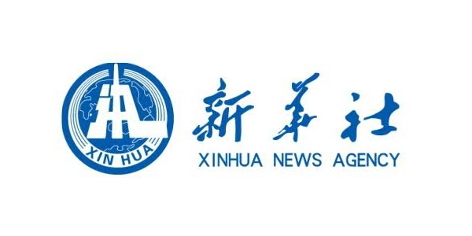
How did Maoism affect the arts and the Media?
Writers and artists were expected to educate the masses, not create artistic works for their own sake
1950 – traditional art allowed to continue alongside more modern; Soviet inspired art containing propagandist messages
Old style poetry also continued; plays and movies were overtly propagandist, and all literary works censored
Media was centralized - Xinhua – state controlled news agency; the state controlled which news papers could be printed and published
1965 and after – art seen as extensions of class struggle – campaign against “old culture”
Rigid censorship, and sale / possession of foreign literature became punishable
Libraries and museums closed and for 2 years, and only Mao’s Red Book was printed

Slide 66
What was the position of Women in Mao’s China?
CCP advocated women equality
1950 – traditional practice of killing unwanted baby girls officially outlawed and abolished, foot binding outlawed, and girls expected to go to school, and women to work outside of home
1950 Marriage Law – forbade arranged marriages and child betrothals
1953 Election Law – gave women right to vote, and some joined the government
From 1950 on women had the same property rights as men
However, policies towards women not always positive:
Huge increases in number of divorces
More burden: acting as workers and mothers
Only 13% of party membership
Communes undermined family unit

Slide 68
How were social, religious, and ethnic minorities treated within Mao’s communist state?
Persecution again bourgeois, religious groups, non-Han ethnicity (like Tibetans), etc.
1940s – Mao promised minorities independence, but changed his mind once in power
Tibet forced into PRC in 1950/ Buddhist culture was suppressed and ethnic groups were forced to accept communist rule
From 1959, oppression increased
Tibet national uprising because the government wanted to outlaw their culture – imposed extreme policies that affected Tibetan economy, and self-sufficiency negatively leading to a famine, in which ¼ of Tibetan population died
1974 – PLA forced closures of mosques and burned religious books

Slide 69
1959, Tibetan Uprising

Slide 70
To what extent was authoritarian control achieved?
Mao’s state meets most criteria for authoritarianism:
Mao came to power through the Civil War – never elected
Expected blind submission to his authority
No room for individual thought or action
One-party state with no elected authorities at national level – orders passed through strong chain of party command
Mao’s power arbitrary according to his ideological beliefs
Political and Civil rights were non-existent
Tight control of media
However, Mao did tolerate same pluralism from ethnic and religious minorities (even though state sanctioned)
Authoritarian control varied in intensity
Inability to control Red Guards

Slide 71
What kind of ruler was Mao? Historiography
Some left leaning authors suggested that Mao was a visionary reformer whose mistakes were outweighed by positive achievements
Jean-Paul Sartre – Mao was “profoundly moral”
Some saw Mao as liberator, hero
Historian Stuart Schram – praised Mao’s “unique vision”, and “strong nationalism”
Much of the above writings were published before the cultural revolution, since then more criticism but most felt that Mao should not be regarded as harshly as Hitler of Stalin until recently
Some historians countered these views because 30 to 40 million people starved to death during the Great Leap Forward
Chang accused Mao as the Greatest murderer in human history, responsible for 70 million deaths
Mao persecuted individuals because of their thoughts

