Slide 1
Authoritarian and Single-Party States
Stalin and Russia
Hitler and Nazi Germany
Mao and China

Slide 2
Terms
Communism
Marxism – Karl Marx (and Engels)
History of class struggles
Classless society based in plenty and democratic principles
Stages: Agricultural Capitalism, Industrial Capitalism, Socialism, Communism (could jump if aided)
Leninism: Democratic centralism – decisions could be debated within the party, until a vote was held, then final decision was upheld by all.
Marxism-Leninism: Crafted by Stalin, official state beliefs of the Soviet Union (Stalin…)
Stalinism – those opposed to Stalin – used to describe rejection of socialist democracy – all those parties who wish to achieve overthrow of Capitalism should be allowed to exist – and Stalin’s dictatorial nature

Slide 3
Terms
Fascism
Differences in fascist nations limit an overarching definition, lack of Weltanschauung (world view)
Ultra-nationalism
General belief in destruction of working-class organizations (socialists and communists)
Anti-Semitism and/or racism (Nazi Germany)
“Third Way” – somewhere between capitalism and communism in post-WWI society; attempt to move the world to a third way of political ideology

Slide 4
Terms
Dictatorship
Authoritarian – conservative regime imposing increasingly undemocratic measures or through military coup – maintain or restore traditional structures and values.
Totalitarian – total political power; dictator (usually) that imposes will over state, party, and society. Regimes come to power through mass movement or revolution and are committed to a radical ideology or political, social, or economic change.

Slide 5
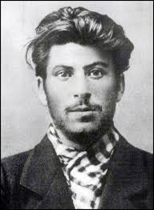
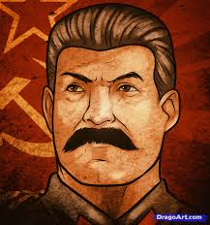
Stalin Origins and Rise
1880 – 1953
1922 general secretary of Communist Party
1924 makes himself supreme ruler

Slide 6
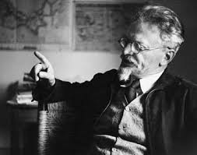
Origins and Rise
Bolshevik Revolution 1917
Civil War: Reds vs Whites
War Communism – utter failure
NEP
Kronstadt Rising
Lenin bans opposition parties
1922 Lenin ill (strokes) and death in 1924
Trotsky vs. Stalin
Zinoviev, Kamenev, Stalin Triumvirate
Lenin’s Testament – recommends Stalin’s removal

Slide 7
Origins and Rise
’23-’24 Moving against Trotsky
12th Congress (delegates elected by local parties)
Re-elects Stalin general secretary and Central Committee created (ruling body between Congresses)
Stalin begins replacing those loyal to Trotsky
Trotsky creates Left Opposition 1923
13th Congress condemns Trotsky’s views – Stalin gives Trotsky wrong date for Lenin’s funeral

Slide 8
Origins and Rise
Defeat Left Opposition 1924-27
Lenin’s widow presents Testament to 13th Congress, Zinoviev and Kamenev believe Stalin to be under their control now
Jan. 1925 Trotsky removed as commissar of war after Lessons of October prove he is against Stalin
1925 Triumvirate begins to split
Zinoviev denounced as Trotskyist and his supporters removed from Leningrad
Stalin allies with right-wing Bukharin

Slide 9
Origins and Rise
United Opposition
1926 Trotsky, Zinoviev, and Kamenev
Publish Testament in the NY Times – Trotsky expelled from Central Committee
Nov. 14 Trotsky and Zinoviev expelled from Communist Party, Kamenev from Central Committee – lesser officials to follow
Opposition members begin being deported

Slide 10
Origins and Rise
Defeat of the Right 1927-29
Stalin seeks to move more left to fix bread shortages and high food prices, Bukharin and his allies disagree
Bukharinists removed from power
Left and right opposition fears Stalin’s movements, but are afraid to ally together over disagreements about NEP
Nov. 1929 Bukharin removed from Politburo on charges of factionalism

Slide 11
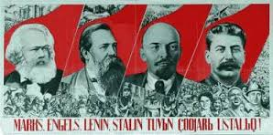
How did Stalin win?
Power Politics
Manipulation of factions within Communist party
Zinoviev and Kamenev portrayed by Edward Carr as careerists and weak
Bukharin was overly committed to the NEP
Trotsky miscalculated Stalin’s ability and could not organize his own party

Slide 12
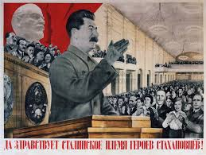
How did Stalin win?
Structuralists
Stalin wins because of the system in place after 1917
Red tsar – a long line of absolute rulers
Death of Bolsheviks in Revolution and Civil War, along with increasing administrative power allows Stalin to position himself at top with supporters in positions below

Slide 13
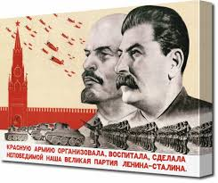
How did Stalin win?
Socio-cultural
Bolsheviks attract patriots and peasants
When other parties are banned, those members are easily manipulated
Ideological
Left feared the eventual end of the NEP → return to Capitalism
Right expected a long term mixed economy under the NEP

Slide 14
Ideology and the Nature of the State
Role in Stalin’s rise
Menial roles in political structure – general secretary was an administrative job
Socialism in one country vs. permanent revolution and internationalism
Nov. 1924 Soviet Union could construct socialism alone, without foreign revolution or aid
Trotsky – internationalist
Russia needed peace and to avoid another foreign intervention (Civil War)

Slide 15
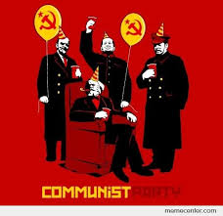
Nature of Stalinist state
One party state
Red Tsar: all-powerful leader, orthodox ideology (communism vs. religion), and national community – creation of socialism in one state
Cult of Personality – Stalin is capable of achieving great things for Soviet Russia
Omnipotent, Omnipresent state

Slide 16
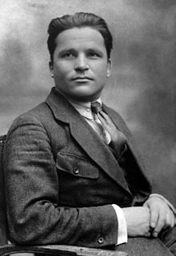
Establishing Power: Great Purge
Ryutin Affair 1932 – calls for end of collectivization, rehabilitation of Trotsky – 17 (Zinoviev and Kamenev included) purged from party
Kirov Affair 1934 – Kirov, who doubted Stalin, was mysteriously assassinated – Stalin claims plotted coup – NKVD sweeps through Leningrad Opposition Centre (Left and United Opposition links). 100 party members shot and 1000’s linked to Trotsky or Zinoviev arrested.

Slide 17
The Great Terror
Trial of 16 – 1936
NKVD noted conspiracy of Trotskyist-Zinovievists
Plotted to kill Stalin
All executed
Trial of 17 – 1937
Plots with Trotsky to sabotage and assassinate party members, 13 death penalty
Trial of 21 – 1938
Bukharin – Trotsky alliance, 16 shot
Great Terror
NKVD given quotas per region
Red Army also purged as WWII approached and Stalin feared military coup
Entire Ukraine party structure purged

Slide 18
Explanation of Great Purge
Around 2 million killed
Totalitarian view
Role of Stalin – determination to remain leader, mental illness, scapegoats for economic failure
Revisionist theory
Genuine opposition to Stalin as some plots were based in fact
Local groups took matters well beyond Stalin’s intentions
Stalin and Lenin
Bolsheviks and Marxists often cite those opposed as enemies of the state/Communism
Others point to the distinct direction against Party members, which never occurred under Lenin

Slide 19
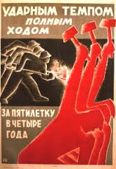
Domestic Policies and Impact
Smychka - NEP had created a link between city and countryside – workers and peasants
Rising beliefs that NEP was creating capitalist groups – kulaks and nepmen
So how do we move forward economically?

Slide 20
Industry
By late 1920’s agriculture is experience shortages
Stalin warns of foreign powers, need for industrialization and abandoning the NEP – explains his split with Bukharin
State run industry is now the policy
First Five Year Plan 1928-1932
Coal, iron, steel, oil, and machine production
Overall to increase 300%
Light industry to double
Electricity +600%
Rapid growth occurs, but targets unmet
2+2=5 propaganda targets reportedly met in 4 years

Slide 21
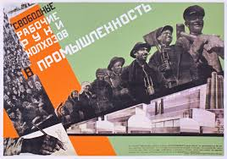
Crisis 1932-33 and call for 2nd5 Year Plan
Rail system could not keep pace with production
Population drawn to cities – housing shortages, food and famine
Second Five Year Plan 1933-37
Build upon successes of 1st 5 year plan
Iron and steel become practically self-sufficient

Slide 22
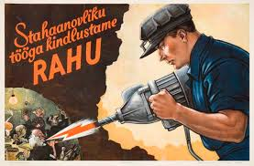
Stakhanovites and 3rd 5 Year Plan
Aug. 1935 Aleksei Stakhanov mined an apparent 102 tons (normal shift was 7 tons) in one shift
Heroes of Social Labor medals created
Third Five Year Plan 1938-42
Planned to move Soviets from Socialism to Communism
Disrupted by German invasion
Also lacking success, consequence of purging and movement of funds and resources towards defense

Slide 23
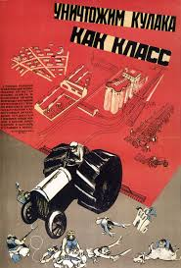
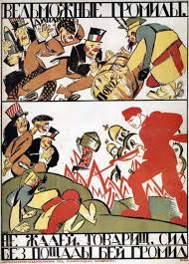
Agriculture
NEP held limited success – failed harvests and market grain prices led to needs to collectivize
Dec. 1929 Stalin forces collectivization of farms and end of kulaks as a class
Forced collection of grains occurs Jan. 1930 – 16 million tons worth
Kolkhoz- collective farms, reported 58% of peasant communities collectivized
By Oct. 1930, voluntary collectivization returns as official policy and 28% report as collective farms

Slide 24
Swift Return to Collectivization
1931 – 50%
1934 – 70%
Upheaval and confusion – along with drought – lead to widespread famine in areas
Ukraine, Caucasus, and eventually Russia experience worst famine in their history
1935 agriculture surpasses pre-collectivized levels

Slide 25
Success of Stalin’s Policies
Historians disagree about Stalin’s goals – uncertainty of his policies directions vs. clear intentions of modernization
Reliability of statistics – official reports are hard to judge, while increases occurred, many managers feared being purged and may fudge numbers
Impact on Workers
Uninterrupted Week – 4 days on, 1 day off; keeps factory open all the time.
As women enter workforce, double incomes for families stave off falling standards
Opening of technical and advanced universities opens education to larger groups of workers

Slide 26
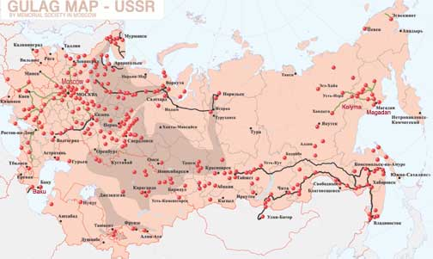
Gulags and Collectivization
Zeks: prisoners, used in gulags to undertake construction and extraction of resources in remote areas
Collectivization
Estimations of deaths because of famine AND process vary widely – 6 million to 20 million
Shifted food to urban areas, allowing for industrialization
Others argue that the process was a disaster – see famines

Slide 27
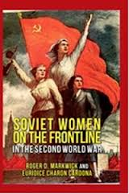
Position of Women
Family Code – civil marriages, divorce, abortion legalized, education equal
Fear of invasion of slowing population growth Stalin returns to “traditional” values
Divorce more difficult, rewards for large families, abortions only for medical reason, only registered marriages recognized (along with children from only marriages)
Still encouraged to work, though – 1939 1/3 of engineers and 79% of doctors
43% of industrial workers were women by 1940 (were these results of policy?)

Slide 28
Religion
Bolsheviks saw church as aspects of social-division
Majority Russian Orthodox Church
Initially allowed to coexist
Stalin – 1928 Anti-religion campaign: closure or confiscation of religious places of worship
By 1941 – 40,000 Christian churches and 25,000 Muslim Mosques converted into other uses

Slide 29
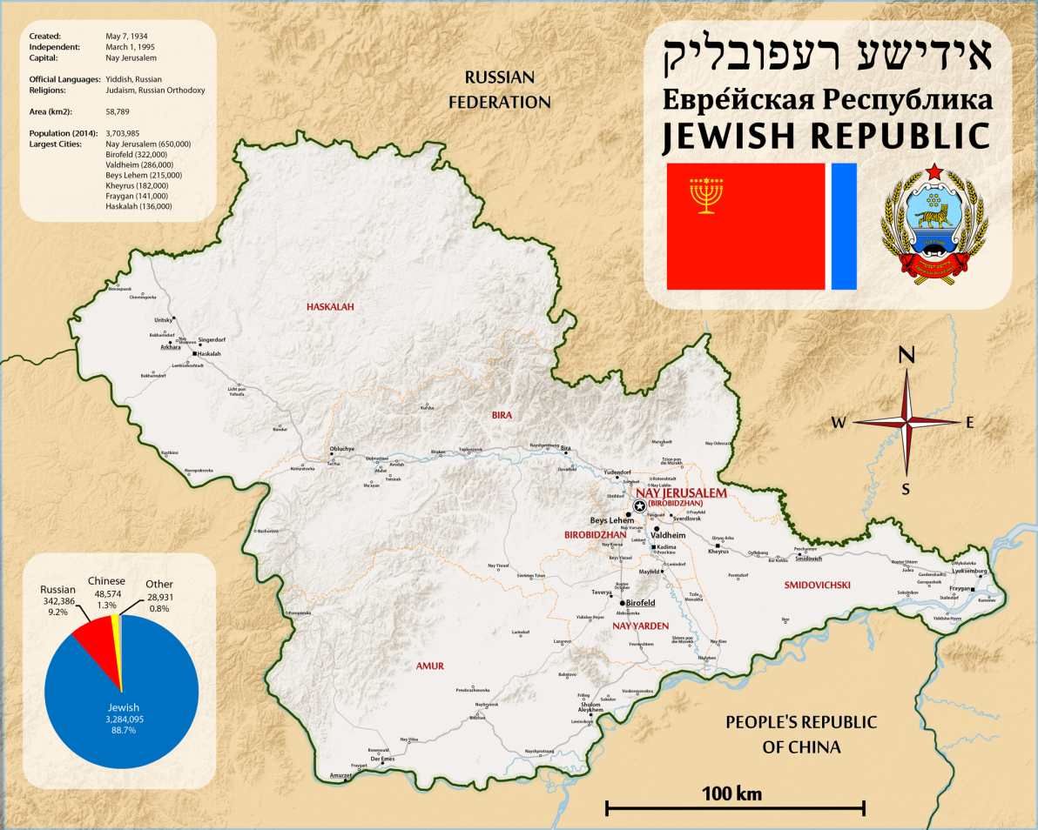
Ethnic Minorities
Stalin’s rise led to the Russification of minority populations
Some argue this was for Russian nationalism – to create the Russian Soviet Empire in an ethnic/racial move
Others argue this was to defend against advancing enemies – strategic political/military reactions
Jews – zionism (belief in Jewish homeland). Many Soviet policies were anti-Zionist, rather than anti-Semitic.

Slide 30
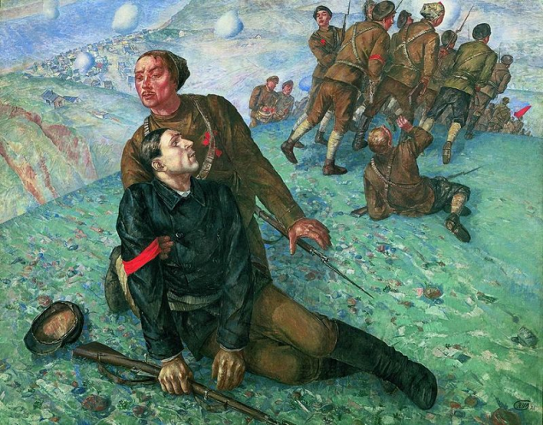
Education, Youth, Arts
Education
Priority for industrial workers
Free, enrollment surges in primary and secondary, literacy jumps to 94% (from around 74% in 1937)
Youth
KOMSOMOL Communist Union of Youth
Nationalism promoted as WWII neared
Some groups rebelled and listened to…jazz.
Arts
Must be member of Union of Soviet Writers
Writing must not be anti-socialist
Also applied to music, theater, film, paintings, etc.

